Slide 1
Standalone desktop application for analysis, visualization and interpretation of hydro chemical data

Slide 2
Abstract
Integrating advanced simulation techniques and data analysis tools in a freeware Geographic Information System (GIS) provides a valuable contribution to the management of conjunctive use of groundwater (the world's largest freshwater resource) and surface-water. To this aim, we describe here the FREEWAT (FREE and open source software tools for water resource management) platform. FREEWAT is a free and open source, QGIS-integrated interface for planning and management of water resources, with specific attention to ground water. The FREEWAT platform couples the power of GIS geo-processing and post-processing tools in spatial data analysis with that of process-based simulation models. The FREEWAT environment allows storage of large spatial datasets, data management and visualization, and running of several distributed modelling codes (mainly belonging to the MODFLOW family). It simulates hydrologic and transport processes, and provides a data base framework and visualization capabilities for hydro chemical analysis. Examples of real case study applications are provided.

Slide 3
Existing System
There likely exists alternative RDBMSs which are faster at reading and writing data.
The maximum value of the ID column is calculated and a column containing a sequence of ID values greater than the maximum existing values are added to the raw data.
An effort is being made to store all new data and move all existing data into relational database management systems (RDBMS), commonly referred to as “databases”.

Slide 4
Disadvantage of Existing System
Modelers may take advantage of integrating advanced hydrological modelling codes within a GIS environment, thus reducing model setup and analysis time, and avoiding data isolation, data integrity problems and broken data flows between model implementation and pre- and post-processing step.
A synthetic problem was designed to show the application of FMP in FREEWAT as a tool to address water management issues in urban and rural areas.
In FREEWAT, MODFLOW-OWHM is used to deal with the con-junctive use of ground- and surface-water for water management issues.

Slide 5
PROPOSED SYSTEM :
It was not possible to foresee the exact direction that WAVE was going take when the idea was first proposed.
The DCR also handled the organization of these data files and databases within the DCR’s network. UMass proposed multiple test versions of the application which received feedback from the DCR.
GitHub is used for many purposes related to WAVE and WAVE development and system processes. The application code is stored on GitHub which offers advanced version control and collaboration features during development.

Slide 6
ADVANTAGE
There is the opportunity to take advantage of this large mass of data and information to develop dynamically growing and efficient ground water management plans.
Geographic Information Systems (GISs) have been applied to sup-port environmental modelling and, being able to store, manage/analyse and visualize large temporal, spatial and non-spatial datasets, they are the most efficient tools to deal with geometric and alphanumerical data.
The interface allows non software programming Users to take advantage of the library features and manage temporal data in the modelling environment.

Slide 7
TITLE | AUTHOR | DESCRIPTION
RIPGIS-NET: a GIStool for riparian groundwater evapotranspiration in MODFLOW | Ajami, H., Maddock, T., Meixner, T., Hogan, J.F., Guertin, D.P., 2012. | RIPGIS-NET, a pre- and post-processor for RIP-ET, incorporates spatial variability of riparian vegetation and land surface elevation into ETg estimation in MODFLOW groundwater models.
Scripting MODFLOW model development using Python and FloPy | Bakker, M., Post, V., Langevin, C.D., Hughes, J.D., White, J.T., Starn, J.J., Fienen, M.N.,2016. | One advantage of Python is that there are many packages available to facilitate the model development process, including packages for plotting, array manipulation, optimization, and data analysis.

Slide 8
TITLE | AUTHOR | DESCRIPTION
Towards integrating GIS and catchment models | Pullar, D., Springer, D., 2000. | The development of spatially distributed hydrologic models has led to improved model forecasting at the cost of requiring more detailed spatial information.
Estimates of the globalwater budget and its annual cycle using observational and model data | Trenberth, K.E., Smith, L., Qian, T., Dai, A., Fasullo, J., 2006. | These include monthly estimates of P, evapotranspiration E, atmospheric moisture convergence over land, and changes in atmospheric storage, for the major continental landmasses, zonal means over land, hemispheric land means, and global land means.

Slide 9
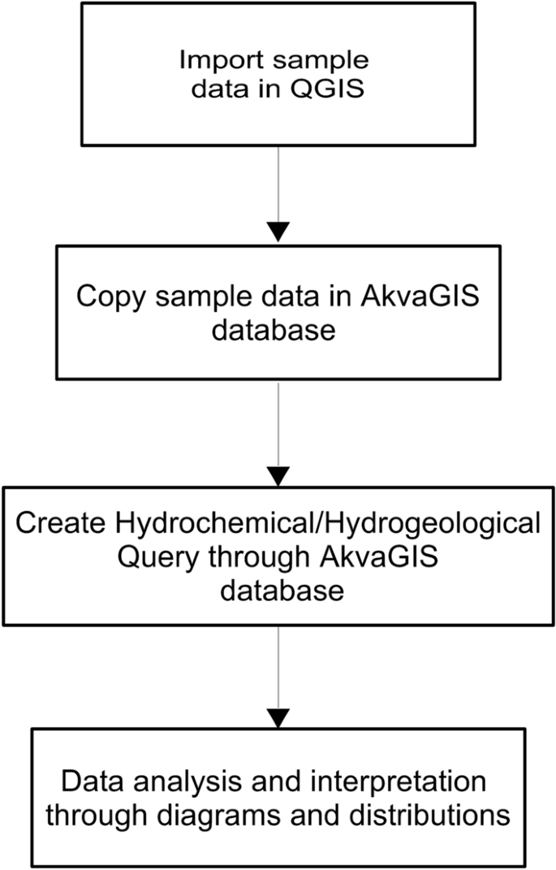
Block Diagram

Slide 10
SOFTWARE REQUIREMENTS:
Operating System : Windows 10
Platform : DOT NET TECHNOLOGY
Front End : ASP.Net 4.0
Back End : SQL SERVER 2014

Slide 11
HARDWARE REQUIREMENTS:
Keyboard
Mouse
Hard disk 500GB
Ram 4 Gb

Slide 12
CONCLUSION
Groundwater is a critical resource for people and ecosystems. Tools are needed for efficient data management so that more technically sound and community-supported decisions may be made. In this view, development and diffusion of robust open source and free software constitutes a cornerstone to enhance groundwater management, thus empowering as much as possible technical units in water authorities, academia and private companies, also in communities/countries with limited resources. In recent years, several efforts have addressed these issues by developing tools in GIS and coupling GIS and numerical hydrological models. Often, commercial software was used to this scope, but the cost of such software is usually prohibitive in many areas of the world.

Slide 13
REFERENCE
Ajami, H., Maddock, T., Meixner, T., Hogan, J.F., Guertin, D.P., 2012. RIPGIS-NET: a GIStool for riparian groundwater evapotranspiration in MODFLOW. Groundwater 50 (1),154–158.R. Rossetto et al. Environmental Modelling and Software 107 (2018) 210–230227
Aquaveo, 2012. Arc hydro groundwater – modflow Analyst. http://www.aquaveo.com/archydro-groundwater, Accessed date: 30 March 2016.
Argus Holdings Ltd, 1995. Argus ONE Open Numerical Environments. http://www.argusone.com/index.html, Accessed date: 3 September 2017.
Bakker, M., Post, V., Langevin, C.D., Hughes, J.D., White, J.T., Starn, J.J., Fienen, M.N.,2016. Scripting MODFLOW model development using Python and FloPy. Groundwater. http://dx.doi.org/10.1111/gwat.12413.
Bakker, M., Post, V., Langevin, C.D., Hughes, J.D., White, J.T., Starn, J.J., Fienen, M.N.,2017. FloPy v3.2.8. U.S. Geological Survey Software Release, 18 December 2017

Slide 14
Pullar, D., Springer, D., 2000. Towards integrating GIS and catchment models. Environ.Model. Software 15 (5), 451–459.
QGIS Development Team, 2009. QGIS Geographic Information System. Open SourceGeospatial Foundation Project.
Refsgaard, J.C., Storm, B., Clausen, T., 2010. Système Hydrologique Europeén (SHE):review and perspectives after 30 years development in distributed physically-basedhydrological modelling. Nord. Hydrol 41 (5), 355–377.
Regione Toscana, 2017. GEOscopio. http://www.regione.toscana.it/-/geoscopio,Accessed date: 4 September 2017.
Trenberth, K.E., Smith, L., Qian, T., Dai, A., Fasullo, J., 2006. Estimates of the globalwater budget and its annual cycle using observational and model data. J.Hydrometeorol. 8, 758–769.

