Slide 1
Need to develop digitally the dynamic model to integrate the impact of climate change (CC) indicators with assessment of vulnerability and adaptation at localized scale for agriculture sector

Slide 2
Abstract
Agriculture and climate change are internally correlated with each other in various aspects, as climate change is the main cause of biotic and abiotic stresses, which have adverse effects on the agriculture of a region. The land and its agriculture are being affected by climate changes in different ways, e.g., variations in annual rainfall, average temperature, heat waves, modifications in weeds, pests or microbes, global change of atmospheric CO₂ or ozone level, and fluctuations in sea level. The threat of varying global climate has greatly driven the attention of scientists, as these variations are imparting negative impact on global crop production and compromising food security worldwide.

Slide 3
According to some predicted reports, agriculture is considered the most endangered activity adversely affected by climate changes. To date, food security and ecosystem resilience are the most concerning subjects worldwide. Climate-smart agriculture is the only way to lower the negative impact of climate variations on crop adaptation, before it might affect global crop production drastically. In this review paper, we summarize the causes of climate change, stresses produced due to climate change, impacts on crops, modern breeding technologies, and biotechnological strategies to cope with climate change, in order to develop climate resilient crops. Revolutions in genetic engineering techniques can also aid in overcoming food security issues against extreme environmental conditions, by producing transgenic plants.

Slide 4
Existing System
Therefore the paper reviews existing interpretations, concepts and frameworks of vulnerability approaches in the climate change context.
However, while there are agreed indicators to measure the impact of climate change, there seem to exist no agreed metrics to describe vulnerability (e.g. of crop yields or agricultural income).
As climate change brings new uncertainties, risks and changes to already existing risks, one of the most efficient ways for agriculture to adapt is increasing its resilience.

Slide 5
Disadvantage of Existing System
These climatic problems severely distress plant development and yield, produce enormous responses, comprising molecular, biochemical, physiological, and morphological modifications.
Food security and safety are threatened by the severe weather conditions and it is not a recent problem. But formerly, no consideration was adopted to tackle this problem.
Because of climate change, food quality, supply, and safety are still the biggest problems for researchers.

Slide 6
PROPOSED SYSTEM :
One objective of climate change research is not to propose testable long-range hypotheses rather to provide indicative forecasts to guide pre-emptive policy-making.
It is important to assess in advance any risks to health from proposed technological adaptations.
The benefit-cost criterion is straightforward: if the winners under a proposed policy value the change more highly than do the losers, it is said that the policy has positive net benefits and enhances efficiency.

Slide 7
ADVANTAGE
Genetic divergence analysis is used for polymorphism, inbreeding, assessment, assortment, and recombination to attain plant perfection, and is amongst the main aspects for defining accomplished inbreeding.
In genome editing technology site specific endonucleases are used comprising of zinc-finger nucleases (ZFNs), transcription activator like effector nucleases (TALENs), and CRISPR-Cas9.
The CRISPR/Cas9 strategy was used to develop tomato mutant lines which showed a considerably enhanced concentration of proline, malondialdehyde, and H₂O₂.

Slide 8
TITLE | AUTHOR | DESCRIPTION
The Routledge Handbook of Agricultural Economics | Arunanondchai P., Fei C., Fisher A., McCarl B.A., Wang W., Yang Y. | The Routledge Handbook of Agricultural Economics explores a broad variety of topics including welfare economics, econometrics, agribusiness, and consumer economics.
Environmental impacts of the cultivation-phase associated with agricultural crops for feed production | Noya I., González-García S., Bacenetti J., Fiala M., Moreira M.T. | The crop variety (out of 3 and 4 varieties of barley and rye, respectively) and cultivation regime (single vs. double cropping of sorghum) with the lowest impacts per kg of crude protein (mass-based functional unit) were identified.

Slide 9
TITLE | AUTHOR | DESCRIPTION
The effects of climate change associated abiotic stresses on maize phytochemical defenses | Vaughan M.M., Block A., Christensen S.A., Allen L.H., Schmelz E.A. | Climate changes are expected to increase the frequency and intensity of both abiotic and biotic stress.
Climate change impacts on global food security | Wheeler T., Von Braun J. | A robust and coherent global pattern is discernible of the impacts of climate change on crop productivity that could have consequences for food availability.

Slide 10
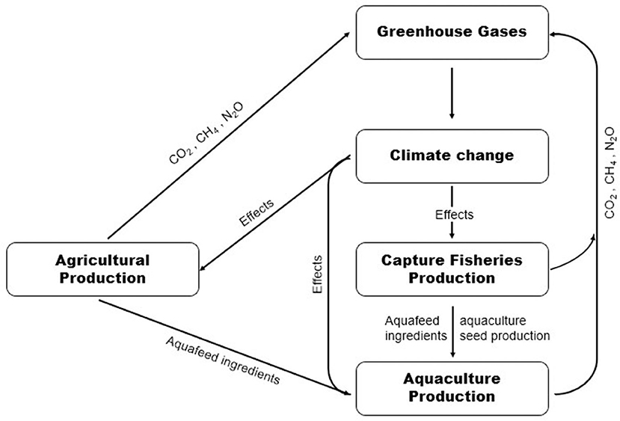
Block Diagram

Slide 11
SOFTWARE REQUIREMENTS:
Operating System : Windows 10
Platform : DOT NET TECHNOLOGY
Front End : ASP.Net 4.0
Back End : SQL SERVER 2014

Slide 12
HARDWARE REQUIREMENTS:
Keyboard
Mouse
Hard disk 500GB
Ram 4 Gb

Slide 13
CONCLUSION
Climate changes are alarming the world by hampering agriculture and its products. Industrialization and poisonous gases cause global warming, which ultimately disturbs the world’s environment. Climate change has devastating effects on plant growth and yield. Abiotic stresses are the major type of stresses that plants suffer. To understand the plant responses under different abiotic conditions the most pressing current need is to explore the genetic basis underlying these mechanisms. Some bottleneck molecular and physiological challenges present in plants need to be resolved for better plant adaptation under abiotic conditions. Temperature fluctuations and variations in rainfall spells are a very crucial indicators of environmental stresses. Weather variations collectively have positive and negative outcomes but the negative effects are more thought-provoking. It is very difficult to overcome the imbalance in agriculture by climate change. How to tackle this problem and what strategies we should apply are still ambiguous.

Slide 14
REFERENCE
1. Arunanondchai P., Fei C., Fisher A., McCarl B.A., Wang W., Yang Y. The Routledge Handbook of Agricultural Economics. Routledge; Abingdon-on-Thames, UK: 2018. How does climate change affect agriculture.
2. Noya I., González-García S., Bacenetti J., Fiala M., Moreira M.T. Environmental impacts of the cultivation-phase associated with agricultural crops for feed production. J. Clean. Prod. 2018;172:3721–3733. doi: 10.1016/j.jclepro.2017.07.132.
3. Vaughan M.M., Block A., Christensen S.A., Allen L.H., Schmelz E.A. The effects of climate change associated abiotic stresses on maize phytochemical defenses. Phytochem. Rev. 2018;17:37–49. doi: 10.1007/s11101-017-9508-2.
4. FAO. UNICEF. WFP. WHO . The State of Food Security and Nutrition in the World 2017: Building Resilience for Peace and Food Security. Food and Agriculture Organization of the United Nations (FAO); Rome, Italy: 2018.
5. Rosenzweig C., Elliott J., Deryng D., Ruane A.C., Müller C., Arneth A., Boote K.J., Folberth C., Glotter M., Khabarov N. Assessing agricultural risks of climate change in the 21st century in a global gridded crop model intercomparison. Proc. Natl. Acad. Sci. USA. 2014;111:3268–3273. doi: 10.1073/pnas.1222463110.

Slide 15
6. Wheeler T., Von Braun J. Climate change impacts on global food security. Science. 2013;341:508–513. doi: 10.1126/science.1239402.
7. Ashraf M.A., Akbar A., Askari S.H., Iqbal M., Rasheed R., Hussain I. Advances in Seed Priming. Springer; Berlin/Heidelberg, Germany: 2018. Recent Advances in Abiotic Stress Tolerance of Plants Through Chemical Priming: An Overview; pp. 51–79.
8. Benevenuto R.F., Agapito-Tenfen S.Z., Vilperte V., Wikmark O.-G., Van Rensburg P.J., Nodari R.O. Molecular responses of genetically modified maize to abiotic stresses as determined through proteomic and metabolomic analyses. PLoS ONE. 2017;12:e0173069. doi: 10.1371/journal.pone.0173069.
9. Suzuki N., Rivero R.M., Shulaev V., Blumwald E., Mittler R. Abiotic and biotic stress combinations. New Phytol. 2014;203:32–43. doi: 10.1111/nph.12797.
10. Pachauri R.K., Allen M.R., Barros V.R., Broome J., Cramer W., Christ R., Church J.A., Clarke L., Dahe Q., Dasgupta P. Climate Change 2014: Synthesis Report. IPCC; Geneva, Switzerland: 2014. Contribution of Working Groups I, II and III to the Fifth Assessment Report of the Intergovernmental Panel on Climate Change.

