Slide 1
To develop Waste water management system in villages

Slide 2
Abstract
The study area where the wastewater treatment is proposed is Rajouri in Jammu And Kashmir State. The growth of population at a faster rate, lack of education, poverty especially in rural areas has polluted the environment to a great extent. Here the paper gives the details about the population of the area, the drainage details, the water supply details and the ground water quality In this paper it has been tried to explain as how we can treat wastewater in rural areas by proposing a wastewater treatment process. Once treated wastewater can be used for number of purposes like growing plants, vegetables etc.

Slide 3
Existing System
An existing treatment system is to be renovated or a new system built, the planning should ensure that all the goals of treatment be considered, that different options be evaluated, and that costs for construction and maintenance of all the options be compared.
It is simple to renovate existing systems to install this alternative. The toilet is replaced with an urine separating stool, and a new, separate pipe or hose is installed to a collection tank.
It is also advantageous that the existing sedimentation basins in the pump station and treatment plant can be used for sedimentation, while the existing building can be used to protect and isolate the trickling filter.

Slide 4
Disadvantage of Existing System
The major disadvantage of the septic tank is that it produce adverse impact on the ground water quality.
The problem of eutrophication in inland waters remained, due to discharge of phosphorus in the wastewater.
The wetland-agriculture rotation, has no problem meeting this requirement since it is a complete eco cycle system in itself.
Smell is not a problem during normal operation, although odours can occur during sludge removal.

Slide 5
PROPOSED SYSTEM :
The proposed tariff structures are designed to achieve full cost recovery through revenue obtained from the users and beneficiaries of the wastewater system.
The local EPB is responsible for conducting monthly site inspections to assure that any environmental mitigation measure proposed in the EIA, as well as other local and national requirements are being implemented.
The purpose of the interceptor tank is to remove settleable solids before they enter the main low gradient sewer to prevent potential clogging of the sewer line.

Slide 6
ADVANTAGE
They are designed to take advantage of many of the same processes that occur in natural wetlands, but do so within a more controlled environment.
Resue of water have many advantages such as reduce in water bill, less depended on singe resource, reduction in pollution due to waste water, reduces load on STP.
Water resource is developing at a rapid pace all over the world, so the water resources available in a particular area should be protected from pollution and only then it should be used for various purposes.

Slide 7
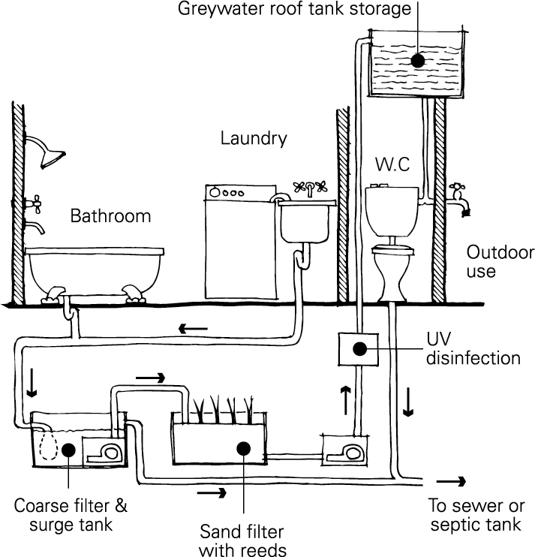
Block Diagram

Slide 8
SOFTWARE REQUIREMENTS:
Operating System : Windows 10
Platform : DOT NET TECHNOLOGY
Front End : ASP.Net 4.0
Back End : SQL SERVER 2014

Slide 9
HARDWARE REQUIREMENTS:
Keyboard
Mouse
Hard disk 500GB
Ram 4 Gb

Slide 10
CONCLUSION
This paper highlights a number of recent problems related with the wastewater discharges in rural areas, and also gives us an idea towards our first step in the development of wastewater treatment in these area. This paper also provides information about the present and future population scenario and water supply demand of the study area. We also proposed the waste water treatment process i.e. wetland. This proposal is intended to reduce pollutant loading rates and generally improve the condition of our rural environment through the delivery of cost-effective wastewater solutions.

Slide 11
REFERENCE
Bowman, J.J., Lough Ree: 1996. An investigation of eutrophication and its causes, Environmental Protection Agency.
Cooper, P., Day, M., Thomas, V., 1994. Process options for phosphorus and nitrogen removal from waste water, J.IWEM, 8, 1, 84-92.
Foot, R.J., Robinson, M.S., Forster, C.F. 1993. Operational aspects of three 'selectors' in relation to aeration tank ecology and stable foam formation. J.IWEM, 7, 304-309.
Ground water information booklet Rajauri district, jammu and kashmir, north western Himalayan region Jammu, November 2009.

Slide 12
Muthukumaran N. and Dr. N.K. Ambujam- Tiruchirappalli City Water Planning – A Case study –Proceedings of the International symposium on Challenges of water resources management in the developing countries in the 21 century at Andhra University, Visakapatnam, 2001.
National Onsite Wastewater Recycling Association. Model Code Framework for the Decentralized Wastewater Infrastructure. http://www.modelcode.org/publications. html. 2007.

