Slide 1
To develop new ways of Waste water management system in rural areas

Slide 2
Abstract
This study has been undertaken to develop Sustainable Waste Water treatment. Most of the river basins in India and elsewhere are closing or closed and experiencing moderate to severe water shortages, brought on by the simultaneous effects of agricultural growth, industrialization and urbanization. Current and future fresh water demand could be met by enhancing water use efficiency and demand management. An estimated 38354 million liters per day (MLD) sewage is generated in major cities of India, but the sewage treatment capacity is only of 11786 MLD. Similarly, only 60% of industrial waste water, mostly large scale industries, is treated. . The scope of this paper is to provide some easy-to-understand guidance on taking decisions in wastewater management in settlements and towns (waste stabilization ponds, HSSF_CW, DEWATS) with up to 10,000 population equivalents (PE).

Slide 3
Existing System
Due to existing regulations, plant volumetric capacity decides the treatment technology.
Much delay exists in wastewater management in rural areas, where construction of centralized WWTP is considered too expensive.
Its robustness and vulnerability towards power cuts, water shortages, floods, etc., and flexibility/adaptability to existing infrastructure and demographic or socio-economic developments are also important aspects.

Slide 4
Disadvantage of Existing System
The discharge of waste into water courses led to gross pollution and health problems for downstream users.
Treatment of wastewater became apparent only after the assimilative capacity of the water bodies was exceeded and health problems became intolerable.
Its disadvantages however include odour problems and it requires a large area of land to function properly.

Slide 5
PROPOSED SYSTEM :
The proposed methodology is developed in three different stages and is applied to a pilot basin for the purpose of validating the results for the design of a model of general application.
This study is proposed the definition of a Support System for decision making which must meet a number of conditions on the geometry of the system and the mathematical structure.
The purpose of the model is the maximizing of the minimum distance between installations and the centres of the closer core.

Slide 6
ADVANTAGE
The excess solids and organisms are removed from the system (waste activated sludge) to enhance the performance of the system.
There are conventional and non-conventional wastewater treatment methods which have been proven and found to be efficient in the treatment of wastewater.
The precautionary and the polluter-pays principles which prevent or reduce pollution to the wastewater have proven to be very efficient in the industrialized countries and should be adapted in developing countries as well.

Slide 7
TITLE | AUTHOR | DESCRIPTION
Small Scale Wastewater Treatment in Ghana (a Scenerio) | Adu-Ahyiah, M. and Anku, R. E. | Any significant improvement in the network will mean demolition of several buildings to make way for pipe network construction.
Wastewater Management and Reuse in Egypt | Hendy, S. M. H. (2006) | Wastewater from industry and domestic use should meet a specific set of requirements before being returned to the natural environment.

Slide 8
TITLE | AUTHOR | DESCRIPTION
Agricultural Use of Untreated Wastewater in Ghana | Keraita B. N. and Dreschsel, P (2004) | It makes pragmatic recommendations aimed at protecting both the public health and farmers' income.
Grey Water Treatment using Constructed Wetland in Ghana | Niyonzima, S. Awuah, E. and Anakwa, A. O. (2008) | The quality of the greywater was greatly improved and further research needs to be carried on improving on increasing the size of the wetland based on wastewater characteristics.

Slide 9
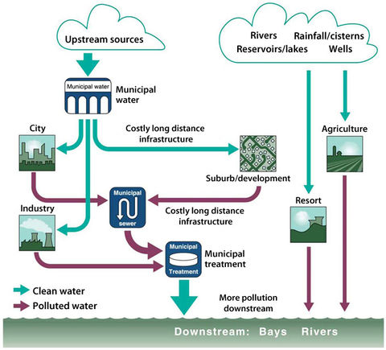
Block Diagram

Slide 10
SOFTWARE REQUIREMENTS:
Operating System : Windows 10
Platform : DOT NET TECHNOLOGY
Front End : ASP.Net 4.0
Back End : SQL SERVER 2014

Slide 11
HARDWARE REQUIREMENTS:
Keyboard
Mouse
Hard disk 500GB
Ram 4 Gb

Slide 12
CONCLUSION
Wastewater is and will always be with us because we cannot survive without water. When water supplied is used for the numerous human activities, it becomes contaminated or its characteristics is changed and therefore become wastewater. Wastewater can and must be treated to ensure a safe environment and foster public health. There are conventional and non-conventional methods of wastewater treatment and the choice of a particular method should be based on factors such as characteristics of wastewater whether it from a municipality or industry (chemical, textile, pharmaceutical etc.), technical expertise for operation and maintenance, cost implications, power requirements among others. In most developing countries like Ghana, low-cost, low-technology methods such as waste stabilization ponds have been successful whilst conventional methods like trickling filters and activated sludge systems have broken down. Effluent which meets set discharge standards can be appropriately used for aquaculture and also irrigation. Though there are a few challenges in waste water management, they can be surmounted if attention and the necessary financial support is given to it.

Slide 13
REFERENCE
Adu-Ahyiah, M. and Anku, R. E. “Small Scale Wastewater Treatment in Ghana (a Scenerio)” Retrieved, 03-10-2010:1-6
Awuah, E. and Amankwaa-Kuffuor, R., (2002) “Characterisation of Wastewater, its sources and its Environmental Effects” I-Learning Seminar on Urban Wastewater Management
Economic and Social Commission for Western Asia (2003) “Waste-Water Treatment Technologies: A General Review” United Nation Publication
Food and Agricultural Organisation (2006) Wastewater Treatment http://www.fao.org/docrep/t0551e/t0551e06.htm#TopOfPage
Hendy, S. M. H. (2006) “Wastewater Management and Reuse in Egypt” Regional Workshop on Health Aspects of Wastewater Reuse in Agriculture Amman, Jordan 30 October –3 November 2006

Slide 14
Keraita B. N. and Dreschsel, P (2004) “Agricultural Use of Untreated Wastewater in Ghana’ International Research Development Center Publication 11-19
Metcalf and Eddy, Inc. (1991) “Wastewater Engineering”: Treatment Disposal and Reuse, third edition. New York: McGraw-Hill.
Niyonzima, S. Awuah, E. and Anakwa, A. O. (2008) Grey Water Treatment using Constructed Wetland in Ghana. Abstract—Switch Urban Water 2008
Peavy, S. H., Rowe, D. R. and Tchobanoglous, G., (1985) Environmental Engineering, International Edition MacGraw-Hill 207-322.
Schultz, T. E. (2005) “Biotreating Process Wastewater: Airing the Options, Chemical Engineering.

