Slide 1
Online registration and processing of dairy farmers producing milk and other livestock products

Slide 2
Abstract
The study was conducted to assess the general milk production system, handling practices, processing, utilization and marketing system of raw cow milk produced in Mizan Aman, Debub and Shey Bench Districts. A total of 270 respondents (thirty respondents from each study area) were selected using simple random sampling technique and interviewed by using a semi structured questionnaires. The results of current study showed that the respondents of Shey Bench and Debub Bench were entirely (100%) engaged in farming activities, predominately mixed production system. Similarly, majority (82.2%) of the respondents of Mizan Aman were also pre-dominantly involved in mixed crop livestock production while the remaining 17.8% were involved only in Peri-urban production system. Majority of the respondents in the three districts (91.1, 100 and 90% of Mizan Aman, Debub and Shey Bench) had dairy cows from 1 to 5, some had from 6 to 10 and 11 to 15. About 95.6, 94.4 and 78.9% of the respondents in Mizan Aman, Debub and Shey Bench use plastic buckets for milking.

Slide 3
As reported by most of the respondents (95.6, 58.9 and 55.6% of Mizan Aman, Debub and Shey Bench districts, respectively), clay pot is used for storage of milk until the wanted amount is accumulated for processing. About 60.0, 26.7 and 20.0% of the respondents utilize raw milk or fresh milk in Mizan Aman, Debub and Shey Bench districts, respectively. Majority of the respondents (97.8, 92.2 and 70.0% in the Mizan Aman, Debub and Shey Bench districts) reported that scarcity of milk is the main problem of milk and milk products marketing in the study areas. The common milk production constraints and prioritized by the sampled farmers were shortage of feed and scarcity of land, diseases, accessibility to marketing place, limitation of market information and inadequate infrastructure. Therefore, it was concluded that the majority of the milk produced in the study areas were not processed, marketed and mainly utilized by household family for home consumption. These suggest the need for enriched dairy cattle production scheme in the study areas.

Slide 4
Existing System
When based on long-term trends in the size of the crossbred, indigenous, and buffalo dairy herds, projections suggest that India can sustain growth and meet targets for dairy production with its existing mix of domestic and trade policies.
An important factor is likely to be the extent to which the private-sector processors catalyze increases in the scale of dairy production enterprises, along with improved management and productivity, a reported trend for which there is currently little data with which to assess future impacts.

Slide 5
Disadvantage of Existing System
That scarcity of milk and milk products marketing are the major problem in the study areas.
The improvement of infrastructure should alleviate the problem of dairy cattle milk production, handling and increase the number of marketing options which is available to smallholder farmers.
The most common problem was adulteration with water, which introduces health risks associated with frequently unsafe water supplies, as well as reducing nutritional value.

Slide 6
PROPOSED SYSTEM :
India has an array of indigenous cattle breeds, some of which are productive milking breeds and others that are bred for draught (animal traction) purposes.
As with cropland, ownership of cattle and water buffalo in India is fragmented, with a large number of small farmers each raising a few animals for draught (animal traction) or milking purposes.
Import policies for animals and genetics for the purpose of upgrading India’s bovine herd give preference to import of semen and embryos, rather than live animals.

Slide 7
ADVANTAGE
These constraints interactively affect the performance of the genetic potential of animals leading to subsistence level of milk production.
To some extent, the variations in performance likely reflect differences in the genetic potential of the particular buffalo breeds available in each region.
A high level of adaptation to climatic and disease conditions in many regions of India, and the capability to efficiently convert many of the available low-quality indigenous grasses and feeds.

Slide 8
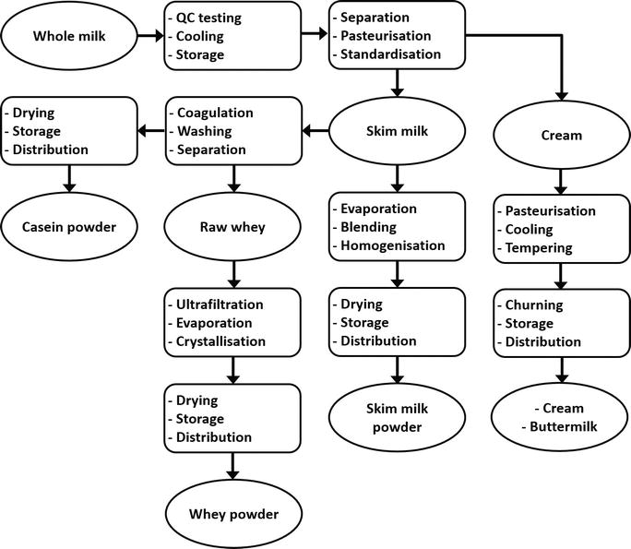
Block Diagram

Slide 9
SOFTWARE REQUIREMENTS:
Operating System : Windows 10
Platform : DOT NET TECHNOLOGY
Front End : ASP.Net 4.0
Back End : SQL SERVER 2014

Slide 10
HARDWARE REQUIREMENTS:
Keyboard
Mouse
Hard disk 500GB
Ram 4 Gb

Slide 11
CONCLUSION
The results of present study showed that all the respondents were engaged in agricultural activities which are dominated by crop-livestock mixed production system. Almost all the respondents in three areas had dairy cows from 1 to 5. Smaller dairy cow holding in the current study could be justified by reduction of grazing land due to expansion of cultivation land, and population growth was forced to reduce their cattle number. All the respondents milk their cows by using hand milking either by washing cow teats or letting calf to suckle its dam for minutes to stimulate milk let-down. The types of utensils used for milking, transportation, collection and storage of milk were plastic buckets, nickel (Aluminum) and some stainless steel. The majority of the respondents did not practice recommended hygienic practices (such as hand and udder washing) during milking and further handling (processing, storage and marketing) of milk and milk products. The common milk products manufactured and utilized in this study areas include raw milk, butter, Ayib (cottage cheese), whey (Aguate), Ergo (naturally fermented milk) and buttermilk (Arrera).

Slide 12
REFERENCE
Abebe B, Zelalem Y, Ajebu N (2012). Hygienic and microbial quality of raw whole cow’s milk produced in Ezha district of the Gurage zone, Southern Ethiopia. Wudpecker J. Agric. Res. 1(11):459-465.
BMZFED (Bench Maji Zone Finance and Economic Development) (2015). Annual report of Bench Maji zone finance and economic development main department. Mizan-Teferi, Ethiopia.
CSA (Central Statistical Agency) (2015). Agricultural Sample Survey. Report on Livestock and Livestock Characteristics (Private Peasant Holdings). Volume V. Addis Ababa, Ethiopia, pp. 109-126.
Food Hygiene Regulations (2006). A practical guide for milk producers to the food hygiene regulations, England. 6 p.
Teklemichael T (2012). Quality and Safety of Raw and Pasteurized Cow Milk Produced and Marketed in Dire Dawa Town, M.Sc. Thesis. Haramaya University, Ethiopia.

Slide 13
Lemma F (2004). Assessment of butter quality and butter making efficiency of new churns compared to smallholders’ butter making techniques in East Shoa Zone of Oromia. MSc thesis. Alemaya University, Alemaya, Ethiopia.
Tesfaye M (2007). Characterization of cattle milk and meat production, processing and marketing system in Metema district, Ethiopia, M.S. thesis, Hawassa University, Awassa, Ethiopia.
Teshome G, Fikadu B, Mitiku E (2014). Handling Practices and Microbial Quality of Raw Cow's Milk Produced and Marketed in Shashemene Town, Southern Ethiopia. Intl. J. Agric. Soil Sci. 2(9):153-162.
Yitaye A, Wurzinger M, Azage T, Zollitsch W (2009). Handling, processing and marketing of milk in the North western Ethiopian highlands. Livest. Res. Rur. Dev. 21(7).
O’Mahony F, Peters J (2004). Options for Smallholder Milk Processing in Sub-Saharan Africa. International Livestock Center for Africa (ILCA) Bulletin 27. Addis Ababa, Ethiopia pp. 206-247.

