Slide 1
Drought Information and Management

Slide 2
Abstract
Drought is the most complex of all natural hazards. The lack of progress in drought preparedness planning and the development of national drought policies is a reflection of this complexity. With the demand for water increasing because of expanding population, urbanization, changes in land use, and many other factors, the time to move to a more risk-based drought management approach is now. Given projected increases in temperature and uncertainties regarding the amount, distribution, and intensity of precipitation, the frequency, severity, and duration of drought may increase in the future.

Slide 3
Making the transition from crisis to drought risk management is difficult because governments and individuals typically address drought-related issues through a reactive approach and very little institutional capacity exists in most countries for altering this paradigm. Drought mitigation planning is directed at building the institutional capacity necessary to move away from this crisis management paradigm. This change is not expected to occur quickly – it is in fact a gradual process that requires changes in government policies and human behavior. Developing improved drought monitoring and early warning systems in support of drought preparedness planning and policy is an urgent need for all drought-prone counties.

Slide 4
Existing System
In addition, drought response is post-impact and relief tends to reinforce existing resource management methods.
It is precisely these existing resource management practices that have often increased societal vulnerability to drought. The provision of drought relief only serves to reinforce the status quo in terms of resource management.
Many governments and others now understand the fallacy of crisis management and are striving to learn how to employ proper risk management techniques to reduce societal vulnerability to drought and, therefore, lessen the impacts associated with future drought events.

Slide 5
Disadvantage of Existing System
Making the transition from crisis to drought risk management is difficult because governments and individuals typically address drought-related issues through a reactive approach and very little institutional capacity exists in most countries for altering this paradigm.
Drought also tends to affect large numbers of people principally because of its impact on both water supply and demand.
When a natural hazard event and resultant disaster has occurred, governments and donors have followed with impact assessment, response, recovery, and reconstruction activities to return the region or locality to a pre-disaster state.

Slide 6
PROPOSED SYSTEM :
The purpose of the planning process is to derive a plan that is dynamic, reflecting the changing government policies, technologies, and natural resource management practices.
The survey found that quality assurance and quality control are practiced by a majority of these networks, but meta datasets are highly variable, as would be expected with the wide range of purposes and inception dates.
The purpose of crop yield monitoring and forecasting, the indicators obviously have to be crop specific.

Slide 7
ADVANTAGE
Preparedness for drought necessitates greater institutional capacity at all levels of government and more efficient coordination between different levels of government.
SPI represents the amount of rainfall over a given time scale, with the advantage that it also gives an indication of what this amount is in relation to the normal, thus leading to the definition of whether a station is experiencing drought or not.
It has also been useful as a drought monitoring tool and has been used to trigger actions associated with drought contingency plans.

Slide 8
TITLE | AUTHOR | DESCRIPTION
Regions at Risk: A Geographical Introduction to Disasters | Hewitt, K. (1997). | An introduction to hazards, human vulnerability and disaster, paying particular attention to the more severe or novel risks and disaster that affect the general public.
How to Reduce Drought Risk | Knutson, C., Hayes, M. and Phillips, T. (1998). | In drought management, making the transition from crisis to risk management is difficult because little has been done to understand and address the risks associated with drought.

Slide 9
TITLE | AUTHOR | DESCRIPTION
Drought planning: A process for state government | Wilhite, D.A. (1991). | The primary purpose of this paper is to present a planning process that can facilitate the preparation of drought contingency plans by state government decision makers.
Drought as a natural hazard: Concepts and definitions | Wilhite, D.A. (2000a). | Drought is one of the most underreported natural disasters because the sources of most of these statistics are international aid or donor organizations.

Slide 10
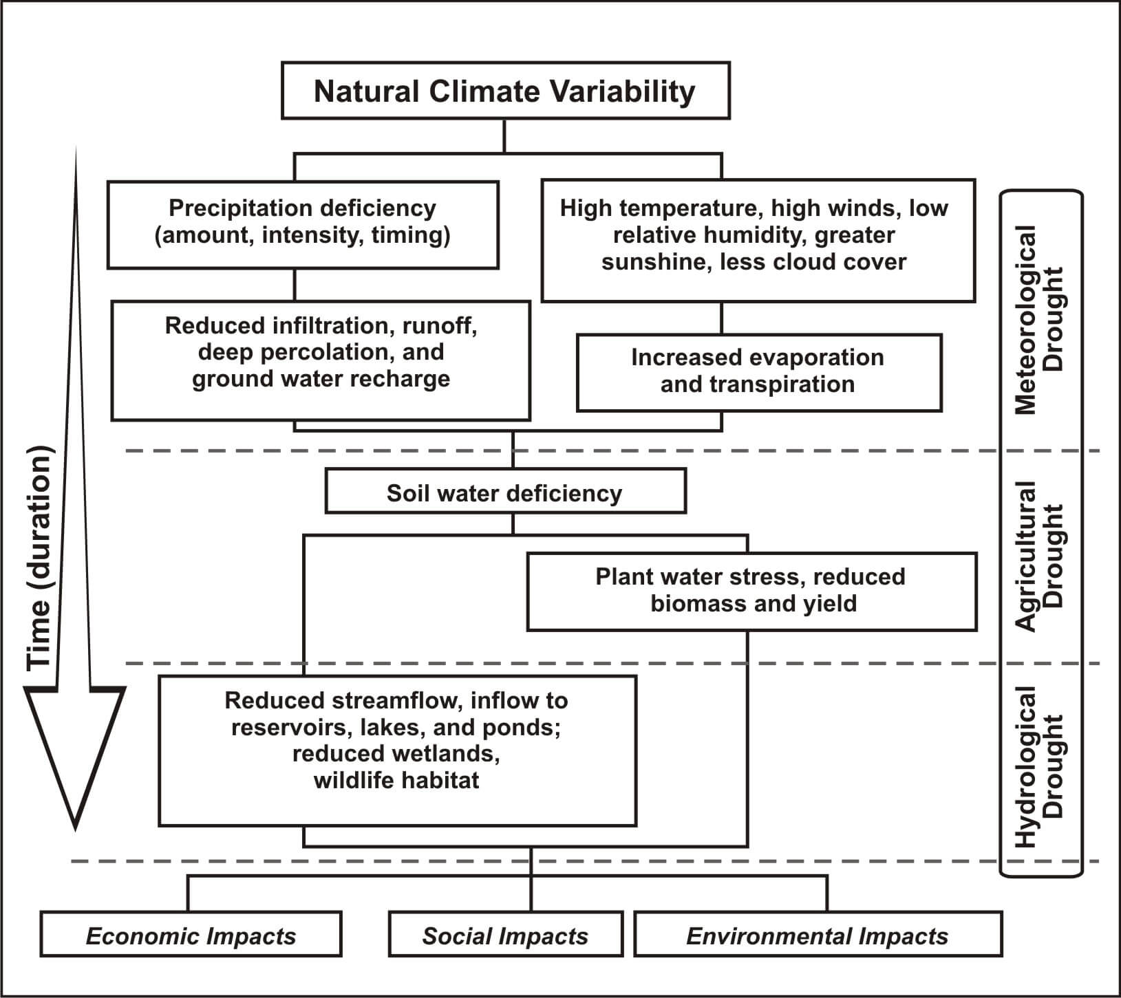
Block Diagram

Slide 11
SOFTWARE REQUIREMENTS:
Operating System : Windows 10
Platform : DOT NET TECHNOLOGY
Front End : ASP.Net 4.0
Back End : SQL SERVER 2014

Slide 12
HARDWARE REQUIREMENTS:
Keyboard
Mouse
Hard disk 500GB
Ram 4 Gb

Slide 13
CONCLUSION
Drought is the most complex of all natural hazards. The lack of progress in drought preparedness planning and the development of national drought policies is a reflection of this complexity. As countries move towards a higher level of preparedness, drought monitoring and early warning systems become paramount because these systems provide the information necessary to make timely decision regarding the management of water and other natural resources. Just as critically important is the development of delivery systems that provide decision makers at all levels and for all primary sectors with data and information that will assist them in making timely decisions. These decision support tools provide end users with information they need to reduce the most serious consequences of drought and reduce the need for government and donor intervention in the form of drought assistance and relief. The goal is to create more drought resilient societies. With the demand for water increasing because of expanding population, urbanization, changes in land use, and many other factors, the time to move to a more risk-based drought management approach is now. Given projected increases in temperature and uncertainties regarding the amount, distribution, and intensity of precipitation, the frequency, severity, and duration of drought may increase in the future. Developing improved drought monitoring and early warning systems in support of drought preparedness planning and policy is an urgent need for all drought-prone countries.

Slide 14
REFERENCE
Bender, S. (2002). Development and use of natural hazard vulnerability assessment techniques in the Americas. Natural Hazards Review, 3(4): 136-138.
Changnon, S.A. (1993). Are we doomed to fail in drought management? In: Proc. of the 8th Conference on Applied Climatology. American Meteorological Society, Boston, pp. 191-194.
CRED, Centre for Research on the Epidemiology of Disasters (2006). CRED CRUNCH newsletter, December, Brussels, Belgium (http://www.em-dat.net/documents/CRED%20CRUNCH%207%20-% 20December%202006.pdf).
Hewitt, K. (1997). Regions at Risk: A Geographical Introduction to Disasters. Addison-Wesley Longman, UK.
Knutson, C., Hayes, M. and Phillips, T. (1998). How to Reduce Drought Risk. Preparedness and Mitigation Working Group of the Western Drought Coordination Council, Lincoln, Nebraska (http://drought.unl.edu/handbook/risk.pdf).

Slide 15
Obasi, G.O.P. (1994). WMO's role in the International Decade for Natural Disaster Reduction. Bulletin of the American Meteorological Association, 75(9): 1655-1661.
Wilhite, D.A. (1991). Drought planning: A process for state government. Water Resources Bulletin, 27(1): 29-38.
Wilhite, D.A. (2000a). Drought as a natural hazard: Concepts and definitions. In: Drought: A Global Assessment, Vol. 1, Wilhite, D.A. (ed.). Routledge, New York, pp. 1-18.
Wilhite, D.A., Hayes, M.J., Knutson, C.L. and Smith, K.H. (2000). Planning for drought: Moving from crisis to risk management. Journal of American Water Resources Association, 36(4): 697-710.
WMO, World Meteorological Organization (2006). Drought monitoring and early warning: Concepts, progress and future challenges. WMO-No. 1006.

