Slide 1
An online platform to link potential dairy importers of the world with the major dairy product manufacturers of the Country

Slide 2
Abstract
Globalization remains a key force in driving Indian economy and India’s dairy industry products acknowledge the demands and preferences around the world by the consumers. New imperatives like production systems issues such as animal welfare and environmental footprint, and also product quality attributes such as traceability and product safety. Dairy farmers need immediate solutions to retain their competitiveness and access to global markets and for this we need innovation which is important that the industry maintains a unified approach and adapts to the changing nature of the people involved. However, with increased pressure on local and central government on environmental management, there is need to recruit additional and more skilled people into the dairy industry. The longer-term success of the dairy industry will depend on attracting and retaining talented people and growing these individuals using effective skills development programmes especially for marketing strategies department. So this paper present marketing Strategies which focus on the actions the dairy industry needs to take to influence perceptible from the dairy farming system to the world.

Slide 3
Existing System
Some challenges exist in developing authentication methods; one of the main problems is the installation of a marker (or markers) that can characterize the food product, its ingredients, the adulterants used, or its processing, production or geographic origin.
Most food products were locally grown, processed, and retailed, and wholesaling was not as common.
The dichotomy between the supply of food and the demands of consumers has only increased due to increasingly complex distribution systems caused by population growth.

Slide 4
Disadvantage of Existing System
Therefore to having shared in global market, over viewing the dairy situation, finding problem area and challenges is necessary.
In the present situation of world market, the milk and dairy market landscape is a dynamic entity within the food industry new opportunities in emerging markets, increasing globalization, changes in consumer demand, nutritional policy and the regulatory environment are among top issues facing the industry.
Global Dairy Platform was created to maximize the impact of these changes and promote and protect dairy’s position worldwide.

Slide 5
PROPOSED SYSTEM :
It has been stressed that cleaning between batches is of primary importance; however, the proposed cleaning procedures are costly for the industry.
Food traceability has been associated with food safety procedures for many years, but recent high-profile cases of food fraud around the world have given traceability a different strategic purpose.
It is important to understand fully how food traceability can serve strategic purposes beyond food safety.

Slide 6
ADVANTAGE
Its performance there are some threats also exist we need to re-correct it and take the global market opportunities. Centralized marketing, centralized quality control, Centralized purchases and pooling of milk efficiently.
Also facilitate improvement of hygiene, sanitation, food safety and operating efficiency in the dairy plants and sensitize dairy personnel to product quality aspects as per international standards.
On the other hand, an excessive emphasis on generating efficiencies through a standard marketing mix may result in the loss of flexibility.

Slide 7
TITLE | AUTHOR | DESCRIPTION
Introduction to Advertising and Promotion: An Integrated Marketing Communications Perspective | Belch, George E., and Belch, Michael A. (1995). | Most of the people involved in advertising and promotion will tell you that there is no more dynamic and fascinating a field to either practice or study.
TV Is the Most-Often-Used Source of Health Information | EPM Communications (1998). | This paper aims to attempt to systematize the knowledge concerning television broadcast dedicated to the subject of health and illness.

Slide 8
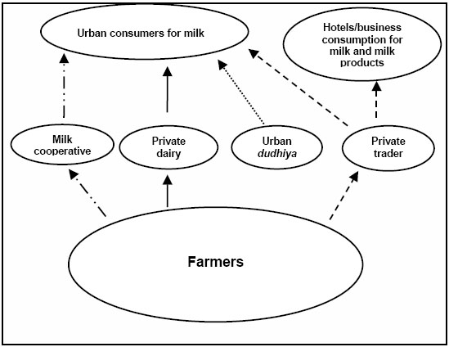
Block Diagram

Slide 9
SOFTWARE REQUIREMENTS:
Operating System : Windows 10
Platform : DOT NET TECHNOLOGY
Front End : ASP.Net 4.0
Back End : SQL SERVER 2014

Slide 10
HARDWARE REQUIREMENTS:
Keyboard
Mouse
Hard disk 500GB
Ram 4 Gb

Slide 11
CONCLUSION
In order to increase the competitiveness of Indian dairy industry, efforts should be made to reduce cost of production, increasing productivity of animals, better health care and breeding facilities and management of dairy animals can reduce the cost of milk production. The Government and dairy industry can play a vital role in this direction. If India has to emerge as an exporting country, it is imperative that we should develop proper production, processing and marketing infrastructure, which is capable of meeting international quality requirements. A comprehensive strategy for producing quality and safe dairy products should be formulated with suitable legal backup. Apart from its performance there are some threats also exist we need to re-correct it and take the global market opportunities. Centralized marketing, centralized quality control, Centralized purchases and pooling of milk efficiently.

Slide 12
REFERENCE
[1] Food and Agricultural Organisation (FAO) Trade Year Book, various issues.
[2] Belch, George E., and Belch, Michael A. (1995). Introduction to Advertising and Promotion: An Integrated Marketing Communications Perspective. Boston: Irwin.
[3] Boyle, Marie A., and Morris, Diane H. (1994). Community Nutrition in Action. St. Paul, MN: West Publishing.
[4] Chetley, Andrew (1986). The Politics of Baby Foods: Successful Challenges to an International Marketing Strategy. New York: St. Martin's.
[5] Connor, John M., et al. (1985). The Food Manufacturing Industries: Structure, Strategies, Performance, and Policies. Lexington, KY: D.C. Heath.

Slide 13
[6] Dandekar, V. M. (1980) “Introduction to the Seminar on Measuring Agricultural Growth” Indian Jl.of Agricultural Economics, 35 ( 2): 1-12.
[7] Debroy, B., Jha B. and Pailwar V. (1996) India’s Agricultural Exports in the Post-Uruguay Setup, a project report submitted to the National Council of Applied Economic Research, New Delhi.
[8] Elder, John P. (2001). Behavior Change and Public Health in the Developing World. Thousand Oaks, CA: Sage.
[9] EPM Communications (1998). "TV Is the Most-Often-Used Source of Health Information." Research Alert 16:7.
[10] Jha, Brajesh (2000) Indian Agriculture and the Multilateral Trading System, Bookwell, New Delhi.

