Slide 1
System for an efficient and transparent process of buyer-seller interactions, provision for creating niche product offerings for SHG groups for all areas

Slide 2
Abstract
This research explores the online purchase decision-making behaviour of consumers by introducing a comprehensive approach that covers two different viewpoints: a) individual-level behaviour and b) market-level behaviour. Individual-level behaviour enhances our understanding of how purchase decision-making processes unfold and whether they differ for different individuals. Drawing from decision analysis and consumer behaviour literature, four segments of online consumers are introduced based on two individual factors: decision making style and knowledge of the product. Archetypal behaviour of each segment is identified addressing variations in the process and process outcome for different groups. In addition, market-level behaviour investigates the actual behaviour of consumers in relation with different retailers in the market; it is based on the aggregated behaviour of 60,000 individuals. Not only behaviour in a particular website but also cross-visiting behaviour of consumers comparing multiple retailers is examined.

Slide 3
Existing System
The limitations of current knowledge in some aspects of online consumer decision-making behaviour and the opportunities that exist to enhance this knowledge.
Some of the current models try to improve the existing models of traditional purchase by introducing factors that influence the online purchase.
They have improved the existing models of traditional purchase by introducing factors that influence online purchase, but their empirical evidence is notably weak.

Slide 4
Disadvantage of Existing System
The ongoing interactions were highly problematic for one supplier, the interaction with the other supplier was highly successful.
The problems in the ongoing interaction also negatively affect the social support function.
The main cause of these problems were found to be related to (a lack of) capabilities.
The document studies provided more detailed insight into issues like Key Performance Indicators and their interrelationships, and the way in which the services to be delivered had been specified.

Slide 5
PROPOSED SYSTEM :
A conceptual model of online purchase decision making is proposed synthesizing theory from three disciplines: consumer behaviour, decision analysis and Information Systems.
An online consumer purchase decision-making process model which synthesizes elements from consumer research and the decision science literature is proposed in order to address the limitations.
The possibility of having a dynamic process that allows moving between different stages, and skipping some, is considered in the proposed model by including loops.

Slide 6
ADVANTAGE
This type of analysis has not been used over a market, it has been widely employed to measure the performance of individual websites.
It is clear that the first two phases are merely performed by consumers with a low level of knowledge, showing that prior knowledge is negatively related to the performance of concept formation.
These consumers would be able to perform the online search more efficiently and accomplish the purchase task.

Slide 7
TITLE | AUTHOR | DESCRIPTION
Dyadic business relationships within a business network context | Anderson, J. C., Håkansson, H. & Johanson, J. 1994. | Recent developments in business practice strongly suggest that to understand these business relationships, greater attention must be directed to the embedded context within which dyadic business relationships take place.
Opportunities for business-to-business services scholarship: a commentary | Brown, S. W. 2002. | This article strives to increase the awareness of this contemporary phenomenon and encourage scholarly work in business-to-business services.

Slide 8
TITLE | AUTHOR | DESCRIPTION
Evolving to a New Dominant Logic for Marketing | Vargo, S. L. & Lusch, R. F. 2004. | A goods-centered dominant logic developed in which the operand resources were considered primary.
Services Marketing | Zeithaml, V. A. & Bitner, M. J. 1996. | The marketer of service cannot rely on product-based clues that the buyer generally employs in alternative evaluation prior to purchase.

Slide 9
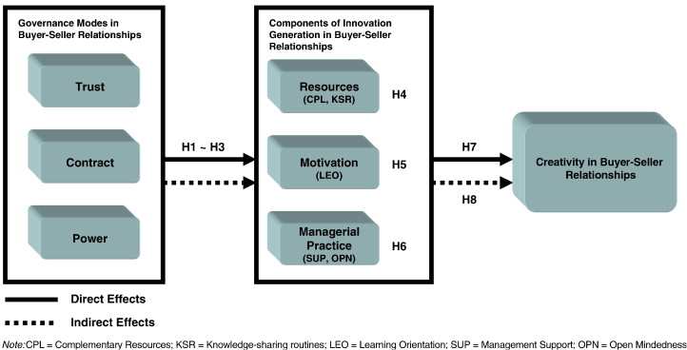
Block Diagram

Slide 10
SOFTWARE REQUIREMENTS:
Operating System : Windows 10
Platform : DOT NET TECHNOLOGY
Front End : ASP.Net 4.0
Back End : SQL SERVER 2014

Slide 11
HARDWARE REQUIREMENTS:
Keyboard
Mouse
Hard disk 500GB
Ram 4 Gb

Slide 12
CONCLUSION
This paper has presented the results of an embedded case study in which three cleaning services, which belong to different classes in the classification of Wynstra et al. (2006), are bundled into a single contract. Within the context of the buying company DR, the ongoing interactions with two service providers were studied. We found that the ongoing interactions with supplier A were perceived by DR as quite problematic, whereas the ongoing interactions with supplier B were considered highly successful. The main cause of these problems were found to be related to (a lack of) capabilities. Whereas supplier B had developed the appropriate capabilities for each of the three types of services they provided, supplier A did not differentiate. For one of the cleaning services, supplier A lacked capabilities altogether. Supplier B in contrast is very experienced in cleaning for DR, as a result of which they have a thorough understanding of DR’s processes. This shows most evidently from the way that supplier B has organized the DR account internally (which brings appropriate management skills into the contract), as well as from the fact that they pro-actively try to optimize their cleaning activities performed at stations (either on trains or on the station itself).

Slide 13
REFERENCE
Anderson, J. C., Håkansson, H. & Johanson, J. 1994. Dyadic business relationships within a business network context. Journal of Marketing. 58, 4, 1-15.
Brown, S. W. 2002. Opportunities for business-to-business services scholarship: a commentary. Australasian Marketing Journal. 10, 1, 10-12.
Vargo, S. L. & Lusch, R. F. 2004. Evolving to a New Dominant Logic for Marketing. Journal of Marketing. 681-17.
Yin, R. K. 2003. Case study research: design and methods. Sage Publications, Inc., Thousand Oaks, California.
Zeithaml, V. A. & Bitner, M. J. 1996. Services Marketing. McGraw-Hill Companies, Inc., Singapore.

Slide 14
Ford, D. 2002. Understanding business marketing and purchasing. Thomson Learning, London, UK.
Gummesson, E. 1998. Productivity, Quality and Relationship Marketing in Service Operations. International Journal of Contemporary Hospitality Management. 10, 1, 4-15.
Håkansson, H. 1982. International Marketing and Purchasing of Industrial Goods: An Interaction Approach. Wiley, London.
Lovelock, C. H. 2001. Services Marketing: People, Technology, Strategy. Prentice Hall, Upper Saddle River, NJ.
Mitchell, V. W. 1994. Problems and risks in the purchasing of consultancy services. Service Industries Journal. 14, 3, 315-339

