Slide 1
PrivateGraph: Privacy-Preserving Spectral Analysis of Encrypted Graphs in the Cloud

Slide 2
Abstract
With the wide deployment of public clouds, owners of big graphs want to use the cloud to handle the scalability issues. However, the privacy and ownership of the graphs in the cloud has become a major concern. In this paper, we study privacy-preserving algorithms for graph spectral analysis of outsourced encrypted graph in the cloud. We consider a cloud-centric framework with three collaborative parties: data contributors, data owner, and a honest-but-curious cloud provider. For a N×N graph matrix, our algorithms achieve a practical work allocation with preserved privacy: the cloud handles expensive storage and computation in O(N2) complexity, and data owner and data contributors' algorithms cost only O(N). We have developed the privacy-preserving versions of the two approximate eigendecomposition algorithms: the Lanczos algorithm and the Nyström algorithm, based on different encryption methods: additive homomorphic encryption (AHE) methods and somewhat homomorphic encryption (SHE) methods.

Slide 3
Existing System
More recent works have achieved keyword privacy for keyword search over encrypted data, i.e., the keywords in queries are protected from the cloud server. Solutions for both single-keyword search and multi-keyword search have been proposed in the literature.
Verifiable computation schemes aim to minimize computation effort of the client, but not storage or communication cost. They require the client and the server to interactively authenticate the computation result. Moreover, the client needs to have a copy of the outsourced data, and the data over which computation is verified cannot be changed in the future.
Homomorphic message authenticator schemes which were proposed recently, avoid a local copy of the outsourced data on the client side. Homomorphic message authenticator schemes allow a client to authenticate a collection of data with his secret key sk, and later to authenticate the computation result of a running program over the data.

Slide 4
Disadvantage of Existing System
Homomorphic message authenticator schemes which were proposed recently, avoid a local copy of the outsourced data on the client side.
Homomorphic message authenticator schemes allow a client to authenticate a collection of data with his secret key sk, and later to authenticate the computation result of a running program over the data

Slide 5
PROPOSED SYSTEM :
In this paper, we investigate the problem of achieving verifiability for privacy-preserving multi-keyword search over encrypted cloud data. Different from the honest but- curious model used in existing privacy-preserving keyword search schemes, we assume a partially honest model, in which the cloud server may return wrong results due to system faults or incentive to reduce computation cost.
We design an efficient, verifiable and privacy-preservingmulti-keyword ranked searchable encryption (MRSE)scheme for outsourced cloud data under the partiallyhonest cloud server model. It is realized by integratingan adapted homomorphic MAC technique with a privacypreservingmulti-keyword search scheme. The proposedscheme is very efficient as it relies on only one-wayfunction for security.

Slide 6
ADVANTAGE
We also provide the random challenge technique to verifytop-k search results for a given query. With this solution,the client can be sure that the top-k results are authentic for probability close to 1.
We provide detailed analysis on security, privacy, verifiabilityand efficiency of VPSearch. Specifically, theunderlying homomorphic MAC scheme used in VPSearchcan be proved to be secure.

Slide 7
TITTLE | AUTHOR | DESCRIPTION
Secure computation on floating point numbers | M. Aliasgari, M. Blanton, Y. Zhang, and A. Steele. | We present in this paper a family of protocols for multiparty computation with rational numbers using fixed-point representation.
A survey on pagerank computing | P. Berkhin. | We are interested in the theoretical foundations of the PageRank formulation, in the acceleration of PageRank computing, in the effects of particular aspects of web graph structure on the optimal organization of computations, and in PageRank stability

Slide 8
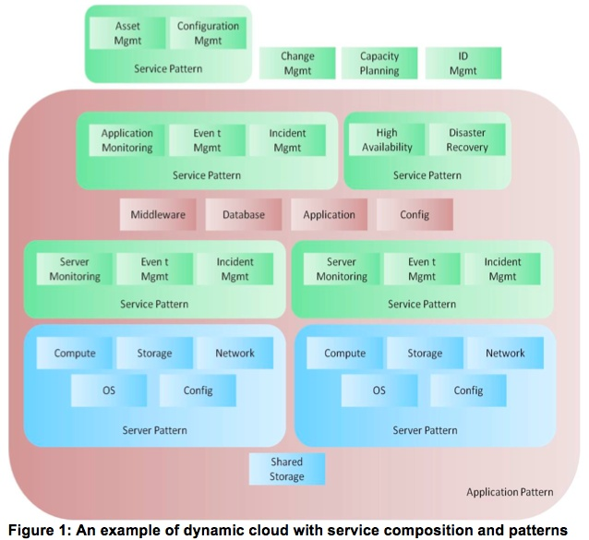
Block Diagram

Slide 9
SOFTWARE REQUIREMENTS:
Operating System : Windows 10
Platform : DOT NET TECHNOLOGY
Front End : ASP.Net 4.0
Back End : SQL SERVER 2014

Slide 10
HARDWARE REQUIREMENTS:
Keyboard
Mouse
Hard disk 500GB
Ram 4 Gb

Slide 11
CONCLUTION
We present a cloud-centric framework for privacy preserving spectral analysis of large matrices, which provides strong privacy guarantee protecting from honestbut-curious cloud providers. It allows data contributors to submit encrypted graph data to the cloud, and the analysis is done via secure protocols between the data owner and the cloud. The framework succeeds in outsourcing the expensive O(N 2 ) computations to the cloud in a secure manner, and limiting in-house computations to O(N) for the resource-restricted data owner and data contributors.

Slide 12
REFERENCE
[1] C. C. Aggarwal and H. Wang. Managing and Mining Graph Data. Springer, 2010.
[2] M. Aliasgari, M. Blanton, Y. Zhang, and A. Steele. Secure computation on floating point numbers. In Annual Network and Distributed System Security Symposium, 2013.
[3] M. J. Atallah and K. B. Frikken. Securely outsourcing linear algebra computations. In ACM Symposium on Information, Computer and Communications Security, pages 48–59, 2010.
[4] P. Berkhin. A survey on pagerank computing. Internet Mathematics, 2:73–120, 2005.
[5] D. Boneh, E.-J. Goh, and K. Nissim. Evaluating 2-dnf formulas on ciphertexts. In International Conference on Theory of Cryptography (TCC), pages 325–341. Springer-Verlag, 2005

