Slide 1
Real-time transaction to be introduced for SHGs and their Federations

Slide 2
Abstract
The last two decades has witnessed a phenomenal growth in the number of Self Help groups (SHGs) and SHG federations in India. There were an estimated 1, 78,664 SHG federations in India1 during 2013-14. SHG federations emerged as important institutions to take over the functions formerly provided by SHG promoting organizations. Placed in a situation where small size of SHGs and their limited financial and human resources did not allow it to deal with larger financial and non-financial, livelihood issues affecting their women members, SHG federations were to address this gap. It was to go beyond being mere financial intermediaries to also become livelihood promotion organizations. The paper argues that while SHG Federations have emerged as financial intermediaries, its role as livelihood support organizations is still a question mark. The study looks at the role of SHG federations as livelihood support organizations.

Slide 3
Existing System
This statement reflects the need to share leadership responsibilities by rotating leadership positions and allowing existing leaders to serve in different roles, such as advocating members’ demands to the bank, the federation, and other external institutions.
Women’s empowerment is a process in which women challenge the existing norms and culture in efforts to promote their well being.
One major advantage of the ‘Indian’ SHG approach to micro-finance is its reliance on the existing very large network of banks, which are already legally and institutionally able to mobilise deposits and make loans.

Slide 4
Disadvantage of Existing System
Similarly in the case of health, social intermediary services such as on health awareness camps by IGA and APM on HIV, Pulse Polio, food and nutrition resulted in diagnosis of problems and addressing the same on a timely basis.
Poverty has been a major issue in India since independence. A number of experiments were made during the last century to find solutions to poverty.
It shall review the forwarded proposal by DDM with her / his comments and thus take decisions on lending issues.

Slide 5
PROPOSED SYSTEM :
Self Help Groups (SHGs) are informal associations consisting of 10-20 members whose purpose is to enable members to reap economic benefits through mutual help, solidarity and joint responsibility.
We chose for our purposes to define SHGs as groups of women whose primary purpose is to save and then to take loans, initially from their own funds but eventually from a bank.
Many other SHG federations, either multipurpose or non-financial, are also recovering some of their operational costs through service fee.

Slide 6
ADVANTAGE
These were related to background information, outreach of the federation, financial performance of the federation, financial products, social services, livelihood services, funding status and nature of enterprises supported.
It is more efficient if the lending norms are established after more local consultation with federated structure and the NGO (if any) and the NGOs made more accountable.
The study revealed that membership in SHG federations had certain advantages than those without membership. The benefits were in relation to financial benefits, livelihood benefits, non-financial benefits and social empowering effects.

Slide 7
TITLE | AUTHOR | DESCRIPTION
A Study of SHG Federation Structures in India: Core elements of sustainability | Dr. Wolfgang Salomo, G. B. (December 2012). | The Self Help Group (SHG) movement in India can be regarded as one of the best financial intermediary systems of the country.
SHG federations: Development costs and Sustainability | Thankha, G. S. (2010). | While SHGs undertake core financial services of savings and credit, the roles the federations take upon themselves vary.

Slide 8
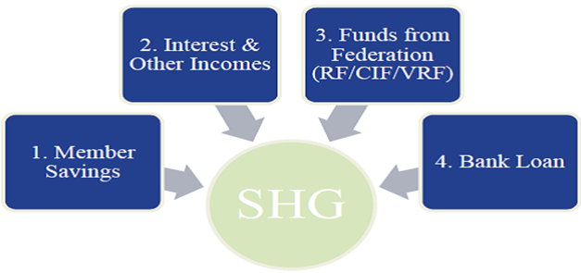
Block Diagram

Slide 9
SOFTWARE REQUIREMENTS:
Operating System : Windows 10
Platform : DOT NET TECHNOLOGY
Front End : ASP.Net 4.0
Back End : SQL SERVER 2014

Slide 10
HARDWARE REQUIREMENTS:
Keyboard
Mouse
Hard disk 500GB
Ram 4 Gb

Slide 11
CONCLUSION
It can be concluded by stating that SHG federations have come to occupy an important place in financial inclusion space in India. While this is appreciable, it needs to graduate into livelihood support organizations. While there have been guidelines for SHGs in the country, there is absence of clear cut guidelines when it comes to SHG federations. Such a set of guidelines with clear cut directions on the role and functions the federations need to take up, the processes which it needs to comply with, the sources from where it can raise capital resources, steps it needs to take for strengthening governance and participation of members, steps it needs to take for inclusion of livelihood promotion tasks etc. – all these will go a long way in strengthening SHG federations as livelihood support organisations.

Slide 12
REFERENCE
Dr. Wolfgang Salomo, G. B. (December 2012). A Study of SHG Federation Structures in India: Core elements of sustainability . New Delhi: GIZ.
NABARD. (2013). Status of Microfinance in India 2012-13. Mumbai: Micro Credit Innovations Department, NABARD.
Thankha, G. S. (2010). SHG federations: Development costs and Sustainability. New Delhi: Access Development Services.

