Slide 1
Mechanism to help rural people to self select for receiving benefit offered under Govt. scheme

Slide 2
Abstract
Rural development is a very dynamic process which includes in improving the socio-economic, political, environmental, and well-being of the poor people living in rural areas. In India more than 70 percent people living in rural areas, the concept of rural development assume great significance. The Molakalmuru taluk is one of the most backward taluk in Chitradurga district these areas have been facing so many problems like unemployment, poverty, lack of skills, illiteracy, and basic infrastructure health care common trend here. The present study is focused on the Socio-Economic status of Self-Help Group on rural development, and to study impact of Self-help Group on rural development in Molakalmuru taluk. The present paper it is based on primary and secondary sources of information.

Slide 3
Existing System
Reorienting existing establishments and organizations in order to protect the interest of the bad constructing up of appropriate organizations of the rural negative specially to protect them from the exploitation.
In this regard, the following hypothesis formed to measure the significance difference if exist.
There is no significant impact exists of Gender basis on perceptions regarding Government schemes for rural development in sundergarh. There is significant impact exists on the gender perception wise.

Slide 4
Disadvantage of Existing System
The NABARD Self-help group means twenty or less people from a homogenous class who are willing to come together for talking their common problem.
To mitigate the Problem of unemployment and under employment, the role of women should not only be confined to generate employment, but also to provide employment to others.
They have to undertake entrepreneurial activities to create additional wealth for the nation and to solve the problem of unemployment and poverty.

Slide 5
PROPOSED SYSTEM :
The propose study is the explorative having the main objectives are to evaluate the government sponsored schemes introduced by the both central and state government from time to time.
In the proposed study KMO is larger than required value, hence the data under construct is fit for the factor analysis and would be considered as the right techniques for interpret correlation matrix.
The factor analysis we have found that 61 percentage of the variables explained to the propose study especially for the rural empowerment.

Slide 6
ADVANTAGE
This study was also focused to understand the role performance of SHGs and women empowerment.
Many women have proved that they are more efficient than men in contributing to the growth of the economy.
The main strategy of the research work is that to analysis in such a way that I will get the right perceptions of the beneficiaries of the government sponsor schems and its performance track.
All the efficiency of the SHG performance is better than others parameters.

Slide 7
TITLE | AUTHOR | DESCRIPTION
Social-Economic Impact through self help groups | K. Ritu, R.K. Kushwaha and A.K. Srivastava (2003), | Empowerment signifies increased participation in decision-making and it is this process through which people feel themselves to be capable of making decisions and the right to do so.
Empowerment of women through SHGs: The case of DWCRA in AP | Somasekhar, K. &M.Bapuji (2005), | Micro-finance interventions are well recognized world over as an effective tool for poverty alleviation and improving socioeconomic conditions of rural poor.

Slide 8
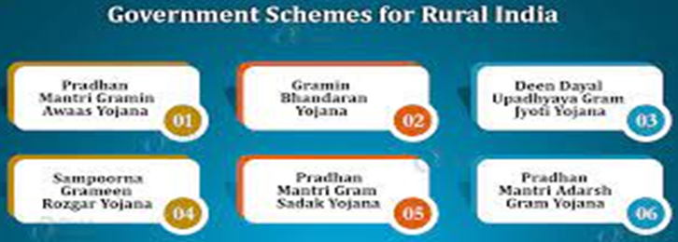
Block Diagram

Slide 9
SOFTWARE REQUIREMENTS:
Operating System : Windows 10
Platform : DOT NET TECHNOLOGY
Front End : ASP.Net 4.0
Back End : SQL SERVER 2014

Slide 10
HARDWARE REQUIREMENTS:
Keyboard
Mouse
Hard disk 500GB
Ram 4 Gb

Slide 11
CONCLUSION
The financial support provided the self-help groups for the development of social-economic status are found to have reached the socially backward, and economically marginalized in the study area. Have well done in the nation to alleviate poverty and authorize rural people. The influx of small enterprises and its activities have made a considerable contribution in the socio-economic development of rural poor in the society. The understanding of the significance of self-help groups in the economic development of rural India by the government of India recognized over 2.25 million SHGs in the country.

Slide 12
REFERENCE
1) Anjugam and Alagumani (2001), The impact of micro finance on the socioeconomic status of women in Madurai District
2) K. Ritu, R.K. Kushwaha and A.K. Srivastava (2003), “Social-Economc Impact through selfhelp groups”, examined the functioning of selfhelp groups in Kanpur Dehat District.
3) M.A. Lokhande (2008) in his work “Socioeconomic impact of microfinance through selfhelp groups in Maharashtra Region.
4) Sabyasachi Das (2003), “Self Help Groups and Micro credit: Synergic Integration”, Kurukshetra, Vol.51, No (10), pp.25- 30.

Slide 13
5) Somasekhar, K. &M.Bapuji (2005), “Empowerment of women through SHGs: The case of DWCRA in AP” C. Narasimha Rao, Rural Development in India-A Multidisciplinary Analysis, New Delhi: Serials Publications.
6) Planning Commission, Government of India, Seventh Five Year Plan (1985-90), Vol.II, Chapter 14, pp.321-328. 55.
7) Department of women and child development report Karnataka government and ZillaPanchayathchitradurga.
8) Financing self – Help Groups: A Reference Hand Book, NABARD, Bangalore.
9) www.rajeshtimane.com

