Slide 1
Mechanism for linking of works under convergence in Rurban with multiple DBs (e.g.MGNREGS, PMUY, DDU-GKY, PMAY etc.)

Slide 2
Abstract
India’s development trajectory is marked by growing economic prosperity but high inequality, which often exacerbates the existing rural– urban divide. One of the current policy instruments to address this divide is the National Rurban Mission, which aims to improve infrastructure and service provision, facilitate regional development and attract investment in rural areas. Against the backdrop of growing rural unrest on one hand and emerging evidence of unsustainable development in the urban on the other, we examine the National Rural Mission and its discursive underpinnings. We find that while the mission and its stated aims are a promising step to improve regional development, its focus on ‘smart villages’ and seeing urbanisation as the only development model, undermines the strengths and challenges in rural India. We highlight ways in which the mission can avoid some past pitfalls of development interventions in India while strengthening its mandate of facilitating inclusive regional development.

Slide 3
Existing System
This may include the history of the street, the existing social, environmental, architectural and structural conditions, existing infrastructure, policies and regulations, project size, zoning and land use and its potential future as a place.
Much can be achieved by adding the biophilic elements of green walls, green roofs and green balconies to building envelopes.
Considerable benefit is also possible by adding elements to existing urban streets and road reserves: tree pits, street trees, linear gardens, pocket parks, bioswales, rain gardens, daylighting streams, and biophilic elements integrated with street furniture.

Slide 4
Disadvantage of Existing System
The larger concern this mission aims to address is growing rural to urban migration and its consequences: increasing pressure on urban infrastructure and services, issues of illegal tenure and encroachment, and questions around who has a right to a city.
The programme also overlooks structural issues undermining farming livelihoods and their profitability.
This sets up the mission to suffer from common issues of development interventions such as elite capture, inequitable access and token participation.

Slide 5
PROPOSED SYSTEM :
Potential benefits of the biophilic streets have been presented; however, it is also necessary to address potential issues and trade-offs associated with the proposed concept.
A biophilic street as a green infrastructure project would require a holistic economic analysis to prove the feasibility of a proposed design scheme.
Elements such as window boxes, planter boxes with climbers, hanging baskets and miniature rain gardens were proposed.

Slide 6
ADVANTAGE
Urban designers, planners and civil engineers have conceived and developed regulatory frameworks for streets to enable efficiency, security and, most of all, the rapid conveyancing of traffic, both public and private.
The focus of urban streets is changing from ensuring traffic movement efficiency to a more peoplecentred design that puts pedestrians first, then cyclists and transit, and lastly private motorised vehicles.
In order to improve the efficiency of the green roof and wall systems, the run-off from the roof was collected into cisterns and then used to irrigate the green walls with drip irrigation.

Slide 7
TITLE | AUTHOR | DESCRIPTION
Environmental Planning and Management of the Peri-Urban Interface: Perspectives on an Emerging Field | Allen A (2003) | This paper argues that environmental planning and management of the peri-urban interface cannot simply be based on the extrapolation of planning approaches and tools applied in rural and urban areas.
Migration, Gender and Right to the City | Bhagat R (2017) | The urban poor, slum dwellers, and migrants are dispossessed as a result of urban restructuring and gentrifycation.

Slide 8
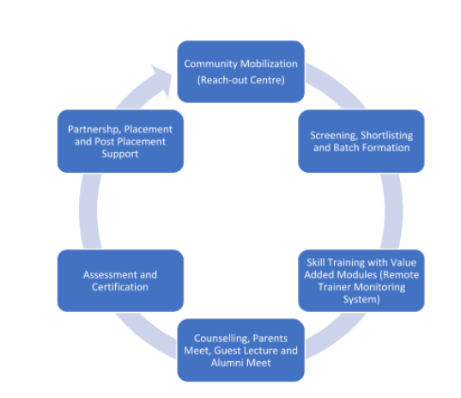
Block Diagram

Slide 9
SOFTWARE REQUIREMENTS:
Operating System : Windows 10
Platform : DOT NET TECHNOLOGY
Front End : ASP.Net 4.0
Back End : SQL SERVER 2014

Slide 10
HARDWARE REQUIREMENTS:
Keyboard
Mouse
Hard disk 500GB
Ram 4 Gb

Slide 11
CONCLUSION
In conclusion, we argue that the Rurban Mission is a promising step, particularly because it focuses on creating employment opportunities in smaller clusters across India. It is also a timely policy intervention that matches with changing rural aspirations. However, in its present form that romanticises rural India on one hand but wants to smarten it by following an urban-like development trajectory on the other, the Rural Mission is poised to repeat mistakes of the past. We do not need to reimagine the rural as a replica of the urban but use its strengths to forge a contextual future that is forward-looking, sustainable, livelihoods-centred and mindful of existing socio-economic conditions.

Slide 12
REFERENCE
Ahluwalia IJ, Kanbur R, Mohanty PK (eds) (2014) Urbanisation in India: Challenges, Opportunities and the Way Forward. SAGE Publications India.
Allen A (2003) Environmental Planning and Management of the Peri-Urban Interface: Perspectives on an Emerging Field. Environment and Urbanization 15(1), 135–48.
Bearak M (2013) New Delhi Puzzled over Governing Hybrid Rural-Urban Areas. New York Times, 18 October 2013. https://india.blogs.nytimes.com/2013/10/ 18/new-delhi-puzzled-over-governing-hybrid-rural-urban-areas/ Accessed on 18 September 2017.
Bhagat R (2017) Migration, Gender and Right to the City. Economic and Political Weekly LII, 35–40.
Chatterjee S (2014) The ‘Rurban’ Society in India: New Facets of Urbanism and its Challenges. IOSR Journal of Humanities And Social Science 19(8), 14–18.

Slide 13
Datta A (2015) New Urban Utopias of Postcolonial India: ‘Entrepreneurial Urbanization’ in Dholera smart city, Gujarat. Dialogues in Human Geography 5(1), 3–22.
Denis E, Marius-Gnanou K (2011) Toward a Better Appraisal of Urbanization in India: A Fresh Look at the Landscape of Morphological Agglomerates. Cybergeo 569, 1–32.
Gupta D (2015) The Importance of Being “Rurban” Tracking Changes in a Traditional Setting. Economic and Political Weekly 50, 37–43.
Indian Institute for Human Settlements (2015). Urban India 2015: Evidence, 81pp. Available at: http://iihs.co.in/knowledgegateway/urban-india-2015-evidence-2/
Land AE (1967) Unraveling the Rurban Fringe: A Proposal for the Implementation of Proposition Three. Hastings LJ 19, 421.

