Slide 1
Identification of missing LSBs which can be added in the road network to minimize the travel time

Slide 2
Abstract
A wide range of relatively short-term disruptive events such as partial flooding, visibility reductions, traction hazards due to weather, and pavement deterioration occur on transportation networks on a daily basis. Despite being relatively minor when compared to catastrophes, these events still have profound impacts on traffic flow. To date there has been very little distinction drawn between different types of network-disruption studies and how the methodological approaches used in those studies differ depending on the specific research objectives and on the disruption scenarios being modeled. In this paper, we advance a methodological approach that employs different link-based capacity-disruption values for identifying and ranking the most critical links and quantifying network robustness in a transportation network.

Slide 3
We demonstrate how an ideal capacity-disruption range can be objectively determined for a particular network and introduce a scalable system-wide performance measure, called the Network Trip Robustness (NTR) that can be used to directly compare networks of different sizes, topologies, and connectivity levels. Our approach yields results that are independent of the degree of connectivity and can be used to evaluate robustness on networks with isolating links. We show that system-wide travel-times and the rank-ordering of the most critical links in a network can vary dramatically based on both the capacity-disruption level and on the overall connectivity of the network. We further show that the relationships between network robustness, the capacity-disruption level used for modeling, and network connectivity are non-linear and not necessarily intuitive. We discuss our findings with respect to Braess’ Paradox.

Slide 4
Existing System
The SSNN is a non-linear model with many degrees of freedom there exist (in principle) infinite parameter settings that would fit a particular travel time prediction problem well.
There exists a wide and detailed body of theoretical and empirical knowledge on the propagation and operation of vehicular traffic.
We argue that if the number of inputs to a problem is not too large, and either sound theoretical or statistical methods exist to determine the appropriate inputs and input time lags, a feed-forward ANN approach is certainly suitable for dynamic problems.

Slide 5
Disadvantage of Existing System
Network-disruption analysis is a methodological approach that has been successfully applied to transportation maintenance and planning problems to identify and rank the most critical links in a network and to evaluate the robustness of the network as a whole.
The most obvious problem resulting from completely removing a network links to model disruptions is the creation of isolated sub-networks, which are no longer accessible when the single link connecting them to the network has been removed.
A shortcoming in the original formulation of the NRI was the inability to address the problem of isolating links in a methodologically sound manner.

Slide 6
PROPOSED SYSTEM :
Several approximations are proposed that correct for the overestimation of mean speed (and thus underestimation of travel time) through arithmetic time averaging.
We propose robust and easy-to-implement procedures that account for the missing data and allow accurate predictions even at high degrees of input failure.
The central component in the proposed framework is inevitably the data driven short term freeway travel time prediction model, which predicts travel times on the freeway route of interest based on current and / or near-past traffic conditions.

Slide 7
ADVANTAGE
It is equally important to have a sound methodological foundation for the assumptions used in the model and to define exactly what performance measures are used and how they are derived.
Within the domain of network-disruption literature, different network performance measures are frequently used.
The modified NRI and NTR have advantages over, and increased policy-relevance when compared to well-known and widely used performance measures such as the V/C because they account for the relative value of each link to the entire network as opposed to providing only a localized measure of the value of each link.

Slide 8
TITLE | AUTHOR | DESCRIPTION
Reliability measures of an origin and destination pair in a deteriorated network with variable flow | Asakura, Y., 1996. | This paper aims to show reliability measures of an origin and destination (OD) pair in a road network when some links are possibly damaged by natural disasters and may be closed to traffic.
Vulnerability: a model-based case study of the road network in Stockholm | Berdica, K., Mattsson, L.G., 2007. | This paper presents the results from a model-based case study, performed with the overall objective to study how vulnerable the Stockholm road network is in different respects.

Slide 9
TITLE | AUTHOR | DESCRIPTION
Capacity reliability of a road network: an assessment methodology and numerical results | Chen, A., 2000. | The proposed capacity reliability index includes connectivity reliability as a special case and also provides travel time reliability as a side product.
Residual closeness in networks | Dangalchev, C., 2006. | This characteristic is more sensitive than the well-known measures of vulnerability it captures the result of actions even if they are small enough not to disconnect the graph.

Slide 10
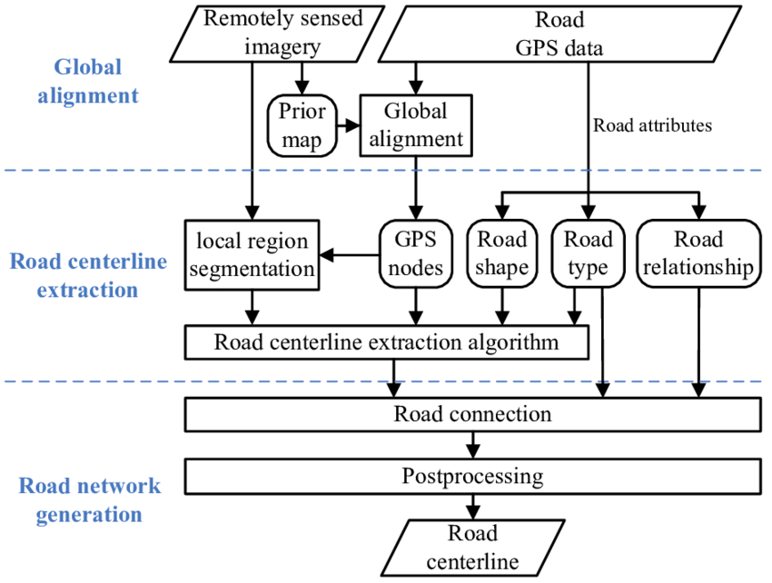
Block Diagram

Slide 11
SOFTWARE REQUIREMENTS:
Operating System : Windows 10
Platform : DOT NET TECHNOLOGY
Front End : ASP.Net 4.0
Back End : SQL SERVER 2014

Slide 12
HARDWARE REQUIREMENTS:
Keyboard
Mouse
Hard disk 500GB
Ram 4 Gb

Slide 13
CONCLUSION
The NTR is a scalable network performance measure that can be used to directly compare different physical transportation networks to one another regardless of scale, topology, or level of connectivity. The NTR can be used to project the effects of future expansion or disruption scenarios that may end up altering the connectivity and/or topology of a specific network. This is useful when large-scale budgeting decisions need to be made between numbers of disparate networks – within a state for example. We employ a variety of link-based capacity-disruption values from 99% to 30% to model network robustness and to identify the most critical links for three test networks and compare the results using the NTR. We show that identifying an appropriate capacity-disruption level is imperative, as the performance results and rank-ordering of the most critical links in the network can change dramatically as the capacity-disruption level changes.

Slide 14
REFERENCE
Asakura, Y., 1996. Reliability measures of an origin and destination pair in a deteriorated network with variable flow. In: Bell, M.H. (Ed.), Transportation Network: Recent Methodological Advances. Pergamon Press, Oxford.
Berdica, K., Mattsson, L.G., 2007. Vulnerability: a model-based case study of the road network in Stockholm. Critical Infrastructure, 81–106.
CCMPO, 2008. CCMPO Regional Transportation Model Documentation, 2000 Base Year Model, Version 2.3.0. Prepared by Resource Systems Group of White River Junction, Vermont for the Chittenden County Metropolitan Planning Organization, January 24, 2008.
Chen, A., 2000. Capacity reliability of a road network: an assessment methodology and numerical results. Transportation Research Part B 36 (3), 225–252.
Dangalchev, C., 2006. Residual closeness in networks. Physica A: Statistical Mechanics and its Applications 365 (2), 556–564.

Slide 15
FHWA, 2008. Our Nation’s Highways 2008. The US Department of Transportation, Federal Highway Administration.
Grubesic, T.H., 2005. Vital nodes, interconnected infrastructures, and the geographies of network survivability. Annals of the Association of American Geographers 96 (1), 64–83.
Holmgren, Å., 2007. A framework for vulnerability assessment of electric power systems. Critical Infrastructure, 31–55.
Jenelius, E., 2007a. Considering the User Inequity of Road Network Vulnerability. Division of Transport and Location Analysis, The Royal Institute of Technology (KTH), Stockholm.
Matisziw, T.C., 2007. Evaluating vulnerability and risk in interstate highway operation. In: TRB 86th Annual Meeting, Washington, DC

