Slide 1
Design a system generating the total no of people eligible for receiving pensions under NSAP ( Indira Gandhi National Old Age Pension Scheme) but are not included(area wise)

Slide 2
Abstract
The National Social Assistance Programme consists of five social assistance transfers, which form the core of India’s fledgling minimum social protection floor. These transfers have been scaled up over the last decade and further steps will soon be taken towards their universalization with exclusion criteria. This paper provides a rigorous evaluation of two of the NSAP schemes, the old age pension and the widow’s pension. Using the 2005 Indian Human Development Survey data’s detailed information on household income and consumption expenditure, the paper measures the impact of the two pensions on household’s incomes, consumption and poverty status, using the propensity score matching estimator. The pensions are found to vary in their effectiveness given the wide diversity of recipients across income quintiles, spatial location, and social group. The widow’s pension is shown to reduce poverty among recipients by about 2.7 percentage points. Government attempts to target the pensions to poor households have been ineffective, and steps towards universalization may in fact improve the pensions’ effectiveness.

Slide 3
Existing System
The success of implementation will lie in proactive identification, enrolment and coverage led by the State without imposing entry level or other subsequent burdens on the potential or existing beneficiaries.
To ensure consistency with existing legal norms of marriage, minimum age for IGNWPS should be reduced from 40 to 18 years.
With problems in existing BPL lists, difficulties of applying and gaining entry to the schemes, and uneven implementation, deserving beneficiaries risk exclusion.

Slide 4
Disadvantage of Existing System
Some of the populations targeted by the scheme, such as elderly persons, are not considered among the most vulnerable populations in the country, given other pressing social problems like widespread informal and vulnerable employment.
In practice, using the ration card as a proxy for NSAP eligibility is problematic. The problems of the ration card and their procurement are well known.
Aging is not an issue of great immediate concern to India compared with other developed and developing countries.

Slide 5
PROPOSED SYSTEM :
All reforms proposed and implemented must be undertaken with citizen centricity or beneficiary-centricity, as its focus.
The ultimate objective to be achieved latest by the end of the 12th Plan should be to cover all those beneficiaries who are eligible for the proposed National Food Security Act, in both rural and urban areas.
It is proposed to be 100% funded by the Central Government with States having flexibility to increase the pension amount.

Slide 6
ADVANTAGE
These efforts harness modern technologies and aim to deliver social protection more efficiently and with an eye on improving the countries human and physical capital.
These probabilities were then used to match a suitable comparison group to the treatment group for both samples.
The outcomes of interest used to measure household livelihoods are total household income, income per capita, consumption expenditure per capita and poverty status.

Slide 7
TITLE | AUTHOR | DESCRIPTION
Performance of Social Safety Net Programs in Uttar Pradesh | Ajwad, Mohamed Ihsan (2007) | Many of the social safety net programs implemented in Uttar Pradesh have very low coverage rates, which in turn imply that exclusion errors are very large
The BPL Census and a Possible Alternative | Drèze and Khera (2009), | It first considers the possibility of a quasi-universal approach, whereby all households are eligible unless they meet pre-specified exclusion criteria.

Slide 8
TITLE | AUTHOR | DESCRIPTION
Grandmothers and Granddaughters: Old-Age Pensions and Intrahousehold Allocation in South Africa | Duflo, Esther, (2003) | This article evaluates the impact of a large cash transfer program in South Africa on children's nutritional status and investigates whether the gender of the recipient affects that impact.
The Battle for Employment Guarantee in India | Khera, Reetika, editor (2011) | They examine a wide-range of issues such as entitlements, corruption, people's perceptions of NREGA, women's empowerment, mobilization of unorganized workers, and socio-economic impact of NREGA.

Slide 9
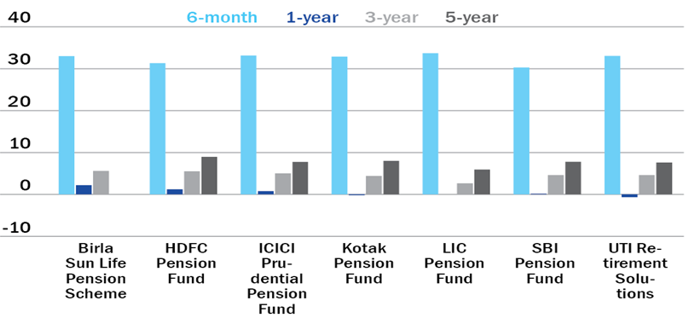
Block Diagram

Slide 10
SOFTWARE REQUIREMENTS:
Operating System : Windows 10
Platform : DOT NET TECHNOLOGY
Front End : ASP.Net 4.0
Back End : SQL SERVER 2014

Slide 11
HARDWARE REQUIREMENTS:
Keyboard
Mouse
Hard disk 500GB
Ram 4 Gb

Slide 12
CONCLUSION
The results presented in this paper demonstrate ex post that in 2005 the widow’s pension, which today makes up part of the National Social Assistance Programme, was a partially effective instrument for significantly improving the livelihoods of the households who received it. These gains point to the important role that the Old Age Pension Scheme and the Widow Pension Scheme, as well as the broader National Social Assistance Programme as a whole, can play in protecting vulnerable populations in India, with a relatively small cash layout. Nonetheless, this evaluation showed no significant impact on household incomes, and suggests that targeting problems with the NSAP are very real. First of all, the incidence of the benefits from the programmes indicate that there are regressive elements at work in the targeting mechanism of the NSAP, particularly the old age pension. Given planned increases in the benefits for the programs, and gradual relaxation of the eligibility criteria towards universalization of the widow’s pension, it remains an open question whether increased outlays for the NSAP will be captured by non-poor or will lead to further expansions in coverage to the people whom the programme aims to benefit.

Slide 13
REFERENCE
Ajwad, Mohamed Ihsan (2007) “Performance of Social Safety Net Programs in Uttar Pradesh” Policy Research Working Paper 714, The World Bank, Washington, DC.
Case and Deaton (1998) "Large Cash Transfers to the Elderly in South Africa," Economic Journal, Royal Economic Society, vol. 108(450), pages 1330-61, September.
Drèze and Khera (2009), “The BPL Census and a Possible Alternative”, Economic and Political Weekly, Vol - XLV No. 09, February 27, 2010.
Duflo, Esther, (2003) "Grandmothers and Granddaughters: Old-Age Pensions and Intrahousehold Allocation in South Africa," World Bank Economic Review, Vol. 17, no. 1, (June 2003): 1-25.
Kassouf and de Oliveira (2012) “Impact Evaluation of the Brazilian Pension Program Beneficio de Prestaçao Continuada (BPC) on Family Welfare” International Policy Centre for Inclusive Growth.

Slide 14
Kautilya (1992[1987]), The Arthashastra, translated by L. N. Rangarajan, New Delhi: Penguin Books India.
Khera, Reetika, editor (2011) The Battle for Employment Guarantee in India, Oxford University Press.
Murgai, Rinku, Salman Zaidi, Arindam Nandi, and Juan Munoz. “Do Public Funds Reach the Destitute? Assessment of Leakages and Targeting of Social Pension Programs in Karnataka” draft manuscript.
Srivastava, Ravi. (forthcoming) A Social Protection Floor for India, draft manuscript of forthcoming UN employment and social protection task team report.
World Bank (2011) Social Protection for a Changing India, Vol. 1, Washington, DC.

