Slide 1
Create a system to recognize and understand local dialect by Computer or other IT devices to deliver voice

Slide 2
Abstract
Computer as a medium for language learning has been acknowledged by many educators in the past years. Using computers for language learning has proved not only interesting but also positive and stimulating for many language teachers and learners. The present paper tries to show the impact/s of computers in the field of second and foreign language learning. First of all, the advantages inherent in the use of computers for language learning will be discussed. Secondly, the technical preparation and requirements of language teachers and learners for the use of computers will be presented. And finally, the application of computers in the development of the four language skills will be analysed. We illustrate the computer capabilities to support different classroom activities, group-work and pair-work tasks; independent work; to stimulate student-centered learning and the individualization in language learning.

Slide 3
Existing System
The existing service method, which has transmitted texts through voice, does not read texts entered by the user and send back to the user.
It is composed of not only an operating system, but also middleware, user interface (UI), browser, and application. It also includes C/C++ libraries that are used in components of various Android systems.
The purpose of this system is to provide a way the blind and physically disabled population can easily control many functions of a computer via speech.

Slide 4
Disadvantage of Existing System
The usefulness of speech recognition software for language students hinges on its ability to recognize nonnative utterances and (2) identify problem areas of student production to provide corrective feedback.
The social and learning impacts of these applications deserve great attention in the near future.
We argue that because children are learning for real life and preparing to solve real complex problems in the future, the complexity of the world should be taken into account much more and much earlier than usually happens.

Slide 5
PROPOSED SYSTEM :
The proposed system also provides blind people with a function via TTS (Text To Speech) of the Google server when they want to receive contents of a document stored in a computer.
Our proposed computer remote control system using speech recognition technologies of mobile devices and wireless communication technologies was implemented by Java programming language.
The purpose of this system is to provide a way that the blind and physically disabled population can easily control many functions of a computer via speech.

Slide 6
ADVANTAGE
In an effort to convey the benefits and efficacy of the product, the process of communication can not be released from the distribution of a product to consumers.
The vectors would consist of cepstral coefficients, which are obtained by taking a Fourier transform of a short time window of speech and decorrelating the spectrum using a cosine transform, then taking the first (most significant) coefficients.
When used to estimate the probabilities of a speech feature segment, neural networks allow discriminative training in a natural and efficient manner.

Slide 7
TITLE | AUTHOR | DESCRIPTION
Technology in testing: The present and the future | Alderson, J. C. (2000). | The current article is an attempt to review the history of employing technology for the purpose of assessing English as a second/foreign language.
Effects of multimedia annotations on vocabulary acquisition | Chun, D, & Plass, J (1996). | With multimedia applications, it is possible to provide, in addition to traditional definitions of words, different types of information, such as pictures and videos.

Slide 8
TITLE | AUTHOR | DESCRIPTION
Using computer networks to enhance foreign language/culture education | Cononelos, T. & Oliva, M. (1993). | The call for more authentic communication in the language classroom has led to a variety of educational innovations such as content-based and learner-centered instructional approaches.
Design principles and guidelines for authoring hypermedia language learning applications | Hemard, D. P. (1997). | The recent popularity and potential of hypermedia authoring shells are increasingly generating high-profile developments of hypermedia courseware in higher education.

Slide 9
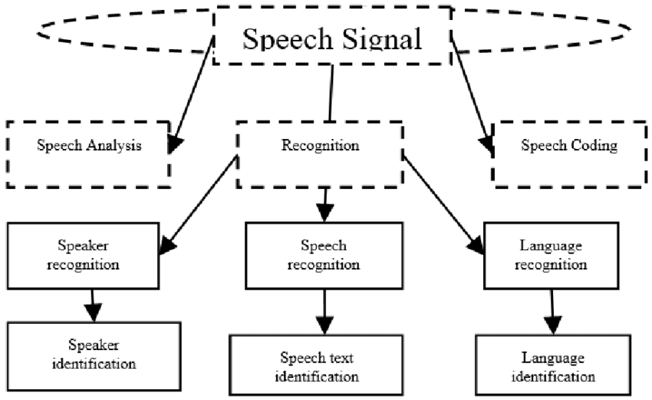
Block Diagram

Slide 10
SOFTWARE REQUIREMENTS:
Operating System : Windows 10
Platform : DOT NET TECHNOLOGY
Front End : ASP.Net 4.0
Back End : SQL SERVER 2014

Slide 11
HARDWARE REQUIREMENTS:
Keyboard
Mouse
Hard disk 500GB
Ram 4 Gb

Slide 12
CONCLUSION
It can be a tutor which offers language drills or skill practice; a stimulus for discussion and interaction; or a tool for writing and research. These emerging technologies give learners great opportunities to engage in authentic conversation and expand their exposure to target language .The social and learning impacts of these applications deserve great attention in the near future. Multimedia software as well as most online materials delivered via combination of different media caters to learners with different cognitive styles. Information technology benefits both the students as well as the teachers. Both get to know each other to enable the rapport normally associated with good teaching. It enables greater imaginative understanding through increased access to information and new ways of accessing the information. It enables the recording process to take place while it is being used. With the advent of the Internet, it can also be a medium of global communication and a source of limitless authentic materials. Findings from numerous studies suggest that the use of visual media supported vocabulary acquisition and reading comprehension and helped increase achievement scores.

Slide 13
REFERENCE
Alderson, J. C. (2000). Technology in testing: The present and the future. System, 28(4), 593-603.
Al-Issa, A., & Al-Bulushi, A. (2011). Mere indolence or genuine Hindrance: Paucity of publishing in ELT at Sultan Qaboos University. Cypriot Journal Of Educational Sciences, 6(1), 2-12.
Chávez, C. L. (1997). Students take flight with Daedalus: Learning Spanish in a networked classroom. Foreign Language Annals, 30(1), 27-37.
Chun, D, & Plass, J (1996). Effects of multimedia annotations on vocabulary acquisition. Modern Language Journal, 80(2), 183-198.
Cononelos, T. & Oliva, M. (1993). Using computer networks to enhance foreign language/culture education. Foreign Language Annals, 26(4), 527-534.

Slide 14
Dunkel, P. (1990). Implications of the CAI effectiveness research for limited English proficient learners. Computers in the Schools, 7(1/2), 31-52.
Godwin-Jones, R. (1999). Web course design and creation for language learning. CALICO Journal, 17(1), 43-58.
Hemard, D. P. (1997). Design principles and guidelines for authoring hypermedia language learning applications. System, 25(1), 9-27.
Hulstijn, J. (2000). The use of computer technology in experimental studies of second language acquisition: A survey of some techniques and some ongoing studies. Language Learning and Technology, 3(2), 32-43. Retrieved February 13, 2001 from the World Wide Web: http://llt.msu.edu/vol3num2/hulstijn/index.html.
Iandoli, L. J. (1990). CALL and the profession: The current state. French Review, 64(2), 261-272.

