Slide 1
Recommender based E- Commerce website

Slide 2
Abstract
To overcome the product overload of online shoppers, a variety of recommendation methods have been developed. Recommender systems are being utilized by an ever increasing number of E-commerce sites to help consumers discover products to buy. The most of existing system gives the recommendation based on best selling product, on demographics of the consumer, or on an analysis of the past buying behavior of the consumer. Our purposed system based on the consumer reviews and advanced multi-criteria search engine. In this paper, we used a text mining approach to mine product features, opinions and their semantic similarity from Web opinion sources.

Slide 3
The consumer can clearly see the strengths and Weaknesses of each product in the minds of existing consumer’s opinion. The system assists on-line shoppers or goal oriented shopper by suggesting the most effective navigation products for their specified criteria and preferences.

Slide 4
Existing System
The existing recommendation system lacks the capability of creating the difference on respective systems specifications meaning a review on specific attribute of system is utilized to measure the overall system or item’s rating.
These kinds of feedbacks are accountable in existing systems while rating or comparing the complete product.
The provided recommendations are user opinions based on products feature; the user can clearly understand the strengths and Weaknesses of each product in the minds of existing users.

Slide 5
Disadvantage of Existing System
It is very challenging to recommend the products to new customers, therefore Demographics techniques are used to handle this kind of problem.
To address this problem statement our recommendation system focuses on the product’s features, opinion and recommends & condemns it depending upon its feature, opinion and requirements of users fairly considering the reviews in the system.
A new assessment mechanism is introduced to short out the new consumer problem of E- commerce recommendation.

Slide 6
PROPOSED SYSTEM :
The proposed method involves forecasting an expected mistake that each system will generate for each user based on their historical behavior.
The proposed system depends on statistical analysis to solve the problem of a cold-start by providing a recommendation depending on the preferences matrix of the products.
The proposed system is a part of the commercial environment, which involves an e-commerce website, an e-bank system, and customers.

Slide 7
ADVANTAGE
Goal-oriented shopping is efficient and purposeful, with a preplanned purchase in mind.
We can rely on this product to make text analysis easier and more efficient for our research because it is a linguistics-based solution.
The advantage of recommender system is their user-friendliness they don't need any extra search terms, they just use certain keyword according to user knowledge. This can be a significant advantage for inexperienced internet users.

Slide 8
TITLE | AUTHOR | DESCRIPTION
Work and/or fun: measuring hedonic and utilitarian shopping value | Babin, Barry J., William R. Darden, and Mitch Griffin. | This article describes the development of a scale measuring both values obtained from the pervasive consumption experience of shopping.
Marketing in hypermedia computer-mediated environments: conceptual foundations | Hoffman, Donna L., and Thomas P. Novak. | Our approach considers hypermedia CMEs to be large-scale (i.e. national or global) networked environments, of which the World Wide Web on the Internet is the first and current global implementation.

Slide 9
TITLE | AUTHOR | DESCRIPTION
Customer profile classification using transactional data | Apeh, Edward Tersoo, Bogdan Gabrys, and Amanda Schierz. | It is often the case that due to reasons such as high cost of data acquisition and/or protection, only the transactional data are available for data mining operations.
Data mining for web personalization | Mobasher, Bamshad | These phases include data collection and pre- processing, pattern discovery and evaluation, and finally applying the discovered knowledge in real-time to mediate between the user and the Web.

Slide 10
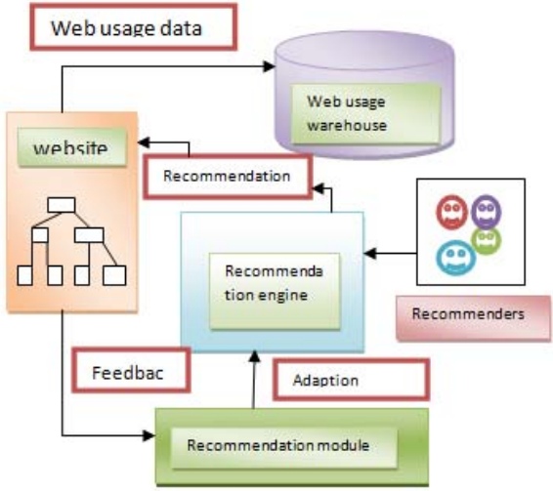
Block Diagram

Slide 11
SOFTWARE REQUIREMENTS:
Operating System : Windows 10
Platform : DOT NET TECHNOLOGY
Front End : ASP.Net 4.0
Back End : SQL SERVER 2014

Slide 12
HARDWARE REQUIREMENTS:
Keyboard
Mouse
Hard disk 500GB
Ram 4 Gb

Slide 13
CONCLUSION
The rapid expansion of e-commerce forces existing recommender systems to deal with a large number of customers and products and to ensure high quality of recommendations. In this paper, we have studied about the Ecommerce web interface and online reviews available on web and extraction product features opinion and categorization, from online product reviews using the IBM SPSS Text Analytics for Surveys. We utilize the semantic knowledge similarity measures to calculate the similarities and categorize product features into different feature groups. The experimental results have demonstrated the effectiveness of our proposed model. In this article, a new assessment mechanism is introduced to short out the new consumer problem of E- commerce recommendation.

Slide 14
REFERENCE
[1] Babin, Barry J., William R. Darden, and Mitch Griffin. "Work and/or fun: measuring hedonic and utilitarian shopping value." Journal of consumer research (1994): 644-656.
[2] Hoffman, Donna L., and Thomas P. Novak. "Marketing in hypermedia computer-mediated environments: conceptual foundations." The Journal of Marketing (1996): 50-68.
[3] Hoffman, Donna L., Thomas P. Novak, and Ann Schlosser. "Consumer control in online environments." Elab. vanderbilt. edu (2000).
[4] Apeh, Edward Tersoo, Bogdan Gabrys, and Amanda Schierz. "Customer profile classification using transactional data." Nature and Biologically Inspired Computing (NaBIC), 2011 Third World Congress on. IEEE, 2011.
[5] Mobasher, Bamshad. "Data mining for web personalization." The adaptive web. Springer Berlin Heidelberg, 2007. 90-135.

Slide 15
[6] Jakob, Niklas. "Extracting Opinion Targets from UserGenerated Discourse with an Application to Recommendation Systems." (2011).
[7] Yousefi, Ayoub, and Jie Tang. "E-commerce: Consumer Online Shopping in Canada." Contemporary Research on E-business Technology and Strategy. Springer Berlin Heidelberg, 2012. 1-14.
[8] Gretzel, Ulrike, and Daniel R. Fesenmaier. "Persuasion in recommender systems." International Journal of Electronic Commerce 11.2 (2006): 81-100.
[9] Chen, Yen-Liang, et al. "Market basket analysis in a multiple store environment." Decision support systems 40.2 (2005): 339-354.
[10] Lin, Qi-Yuan, et al. "Mining inter-organizational retailing knowledge for an alliance formed by competitive firms." Information & management 40.5 (2003): 431-442.

