Slide 1
Website and Application For convergence with MoLE initiatives

Slide 2
Abstract
The term Web 2.0 describes web-based applications such as social networking sites, wikis, and blogs that facilitate collaboration, creativity, and sharing among users. Web 2.0 applications are often enabled by reusing content from other web-based applications or web services. This trend is largely parallel to the principles of service-oriented architecture (SOA), which encourages integration and reuse of online services. In this paper, we discuss the possibility of convergence of Web 2.0 and SOA, which is illustrated by a multimodal social networking system built using web services. We also present the results of benchmarking experiments aimed to study the latency caused by web service composition and integration and its effects on the end-user experience.

Slide 3
Existing System
We recommend starting with any existing guidance you can find from your vendor or those available from the various existing security organizations such as OWASP, CERT, and SANS and then tailoring them for your particular needs.
Use an existing configuration tool or develop your own. A number of such tools already exist.
You can also use disk replication tools such as Ghost to take an image of an existing hardened server, and then replicate that image to new servers.

Slide 4
Disadvantage of Existing System
Web services offer a standards-based solution to the problem of connecting producers and consumers of information over the Internet.
One of the possible solutions addressing this problem is to leverage the capabilities of SOA by creating a specialized social network-oriented framework of web services that would help interconnect people and content in more meaningful ways.
The distributed nature of SeeCCT architecture can lead to a problem where the invocation and integration of various web services can generate latency in the system that may be unacceptable to a user.

Slide 5
PROPOSED SYSTEM :
In this paper, we propose using flow as a fundamental notion underlying understanding of activities in Web Services.
This proposed flow model is a promising approach to software development in service-oriented applications.
Object-oriented analysis and design and UML-based diagrams are typically used in the software development process.
Web Services technology is based on the concept of service-oriented computing.

Slide 6
ADVANTAGE
Speech remains the most basic and the most efficient form of interpersonal communication, and facilitating voice communication remains the main function of even the simplest mobile phone.
One of the main advantages of SOA is an ability to rapidly develop applications using loosely coupled and reusable services that are accessible via standardized interfaces used to hide the complexity of their implementation.
We conducted a series of experiments to gauge the latency of the system’s interaction with the users using its speech interface, which reveal some possible ways for improving the system by taking advantage of a more aggressive caching or pre-fetching of audio data.

Slide 7
TITLE | AUTHOR | DESCRIPTION
A Multimodal Interaction Guide for Pervasive Services Access | A. Augello, A. Santangelo, S. Sorce, G. Pilato, A. Gentile, A. Genco, S. Gaglio, | The aim of the work is to offer a more natural, context sensitive access to information with respect to traditional audio/visual pre-recorded guides.
Context Aware Middleware for Anytime, Anywhere Social Networks | D. Bottazzi, R. Montanari, A. Toninelli, | SAMOA, a semantic context-aware middleware approach, lets you create anytime, anywhere social networks among users in physical proximity.

Slide 8
TITLE | AUTHOR | DESCRIPTION
The Future of Social Networks on the Internet | J. Breslin, S.Decker, | A possible solution is to build semantic social networking into the fabric of the next-generation Internet itself-interconnecting both content and people in meaningful ways.
Classifying Multimedia Resources Using Social Relationships | S. Föll, J. Pontow, D. Linner, I. Radusch, | In particular, the mass of shared user generated content and strong multimedia diversity lead to a vast amount of heterogeneous and unstructured information.

Slide 9
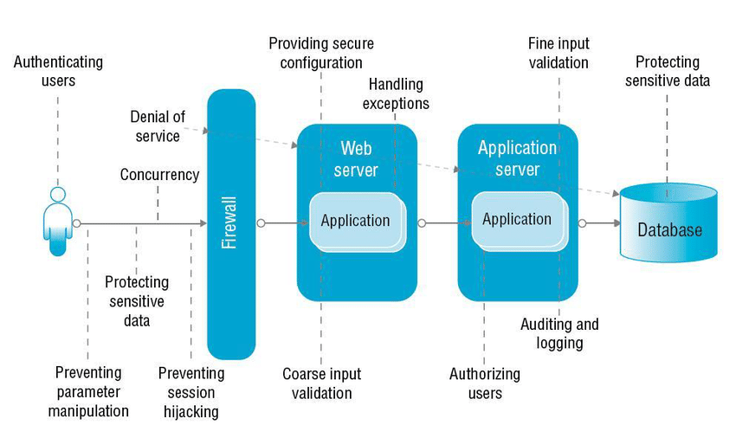
Block Diagram

Slide 10
SOFTWARE REQUIREMENTS:
Operating System : Windows 10
Platform : DOT NET TECHNOLOGY
Front End : ASP.Net 4.0
Back End : SQL SERVER 2014

Slide 11
HARDWARE REQUIREMENTS:
Keyboard
Mouse
Hard disk 500GB
Ram 4 Gb

Slide 12
CONCLUSION
In this paper, we demonstrated the viability of such an approach. SeeCCT is an SNS that is built using the SOA approach facilitated by a number of web services, including those provided by a VoiceXML portal. As a proof-of-concept application, it is limited in scope, but its web service-based architecture is scalable and will allow the system to embrace a larger scope of localities. We conducted a series of experiments to gauge the latency of the system’s interaction with the users using its speech interface, which reveal some possible ways for improving the system by taking advantage of a more aggressive caching or pre-fetching of audio data.

Slide 13
REFERENCE
[1] G. Alonzo, Web Services: Concepts, Architectures and Applications, Springer, Berlin, 2004.
[2] A. Augello, A. Santangelo, S. Sorce, G. Pilato, A. Gentile, A. Genco, S. Gaglio, “A Multimodal Interaction Guide for Pervasive Services Access,” IEEE International Conference on Pervasive Services, 2007, pp. 250-256.
[3] J. Barnett, M. Bodell, D. Raggett, A. Wahbe (Eds.), “Multimodal Architecture and Interfaces,” W3C Working Draft (2006), Retrieved on Mar 1, 2008 from http://www.w3.org/TR/2006/WD-mmi-arch-20061211.
[4] D. Bottazzi, R. Montanari, A. Toninelli, “ContextAware Middleware for Anytime, Anywhere Social Networks,” IEEE Intelligent Systems, Sep 2007, pp. 23-32.
[5] J. Breslin, S.Decker, “The Future of Social Networks on the Internet,” Internet Computing, IEEE, Nov-Dec 2007, pp. 86-90.

Slide 14
[6] F. Curbera, M. Duftler, R. Khalaf, W. Nagy, N. Mukhi, S. Weerawarana, “Unraveling the Web Services Web” Internet Computing, Mar-Apr 2002, pp. 86–93.
[7] S. Föll, J. Pontow, D. Linner, I. Radusch, “Classifying Multimedia Resources Using Social Relationships,” 8th IEEE International Symposium on Multimedia, 2006, pp. 690-695.
[8] G. Frattini, F. Gaudino, V. di Carlo, “Mobile Multimodal Applications on Mass-market Devices: Experiences,” 18th International Conference on Database and Expert Systems Applications, 2007, pp. 89-93.
[9] R. Högg, M. Meckel, K. Stanoevska-Slabeva, R. Martignoni, “Overview of Business Models for Web 2.0 Communities,” Proceedings of GeNeMe, Dresden, 2006, pp. 23-37.
[10] T. Ishikawa, P. Klaisubun, M. Honma, “Navigation Efficiency of Social Bookmarking Service,” IEEE/WIC/ACM International Conferences on Web Intelligence and Intelligent Agent Technology, 2007, p. 280-283.

