Slide 1
Develop an ICT enabled mechanism to monitor quality of houses constructed under Pradhan Mantri Awaas Yojana– Gramin (PMAY-G) in most cost-effective way

Slide 2
Abstract
Rapid growth of the urban population leading to housing shortages and poor urban living conditions is a prime challenge for the government of India. Recently launched affordable housing scheme, Pradhan Mantri Awas Yojana (PMAY) -Housing for All (Urban) is drawing attention of the researchers in critically analysing the programme. The focus of this paper is to review various literatures and understand PMAY, an affordable housing scheme for all specifically of Economically Weaker Section (EWS) beneficiaries in India as well as in Ahmedabad city of Gujarat State.

Slide 3
Existing System
Different housing zones are identified for each state based on the availability of local materials and technology, vulnerability to disaster, existing community skills, knowledge, culture and building tradition.
This monograph is an overview of methodologies and progress of the various existing models of information and communication technology (ICT) use for broad-based development and economic growth specifically in the rural sector of India.
These villages have rich agricultural potential and in the stage of development due to the existence of almost all basic economic and infrastructural setup.

Slide 4
Disadvantage of Existing System
India is still grappling with the growing housing problem, especially of the urban poor.
The rapid population growth in urban areas has led to acute housing shortages and poor urban living conditions. Continuous influx of rural population to cities in search of jobs is causing problems on urban housing.
This growing concentration of people in urban areas has led to problems of land shortage, housing shortfall and congested transit and has also severely stressed the existing basic amenities such as water, power and open spaces of the towns and cities.

Slide 5
PROPOSED SYSTEM :
This purpose the village level secondary data have been collected from census village directory and other published sources.
Significant contribution has been made by Copp, according to him the first and foremost aspect of rural development is the availability and use of infrastructure facilities such as better housing, education, electricity, industries and so on.
It is receiving top priority even in the process of planning at the national level.

Slide 6
ADVANTAGE
They do not fully exploit the potential that is there in an increased FSI, appropriate exploitation of location value, judicious use of government land, reform of titles and squatter rights, and more efficient land use regulations.
The method allows the estimation of both direct and indirect impact of a particular sector on different parameters of economic performance.
Another advantage of using the I-O table 2009-10 is that it disaggregates some sectors to capture the inter-linkages of housing sectors.

Slide 7
TITLE | AUTHOR | DESCRIPTION
Challenges in Slum Upgradation: Need Innovative Approaches | Chaturvedi, Adesh (2013) | These households were able to manage the subsidized connection fee best when the electricity company or the NGO intermediary made it possible to pay over time.
Smart Cities and Affordable Housing in India | Gill H S and Sharma P K (2014) | Indian cities are facing the problems of traffic congestion, reduction of green cover, haphazard peri-urban settlements, an increased traffic, affecting the cities and surrounding areas’ environment adversely.

Slide 8
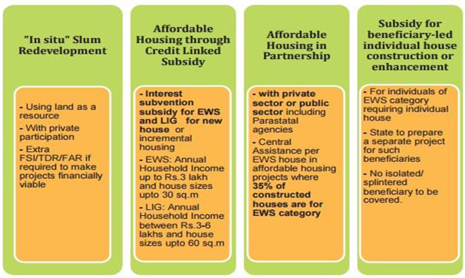
Block Diagram

Slide 9
SOFTWARE REQUIREMENTS:
Operating System : Windows 10
Platform : DOT NET TECHNOLOGY
Front End : ASP.Net 4.0
Back End : SQL SERVER 2014

Slide 10
HARDWARE REQUIREMENTS:
Keyboard
Mouse
Hard disk 500GB
Ram 4 Gb

Slide 11
CONCLUSION
Rapid growth of the urban population leading to housing shortages and poor urban living conditions is a prime challenge for the government of India. While analysing the review of various related literature, a number of studies on affordable housing was observed. It was observed that in India, a number of housing programmes have been implemented since independence by different governments. However, these programmes lacked continuity and interconnectedness, which has drawn attention of the earlier researches to assess housing policies and programmes in India. Recently launched affordable housing scheme, PMAY-Housing for All (Urban) is drawing attention of some of the researchers in critically analysing the programme. The researcher of the present study is pursuing a study for PhD, with the aim to evaluate the impact of Pradhan Mantri Awas Yojana (PMAY) Affordable Housing scheme for Economically Weaker Section (EWS) in Ahmedabad city of Gujarat state of India.

Slide 12
REFERENCE
Adeboyejo O (2005); “Cooperative housing strategy for mass housing delivery in Nigeria”. Paper delivered at the conference of heads of planning schools in Nigeria. Facilitated by Federal Ministry of Housing and Urban Development at Kaduna.
Bhatt Mihir R. (2003); Urban Slums Report: The case of Ahmedabad, India
Census 2011; Data, Government of India
Chaturvedi, Adesh (2013); “Challenges in Slum Upgradation: Need Innovative Approaches”. Yojana, http://yojana.gov.in/slum-upgradation.asp (Accessed 11.01.2018)
Gill H S and Sharma P K (2014); Smart Cities and Affordable Housing in India, The International Journal Of Business & Management, Vol 2 Issue 8, pp 68-73

Slide 13
Jones Lang Lasalle, (2012); Affordable Housing in India- An Inclusive Approach to Sheltering the Bottom of the Pyramid; On Point
Kumar, Arjun, (2015); “Housing Amenities in Urban India: Issues and Challenges.” Shelter 16: pp 7–14,
Kurup E Jayashree, et.al. (nd); Ahmedabad Housing for All; magicbricks.com
Maclennan, D. & Williams, R. (1990); Affordable housing in Britain and the United States.York: Joseph Rowntree Foundation.
Mahadevi D, Bhatia N and Bhonsale B (2014); Slum Rehabilitation Schemes (SRS) across Ahmedabad: Role of an External Agency, CUE Working Paper 27, November 2014

