Slide 1
Suggest a solution to help the ULBs/State/UT Governments to monitor or control the growth of slums in the country and develop a self-sustained environment to ensure affordable housing in order to avoid growth of slums in future.

Slide 2
Abstract
Slums have become an unavoidable reality in many countries of the world, particularly the developing world. Although there are various slums upgrading models and approaches to address the urban poverty in developing countries, the number of slum dwellers has actually grown and the problem is expected to become worse. Other public policies have to eradicate slums and didn't take into account the resources and the potentials that slums offer. This refers to the need to change the procedures followed in the development processes. Along with the human-related problems associated with slums, slums cause serious impacts on the environment and natural resources.

Slide 3
In this context, sustainable development is the main outlet to achieve a real boom of the developing world that consequently confirms the need to develop slums in an integrated manner. So, this paper adopts a concept of investing the positive aspects of the slums' community in conjunction with developing a thorough framework based on the three pillars of sustainability, economy, society, and environment. From this vein, the research is guided by a set of successful practices of many of developing countries through an approach grounded on the three pillars of sustainability. The objectives of this paper are; 1) shedding light on the positive human power of slum dwellers, 2) disseminating best practices on sustainable approaches, from which it can be developed and adapted to fit in the context of the urban slums of developing countries, and 3) providing a comprehensive framework for developing sustainable slums.

Slide 4
Existing System
The existing slums have to be upgraded or redeveloped and secondly, planning initiatives at Urban or city and regional level to control and prevent the future emergence of the slums in the cities.
Therefore, developing sustainable and resilient building utilizing local materials with help of financial and technical assistance from developed countries will improve or upgrade the existing slums leading to slum free cities.
There are factors related to Social, Economic and Environmental sectors responsible for creation of slums and the characteristics of existing slums are also related to these three sectors.
The new Habitat Policy recognizes the sustainability limits of existing urban settlements.

Slide 5
Disadvantage of Existing System
There is a growing global awareness of the necessity for sustainable development to handle the looming environmental problems of global warming and climate change, emissions and resources depletion caused by human activities .
While recognizing all the negatives those related to slum areas, the positive aspects of those slums are absent from the perspective of many who see it as a problem that should be eradicated.
The problem is doubled for women in terms of embarrassment, personal security, and hygiene.
Moreover, the integration of the cultural aspects can give new perspectives on slum development and environmental issues.

Slide 6
PROPOSED SYSTEM :
All the cities/towns under the proposed ‘Healthy Cities Programme’ should strengthen development control regulations based on scientific evidence to maximize the efficiency of urban land (or planning area).
Under the proposed sub-scheme, private sector companies and academic/research institutions shall be engaged by the respective State Governments to work with the planning agencies.
These trainings may be implemented by the anchor institutions that are proposed to be identified by the State Governments.
We must rethink, reimagine and re-establish the very purpose and approach towards planning of cities and towns in India.

Slide 7
ADVANTAGE
The economic aspect comprises of the lower costs of materials, job and skills creation to community members, and the optimization of life-cycle performance.
It optimizes performance of HVAC, reduces demand for non-renewable energy source, and serves as flood barriers.
This ensures developments to be directed towards the local's needs, and thus be more efficient and cost-effective.
These matters enclose energy-related considerations as energy reservation in construction, manufacturing and transporting of materials, the use of renewable energies, and the design and planning for energy efficiency.
It is energy efficient buildings as actively thermal buildings.

Slide 8
TITLE | AUTHOR | DESCRIPTION
Slums: Affects on environment | Agrawal, V. (2014). | Cities have increased and expanded rapidly worldwide over the past centuries. Cities are sources of employment and education, and they are the engines for economic growth.
Garbage dreams | Garbage Dreams. (2010). | When their community is suddenly faced with the globalization of its trade, each of the teenage boys is forced to make choices that will impact his future and the survival of his community.

Slide 9
TITLE | AUTHOR | DESCRIPTION
Urbanization, Housing Quality and Environmental Degeneration in Nigeria | Lanrewaju, A. F. (2012). | The paper finds that the poor housing quality has serious adverse effects on environment and the health of city residents. Strategies for improving the built environment for sustainable living are suggested.
Cities Alliance for Cities without Slums | WorldBank, & UNCHS(Habitat). (2001). | Each of these failures adds to the toll on people already deeply burdened by poverty and constrains the enormous opportunity for human development that urban life offers.

Slide 10
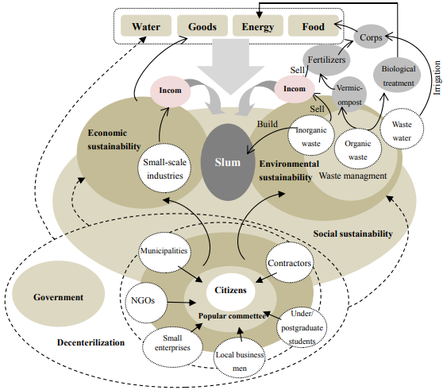
Block Diagram

Slide 11
SOFTWARE REQUIREMENTS:
Operating System : Windows 10
Platform : DOT NET TECHNOLOGY
Front End : ASP.Net 4.0
Back End : SQL SERVER 2014

Slide 12
HARDWARE REQUIREMENTS:
Keyboard
Mouse
Hard disk 500GB
Ram 4 Gb

Slide 13
CONCLUSION
The endeavours were undertaken by governments to eradicate slums and establishing a new housing, predominantly, reflect not only the ignorance of the original needs of the poor, but rather refer to the tendency to attracting investment. That is along with the failure met with many upgrading interventions because of either the shortage of lands or the difficulty of infrastructure supplies. As well as many slums development measures didn't pay attention to the resources offered by slums, as well as the omission of the long-term sustainability. So, investing those positive promising potentials, in tandem with developing a sustainable strategy to the upgrading processes show a great prospect of achieving sustainable slums.

Slide 14
REFERENCE
Agrawal, V. (2014). Slums: Affects on environment. Recent Research in Science and Technology, 6(1), 74-77.
Bettex, M. (2010). In the World: Turning Waste into Profit. Retrieved from http://newsoffice.mit.edu/2010/itw-sanergy-1119.
Cordaid. (2014). Floating Waste Bank- Preparation Phase. Retrieved from https://www.cordaid.org/nl/projecten/floating-waste-bank-preparation-phase/111964/
GarbageDreams. (2010). Garbage dreams. Retrieved from http://garbagedreams.com/
Gowda, K., N., C. M., V., S. M., & N., H. B. (2013). Solid Waste Management in the Slums and Squatter Settlements in the City of Bangalore. International Journal of Scientific and Research Publications, 3(2), 1-10.

Slide 15
Lanrewaju, A. F. (2012). Urbanization, Housing Quality and Environmental Degeneration in Nigeria. Journal of Geography and Regional Planning, 5(16), 422-429. http://dx.doi.org/10.5897/JGRP12.060
Mahgoub, Y. (2014). Slums as Fortune - Slums and Sustainability - Sustainability for the Poor. Retrieved from http://kenanaonline.com/users/YasserMahgoub/posts/621342
Meinhold, B. (2008). M-Velope Transformer House For Sale at Neiman Marcus. Retrieved from http://inhabitat.com/transformable-mvelope-by-michael-jantzen/
WaterStudio. (2014). Floating City Apps. Retrieved from https://www.floatingcityapps.com/blog/?page_id=55
WorldBank, & UNCHS(Habitat). (2001). Cities Alliance for Cities without Slums. Retrieved from http://web.mit.edu/urbanupgrading/sponsor/ActionPlan.pdf

