Slide 1
Student Innovation

Slide 2
Abstract
Innovation in the workplace has been claimed to be a key factor in organizational survival and success. As future workers, university students are a major source of future innovations in organizational settings. Before they enter the labour market, it is in the context of Higher Education that they start developing some of their long-term behaviours, such as innovation behaviours. This study aims to explore the main determinants of university students’ innovation behaviours from a longitudinal perspective. The sample comprised 78 students of Psychology, Management, Fine Arts and Education. Our results show that previous innovation behaviours as freshmen, current levels of autonomy and cognitive demands are positively related with individual innovation among university students. Practical implications regarding how to foster innovation efforts in the context of Higher Education are discussed.

Slide 3
Existing System
Measuring Innovation in Education is a pioneering attempt to provide indicators based on existing international datasets.
This growth is not simply explained by large companies trying to apply their existing technologies to the education sector; a population of small firms have emerged specialising in the development of technological solutions to educational problems and issues.
Recognising and articulating what constitutes an effective market for education technology and supporting its development in countries where none exists.

Slide 4
Disadvantage of Existing System
It is important that students have the opportunity to engage with real-world problems in the feld of study in order to have a rich and meaningful learning experience.
We could consider individual innovation as an active coping strategy which might buffer the detrimental impact of demands that undergraduates face, such as cognitive ones, on their psychological distress, ultimately leading to improved psychological well-being.
Literature on individual innovation has highlighted the impact of different individual variables and personality traits, such as openness to experience, on innovation behaviour.

Slide 5
PROPOSED SYSTEM :
This study was limited in the sense that we only investigated a set of factors that were proposed to be linked to innovation competence and its teaching.
In education, changes are often proposed outside the schools and then disseminated into them by reformers.
The OECD Centre for Educational Research and Innovation (CERI) provides new data on educational innovation and proposed different ways to collect innovation data in education.

Slide 6
ADVANTAGE
This period can bring with it a plethora of new demands on undergraduates, which in turn might have a negative influence on their well-being, performance and adjustment.
In addition, undergraduates, like employees, could use innovation behaviours as an active coping strategy to manage their demands and consequently improve their psychological well-being.
Personal Relevance is the extent to which the content used in the constructivist learning environment is relevant to students’ everyday out-of-school experiences.

Slide 7
TITLE | AUTHOR | DESCRIPTION
Study on innovation capability of college students based on extenics and theory of creativity | Ailing, C., L. Liping, L. Xingsen, J. Zhang, and L. Dong. 2013. | In this paper, the functions and performances of Creativity theory and Extenics are analyzed, and the existing major innovation methods are compared from the perspective of capability promotion.
Transformational leadership and innovation: A comparison study between Iraq's public and private higher education | Al-Husseini, S., and E. Ibrahim. 2014. | With globalization and a rapidly changing environment, the higher education sector in developing countries is facing challenges that require extraordinary leaders.

Slide 8
TITLE | AUTHOR | DESCRIPTION
The job demands-resources model: State of the art | Bakker, A., and E. Demerouti. 2007. | This paper challenges existing stress models, and focuses on both negative and positive indicators of employee well being.
Developing student autonomy in learning (2nd ed) | Boud, D. 1988. | The need to combine social constructivist activities with cognitive constructivist ones has emerged which incorporates personalized learning approaches.

Slide 9
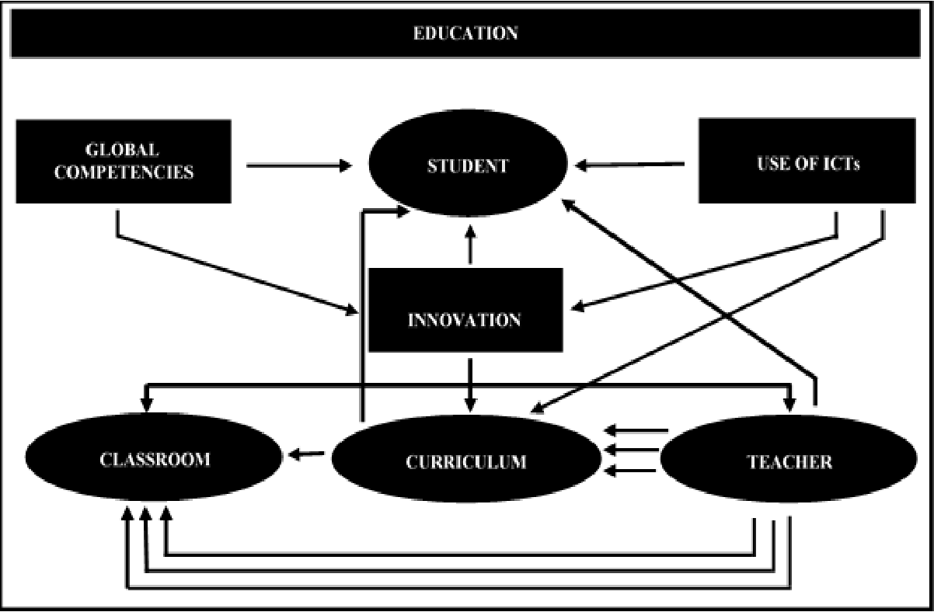
Block Diagram

Slide 10
SOFTWARE REQUIREMENTS:
Operating System : Windows 10
Platform : DOT NET TECHNOLOGY
Front End : ASP.Net 4.0
Back End : SQL SERVER 2014

Slide 11
HARDWARE REQUIREMENTS:
Keyboard
Mouse
Hard disk 500GB
Ram 4 Gb

Slide 12
CONCLUSION
One of the most notable findings of our study, especially from a practical point of view, is that our results highlight the importance of autonomy in fostering university students’ innovation. Our results show that the main determinants of undergraduates’ innovation behaviours changed over time, except for autonomy, which was the only determinant of innovation behaviours at both baseline and follow-up. As job control fosters employee innovation at work, autonomy in accomplishing academic tasks predicts undergraduates’ innovation behaviours. These findings could be of help to educators concerned with promoting university students’ innovation behaviours. Our findings suggest that educators should consider designing tasks and assignments that require higher autonomy from students as part of their curricula. We would also recommend that beyond first year, educators, in addition to providing autonomy, could also consider implementing tasks involving higher cognitive demands to further enhance student innovation.

Slide 13
REFERENCE
Ailing, C., L. Liping, L. Xingsen, J. Zhang, and L. Dong. 2013. Study on innovation capability of college students based on extenics and theory of creativity. Procedia Computer Science 17: 1194-1201.
Al-Husseini, S., and E. Ibrahim. 2014. Transformational leadership and innovation: A comparison study between Iraq's public and private higher education. Studies in Higher Education ahead-of-print: 1-23. doi: 10.1080/03075079.2014.927848.
Bakker, A., and E. Demerouti. 2007. The job demands-resources model: State of the art. Journal of Managerial Psychology 22: 309-328.
Boud, D. 1988. Developing student autonomy in learning (2nd ed). London: Taylor & Francis.
Cohen, J., and P. Cohen. 1983. Applied multiple regression/correlation for the behavioral sciences (2nd ed.). Hillsdale, NJ: Lawrence Erlbaum Associates.

Slide 14
Dolan, P., and R. Metcalfe. 2012. The relationship between innovation and subjective wellbeing. Research Policy 41:1489-1498.
Deci, E.L., and R. Ryan. 1985. Intrinsic motivation and self-determination in human behaviour. New York: Plenum.
Hurt, H.T., K. Joseph, and C.D. Cook. 1977. Scales for the measurement of innovativeness. Human Communication Research 4: 58-65.
Janssen, O. 2000. Job demands, perceptions of effort-reward fairness and innovative behaviour. Journal of Occupational and Organizational Psychology 73: 287-302.
Karasek, R.A. 1979. Job demands, job decision latitude, and mental strain: Implications for job redesign. Administrative Science Quarterly 24: 285-308.

