Slide 1
Smart Buffer Stock Solution

Slide 2
Abstract
The price volatility and scarcity have been became a great problem in the distribution system of seasonal staple food produced by agro industry. It has salient supply disparity during the harvest and planting season. This condition could cause disadvantages to the stakeholders such as producer, wholesaler, consumer, and government. This paper proposes a buffer stock model under free trade considerations to substitute quantitative restrictions and tariffs by indirect market intervention instrument. The instrument was developed through buffer stock scheme in accordance with warehouse receipt system (WRS) and collateral management system. The public service institution for staple food buffer stock (BLUPP) is proposed as wholesaler’s competitor with main responsibility to ensure price stabilization and availability of staple food. Multi criteria decision making is formulated as single objective a mixed integer non linear programming (MINLP). The result shows that the proposed model can be applied to solve the distribution problem and can give more promising outcome than its counterpart, the direct market intervention instrument.

Slide 3
Existing System
With the advent of econometric sophistication and the existence of good time-series data, it may not be difficult for policy makers to logically evaluate the norms for buffer grain stocks, both operational and strategic, to be held by central and state agencies at any point in time.
The latter is supposed to include the existing TPDS- BPL beneficiaries, unless they are found to have crossed the poverty threshold.
The existing system of negotiable warehouse receipts (NWRs) offers a unique, effective tool of insurance and credit to farmers, but a lot still remains to be done to improve stakeholder awareness regarding NRWs, improve the integration and acceptability of these receipts by banks, and its coverage.

Slide 4
Disadvantage of Existing System
The price volatility of commodity has been greatly became a problem in the staple food distribution system.
Based on supply-demand problem, the domestic supply is decreasing contrary to the increasing of the staple food consumption.
Supply Chain Management (SCM) may be able to solve it because the problems above can be seen as an integration of key business processes from the integrated system point of views that include people (government, producer, wholesaler and consumer), material (staple food), equipment (distribution channel/infrastructure), and energy (financial and information).
A strategic level of Supply Chain (SC) design problem is addressed, that is the decision on buffer stocks for stabilizing good’s price.

Slide 5
PROPOSED SYSTEM :
The reduction of uncertainty on the supply side only by determining the buffer stocks schemes consist of time and amount of buffer’s procurement were proposed.
It may also limit unwanted uses by being narrow enough to go unnoticed or too narrow for unintended purposes.
The purpose of the study is to examine the relevance and effectiveness of such operations in the present policy environment and to advocate ways to reduce the levels of grain stocks, without making any compromises on the domestic food security front.
The shift to direct cash transfer will help reduce the level of buffer stocks needed for both strategic and operational purposes to about one-third the present norm.

Slide 6
ADVANTAGE
It can be noted that the increasing of price function parameter will influence the performance criteria for each stakeholder.
This situation are caused by several reasons such as a low level of sugarcane productivity per hectare, a low level of sugar mill/plant efficiency, and the price distortion in the global market.
The buffer stocks schemes can be used by the government to support/stabilize the market price for both the producer and the consumer.
The evaluation of the performance of the buffer stocking policy highlights gaps and inefficiencies at most levels.

Slide 7
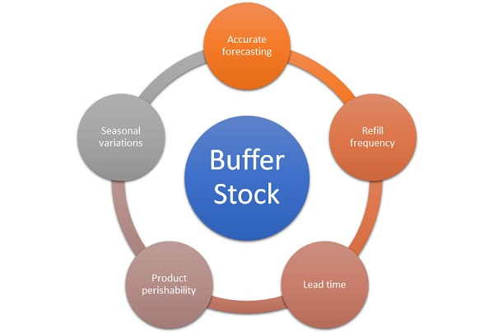
Block Diagram

Slide 8
SOFTWARE REQUIREMENTS:
Operating System : Windows 10
Platform : DOT NET TECHNOLOGY
Front End : ASP.Net 4.0
Back End : SQL SERVER 2014

Slide 9
HARDWARE REQUIREMENTS:
Keyboard
Mouse
Hard disk 500GB
Ram 4 Gb

Slide 10
CONCLUSION
A buffer stock model has been developed in accordance with warehouse receipt and collateral management system for solving the scarcity and price fluctuation of seasonal staple food. The S-WRS facilities and direct access to market are privileges given to BLUPP in order to perform its responsibility to ensure price stabilization and availability of seasonal staple food under free trade considerations. MINLP approach was used to determine the decision variables of buffer stock scheme as an indirect market intervention policy. The numerical analysis showed that the model can be used to determine the stock level and the amount of import, and to solve buffer stock problem considering the interest of stakeholders. Further research is needed to extend the model which considers the dynamic of global market price that can influence the domestic price. Other features can be added to make the model more realistic in order to represent the real system closely such as stochastic factors in supply, demand, and prices. Goal programming, stochastic programming, dynamic programming, and robust optimization, to name a few, can be considered as the alternative approaches to describe the model extensively. The feasibility study of BLUPP stucture is required to support government to implement the proposed model.

Slide 11
REFERENCE
[1] Burhan & Cakravastia, A., A Model to Control Availability and Price of White Sugar, Proc. of the 2nd APCOMS Conf., pp. IV.37–IV.43, 2009.
[2] Sutopo, W., Nur Bahagia, S., Cakravastia, A. & Arisamadhi, TMA., A Dynamic Buffer Stocks Model for Stabilizing Price of Staple Food with Volatility Target, IJLT, 3(2), pp. 149-160, 2009.
[3] Isma’il, N.M., Improvement of Industry Competitiveness National Sugar, Institute for Science and Technology Studies Journal, 2(1), pp. 3-14, 2001.
[4] Sutopo, W., Nur Bahagia, S., Cakravastia, A. & Arisamadhi, TMA., A Buffer Stocks Model to Stabilizing Price of Commodity Under Limited Time of Supply and Continuous Consumption, Proc. of the 9th APIEMS Conf., pp. 321-329, 2008.
[5] Sutopo, W., Nur Bahagia, S., Cakravastia, A. & Arisamadhi, TMA., Price Stabilization using Buffer Stock in Duopoly-Like Market with Consider Exp. of Stakeholders, ASOR Bulletin, 29(4), pp. 60-72, 2010.

Slide 12
[6] Sutopo, W., Nur Bahagia, S., Cakravastia, A. & Arisamadhi, TMA., A Buffer Stocks Model for Stabilizing Price of Staple Food, Proc. of ICMEEM, pp. 2129-2134, 2010.
[7] van der Mensbrugghe, D., Beghin, J.C. & Mitchell, D., Modeling Tariff Rate Quotas in a Global Context: The Case of Sugar Markets in OECD Countries, www.card.iastate.edu, (Accessed on 1 Sept. 2010).
[8] Chand, R., Government Intervention in Food grain Markets in the New Context, First Edition, Chandu Press, pp. 77-98, 2003.
[9] Jamhari, Rice Market Liberalization and Price Stability in Indonesia, Tohoku Journal of Agricultural Research, 54(3-4), pp. 23-36, 2004.
[10] Labys, W.C., Survey of Latest Development-Commodity Price Stabilization Models: A Review & Appraisal, Journal of Policy Modeling, 2(1), pp. 121-126, 1980.

