Slide 1
Automated Identification of Fish Species (AutoFiS)

Slide 2
Abstract
There is a need for automatic systems that can reliably detect, track and classify fish and other marine species in underwater videos without human intervention. Conventional computer vision techniques do not perform well in underwater conditions where the background is complex and the shape and textural features of fish are subtle. Data-driven classification models like neural networks require a huge amount of labelled data, otherwise they tend to over-fit to the training data and fail on unseen test data which is not involved in training. We present a state-of-the-art computer vision method for fine-grained fish species classification based on deep learning techniques.

Slide 3
A cross-layer pooling algorithm using a pre-trained Convolutional Neural Network as a generalized feature detector is proposed, thus avoiding the need for a large amount of training data. Classification on test data is performed by a SVM on the features computed through the proposed method, resulting in classification accuracy of 94.3% for fish species from typical underwater video imagery captured off the coast of Western Australia. This research advocates that the development of automated classification systems which can identify fish from underwater video imagery is feasible and a cost-effective alternative to manual identification by humans.

Slide 4
Existing System
There exists a lack of training in the field of fish identification for FCOs, and many FCOs do not possess this skill.
That different user groups have different requirements with regard to fish identification and that application of existing and development of new species ID tools should be targeting specific purposes (e.g. fishery inspectors would benefit from IRSs).
However, this image property can be characterized by the existence of basic primitives, whose spatial distribution creates some visual patterns defined in terms of granularity, directionality, and repetitiveness.
There exists different approaches to extract and represent textures.

Slide 5
Disadvantage of Existing System
Some of the main factors that require complex yet nonlinear mathematical modelling for the problem of automatic classification as their data distribution cannot be modelled by a linear classifier.
These skip connections also alleviate the vanishing gradient problem as the gradient flows directly through the skip connection regardless of the gradient through the branch.
The major problem associated with the training of any deep network using end-to-end learning is over-fitting on the training set.
This becomes a fine-grained classification problem due to low inter-class variation and high intra-class variation of the fish species.

Slide 6
PROPOSED SYSTEM :
Our proposed method uses Convolutional Neural Networks which makes the process simpler and more robust even while working with a large dataset.
In the proposed method, we provide the comparison of different Activation Functions that will be applied to the different Layers in the CNN.
The initial step taken by the system aims at removing the noise in the dataset.
The second step uses Deep Learning approach by implementation of Convolutional Neural Networks(CNN) for the classification of the Fish Species.

Slide 7
ADVANTAGE
Natural variation and the rich background increases the requirement for nonlinearity in the mathematical modelling which results in a compromise on the performance of the algorithm in the classification task.
CNNs and their variants are considered to be state-of-the-art in image classification tasks with promising performance on handwritten numerical digit classification, facial recognition and generic object recognition.
Therefore, choice of nonlinearity makes a significant impact on the overall performance and is still an active area of research.
This linear independence assumption is not true for the captured data, resulting in poor performance for the SRC based classification method.

Slide 8
TITLE | AUTHOR | DESCRIPTION
Tropical herbivores provide resilience to a climate-mediated phase shift on temperate reefs | Bennett, S., Wernberg, T., Harvey, E. S., Santana-Garcon, J., and Saunders, B. J. 2015. | Climate-mediated changes to biotic interactions have the potential to fundamentally alter global ecosystems. However, the capacity for novel interactions to drive or maintain transitions in ecosystem states remains unresolved.
LIBSVM. A Library for Support Vector Machines | Chang, C., and Lin, C. 2011. | LIBSVM becomes a complete SVM package. We add a function only if it is needed by enough users. By keeping the system simple, we strive to ensure good system reliability.

Slide 9
TITLE | AUTHOR | DESCRIPTION
Bait effects in sampling coral reef fish assemblages with stereo-BRUVs | Dorman, S. R., Harvey, E. S., and Newman, S. J. 2012. | There were no significant differences in the fish assemblages in areas open or closed to fishing, regardless of the bait used.
Reducing the dimensionality of data with neural networks | Hinton, G., and Salakhutdinov, R. 2006. | High-dimensional data can be converted to low-dimensional codes by training a multilayer neural network with a small central layer to reconstruct high-dimensional input vectors.

Slide 10
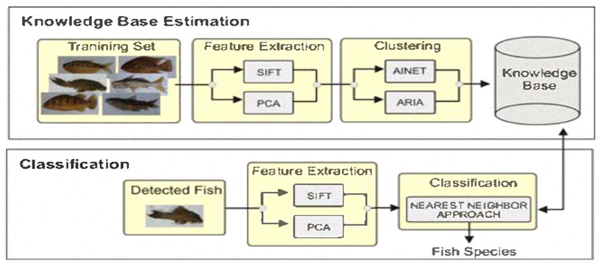
Block Diagram

Slide 11
SOFTWARE REQUIREMENTS:
Operating System : Windows 10
Platform : DOT NET TECHNOLOGY
Front End : ASP.Net 4.0
Back End : SQL SERVER 2014

Slide 12
HARDWARE REQUIREMENTS:
Keyboard
Mouse
Hard disk 500GB
Ram 4 Gb

Slide 13
CONCLUSION
We presented an automatic method that exploits existing pretrained deep neural network models for fish species classification in videos captured in unconstrained underwater environments. Our results are compiled in a challenging realistic scenario where an additional class, that contains numerous fish species that are not of interest, is included during classification. The major contribution of this work is that it shows how to use CNN models trained for a different classification task, for which sufficient labelled training data is available, for fish species classification where labelled data is scarce.

Slide 14
With this strategy, even when our training data was limited, we were able to employ the deepest CNN model so far (with 152 layers) and achieve state-of-the-art results. We proposed a special cross-layer pooling approach that combines features from different layers of the deep network for enhanced discriminative ability. Wide spread use of the proposed and similar automatic techniques will speed up the rate at which marine scientists analyse underwater videos. A bottleneck of the cross-layer pooling method is the extensive computations required which precludes the possibility of real time processing. An essential future research direction is to develop strategies for fine grained classification by directly feed forwarding the images through a pre-trained network to get the final classification results without the need for an external classifier.

Slide 15
REFERENCE
Bennett, S., Wernberg, T., Harvey, E. S., Santana-Garcon, J., and Saunders, B. J. 2015. Tropical herbivores provide resilience to a climate-mediated phase shift on temperate reefs. Ecology Letters, 18: 714–723.
Chang, C., and Lin, C. 2011. LIBSVM. A Library for Support Vector Machines. ACM Transactions on Intelligent Systems and Technology, 2: 1–27.
Dorman, S. R., Harvey, E. S., and Newman, S. J. 2012. Bait effects in sampling coral reef fish assemblages with stereo-BRUVs. PLoS One, 7: e41538.
Duan, K., and Keerthi, S. S. 2005. Which is the best multiclass SVM method? An empirical study. Lecture Notes in Computer Science, 3541: 278–285.
Greene, L. E., and Alevizon, W. E. 1989. Comparative accuracies of visual assessment methods for coral reef fishes. Bulletin of Marine Science, 44: 899–912.

Slide 16
Harvey, E. S., and Shortis, M. R. 1998. Calibration stability of an underwater stereo-video system: Implications for measurement accuracy and precision. Marine Technology Society Journal, 32: 3–17.
Harvey, E. S., Cappo, M., Kendrick, G. A., and Mclean, D. L. 2013. Coastal fish assemblages reflect geological and oceanographic gradients within an australian zootone. PLoS One, 8: e80955.
Hinton, G., and Salakhutdinov, R. 2006. Reducing the dimensionality of data with neural networks. Science, 313: 504–507.
LeCun, Y., Bengio, Y., and Hinton, G. E. 2015. Deep learning. Nature, 521: 436–444.
Turk, M., and Pentland, A. 1991. Eigenfaces for recognition. Journal of Cognitive Neuroscience, 3: 71–86.

