Slide 1
Automated Animal Identification and Detection of Species (AAIDeS)

Slide 2
Abstract
Image sensors are increasingly being used in biodiversity monitoring, with each study generating many thousands or millions of pictures. Efficiently identifying the species captured by each image is a critical challenge for the advancement of this field. Here, we present an automated species identification method for wildlife pictures captured by remote camera traps. Our process starts with images that are cropped out of the background. We then use improved sparse coding spatial pyramid matching (ScSPM), which extracts dense SIFT descriptor and cell-structured LBP (cLBP) as the local features, that generates global feature via weighted sparse coding and max pooling using multi-scale pyramid kernel, and classifies the images by a linear support vector machine algorithm.

Slide 3
Weighted sparse coding is used to enforce both sparsity and locality of encoding in feature space. We tested the method on a dataset with over 7,000 camera trap images of 18 species from two different field cites, and achieved an average classification accuracy of 82%. Our analysis demonstrates that the combination of SIFT and cLBP can serve as a useful technique for animal species recognition in real, complex scenarios.

Slide 4
Existing System
There are currently very limited existing works have attempted to build automated system to process and analyze videos and images captured in the wild for environmental monitoring task.
We focus on developing a “hybrid” wild animal classification framework whose automated module working as a recommendation system for the existing citizen science-based Wildlife Spotter project.
These advances, for non-human primates, manual equipment exist for identifying face expressions and assessing emotional state, impeding animal models of mental health studies.

Slide 5
Disadvantage of Existing System
The simple concatenation would potentially cause the following problem: the feature space becomes more complex and more difficult to classify.
There has been a lot of work on supervised dictionary learning to adapt the dictionary for classification purpose, but it is often computationally expensive and cannot handle large multi-class problem well.
When applied to high dimensional data such as natural images, the total number of parameters can reach millions, leading to serious overfitting problem and impractical to be trained.

Slide 6
PROPOSED SYSTEM :
We propose in this paper a framework to build automated animal recognition in the wild, aiming at an automated wildlife monitoring system.
In addition, similar performances achieved with F-measure metrics indicates the robustness of the proposed system against imbalanced data.
The proposed SISURF hybrid key detector produced promising outcomes similar to other key point detectors.

Slide 7
ADVANTAGE
The SIFT and cLBP can describe the texture at different level, we did the experiment using SIFT, cLBP, and the combination of SIFT and cLBP, respectively, to show how the combination improved the performance.
The combination of SIFT and cLBP as descriptors of local images features significantly improved the recognition performance, which is abundant in texture description at multiple scales.
Computer-assisted species recognition on camera-trap images could make this work flow more efficient, and reduce, if not remove, the amount of manual work involved in the process.

Slide 8
TITLE | AUTHOR | DESCRIPTION
Wireless sensor networks for ecology | J Porter, P Arzberger, H Braun, P Bryant, S Gage, T Hansen, P Hanson, C Lin, F Lin, T Kratz, T Williams, S Shapiro, H King, W Michener, | Field biologists and ecologists are starting to open new avenues of inquiry at greater spatial and temporal resolution, allowing them to "observe the unobservable" through the use of wireless sensor networks.
Monitoring wild animal communities with arrays of motion sensitive camera traps | R Kays, S Tilak, B Kranstauber, P Jansen, C Carbone, M Rowcliffe, T Fountain, J Eggert, Z He, | Our camera network captured the spatio-temporal dynamics of terrestrial bird and mammal activity at the site - data relevant to immediate science questions, and long-term conservation issues.

Slide 9
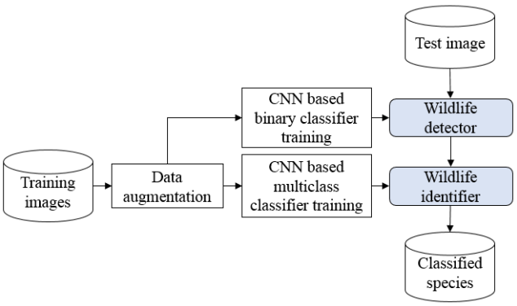
Block Diagram

Slide 10
SOFTWARE REQUIREMENTS:
Operating System : Windows 10
Platform : DOT NET TECHNOLOGY
Front End : ASP.Net 4.0
Back End : SQL SERVER 2014

Slide 11
HARDWARE REQUIREMENTS:
Keyboard
Mouse
Hard disk 500GB
Ram 4 Gb

Slide 12
CONCLUSION
We have shown that object recognition techniques from computer vision science can be effectively used to recognize and identify wild mammals on sequences of photographs taken by camera traps in nature, which are notorious for high levels of noise and clutter. Although some species are of the same ontology, the proposed method can detect imperceptible differences between them. The combination of SIFT and cLBP as descriptors of local images features significantly improved the recognition performance, which is abundant in texture description at multiple scales.

Slide 13
REFERENCE
1. Committee on Grand Challenges in Environmental Sciences NRCUC, Grand Challenges in Environmental Sciences (National Academies Press, Washingthon, DC, 2001)
2. J Porter, P Arzberger, H Braun, P Bryant, S Gage, T Hansen, P Hanson, C Lin, F Lin, T Kratz, T Williams, S Shapiro, H King, W Michener, Wireless sensor networks for ecology. BioScience. 55(7), 561–572 (2005)
3. R Kays, S Tilak, B Kranstauber, P Jansen, C Carbone, M Rowcliffe, T Fountain, J Eggert, Z He, Monitoring wild animal communities with arrays of motion sensitive camera traps. Int J Res Rev Wireless Sensor Netw. 1, 19–29 (2011)
4. J Aguzzi, C Costa, Y Fujiwara, R Iwase, Ramirez-E Llorda, P Menesatti, A novel morphometry-based protocol of automated video-image analysis for species recognition and activity rhythms monitoring in deep-sea fauna. Sensors. 9(11), 8438–8455 (2009)
5. E Fegraus, K Lin, J Ahumada, C Baru, S Chandra, C Youn, Data acquisition and management software for camera trap data: a case study from the TEAM Network. Ecol. Inform. 6(6), 345–353 (2011)

Slide 14
6. J Yang, K Yu, Y Gong, T Huang, Linear spatial pyramid matching using sparse coding for image classification, in IEEE Conference on Computer Vision and Pattern Recognition, (Miami, 20-25 June 2009), pp. 1794–1801
7. J Wang, J Yang, K Yu, F Lv, T Huang, Y Gong, Locality-constrained linear coding for image classification, in 2010 IEEE Conference on Computer Vision and Pattern Recognition (CVPR), (San Francisco, CA, 13-18 June 2010), pp. 3360–3367
8. D Lowe, Distinctive image features from scale-invariant keypoints. Int. J. Comput. Vis. 60(2), 91–110 (2004)
9. T Ahonen, A Hadid, M Pietikainen, Face description with local binary patterns: application to face recognition. Pattern Anal. Mach. Intell, IEEE Trans. 28(12), 2037–2041 (2006)
10. B Bolger, DT Morrison, TA Vance, D Lee, H Farid, A computer-assisted system for photographic mark–recapture analysis. Methods Ecol. Evol. 3(5), 813–822 (2012)

