Slide 1
APP FOR GOVERNMENT ASSET MANAGEMENT

Slide 2
Abstract
The aim of the study is to identify the opportunities and challenges a local government public asset manager is most likely to deal with when adopting the appropriate Public Asset Management Framework especially in developing countries. In order to achieve its aim, this study employs a Case Study in Indonesia for collecting all data i.e. interviews, document analysis and observations at South Sulawesi Province, Indonesia. The study concludes that there are significant opportunities and challenges that local governments in developing countries, especially Indonesia, might be required to manage if apply public asset management framework appropriately. The opportunities are more effective and efficient local government, accountable and auditable local government organization, increase local government portfolio, reflect up to date information for decision makers in local government, and improve the quality of public services.

Slide 3
On the other hand, there are also challenges. Those challenges are local governments has no clear legal and institutional framework to support the asset management application, non-profit principle of public assets, cross jurisdictions and applications in public asset management, the complexity of public organization objectives, and data availability required for managing public property. The study only covers the condition of developing countries where Indonesia as an example, which could not represent exactly the whole local governments’ condition in the world. Further study to develop an asset management system applicable for all local governments in developing countries is urgently needed. Findings from this study will provide useful input for the policy maker, scholars and asset management practitioners to develop an asset management framework for more efficient and effective local governments.

Slide 4
Existing System
The concept of local government assets as the essential resources that should be managed judiciously because their correlation with the existence and wellbeing of the community.
PEFA’s protocol includes assessing elements such as the existence and completion of inventory records for nonfinancial assets, as well as procedures and rules for their transfer or disposal.
Threats to the sustainability of municipal assets exist even in developed countries, and in developing countries they are substantially higher.
Such construction is done without proper planning and budgeting of future life cycle costs of existing and new assets, thus setting the stage for future problems.

Slide 5
Disadvantage of Existing System
There might be other non-asset solutions to soften the problem, adoption and application of a public asset management framework will significantly reduces the impact of the circumstances.
This study applies non-participant observation, which starts from descriptive observation on how local government in South Sulawesi province manages its assets, then move to specific processes and problems in municipal asset management stages.
The lack of coordination between the property department and the other department has meant that there has often been an imbalance between demand and supply.
The correction of just one aspect of the asset management in the process, i.e. applying market value to the property, will have significant impact on governments portfolio.

Slide 6
PROPOSED SYSTEM :
Our proposed methodology suggests a reasonably brief yet well-rounded performance evaluation and includes universal elements of good asset management, which makes the methodology applicable to nearly any country.
In the land proposed to be acquired and the Secretary shall inform the said value to the Land Acquisition Officer concerned.
If the proposed property is for educational purpose, permission from the Deputy Director of Education shall be obtained.
Under the Asset Management Plan (AMP) it is proposed that MMS activities include inspection, assessing asset condition against failure/breakdown, prioritising, scheduling, auctioning the work and reporting what was done to develop a maintenance history to improve maintenance and service delivery performance.

Slide 7
ADVANTAGE
There is no systematic consideration of the efficiency of public assets use or its financial performance in order to recognise the profitability of the assets.
The data used in the accrual based government financial report enables the assessment of accountability and performance of government entities.
Those opportunities and challenges have resulted in a requirement to improved public asset management to produce a high level performance across all divisions and sectors within the local government organisations.
One source of inefficiency is the presence of large portfolios of vacant or underused properties.

Slide 8
TITLE | AUTHOR | DESCRIPTION
Property appraisal in government | Anthony, A., & Michael, P. (2004). | This paper looks at the development and recent changes to these documents particularly from the viewpoint of a public sector property practitioner involved in day‐to‐day appraisal.
The impact of illiquidity on the asset management of insurance companies | Berry-Stolzle, T. R. (2008). | This paper investigates optimal asset management strategies for property and casualty insurance companies in illiquid markets.

Slide 9
TITLE | AUTHOR | DESCRIPTION
Asset life cycle management: Towards improving physical asset performance in the process industry | Charles, A. S., & Alan, C. B. (2005). | The application of performance measurements for the operation and support stages is proposed to influence decision making in the process industry.
Municipal real property asset management: An overview of world experience, trends and financial | Kaganova, O., & Nayyar-Stone, R. (2000). | It outlines a core set of features that are an integral part of an efficient and ac- countable asset management system, and also provides an in-dept analysis of asset management issues in coun- tries in transition, where municipal governments often are the largest property owners.

Slide 10
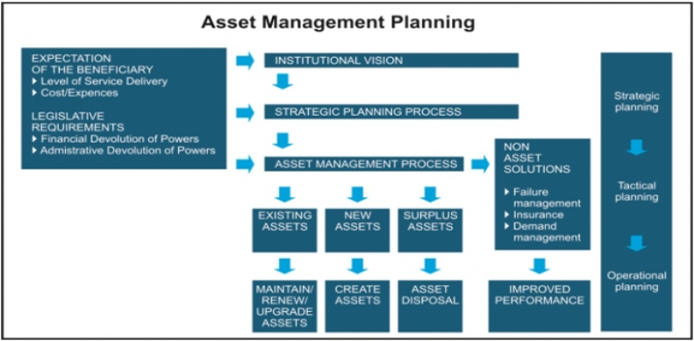
Block Diagram

Slide 11
SOFTWARE REQUIREMENTS:
Operating System : Windows 10
Platform : DOT NET TECHNOLOGY
Front End : ASP.Net 4.0
Back End : SQL SERVER 2014

Slide 12
HARDWARE REQUIREMENTS:
Keyboard
Mouse
Hard disk 500GB
Ram 4 Gb

Slide 13
CONCLUSION
In order to adopt and apply a proper public asset management framework, local government asset managers should first identify the opportunities and challenges that could appear if local governments adopt the framework. This identification should be established in the early stages before the framework is applied in order to calculate its benefits and risks. Based on the study, there are some opportunities that local government asset managers could achieve by adopting current practice of public asset management. Those opportunities are more effective and efficient as well as more accountable and auditable in managing public assets, increase local government portfolio, and improve the quality of public services. On the other hand, there are also some challenges that local governments might face.

Slide 14
Those challenges are the absent of institutional and legal asset management framework; the old perception of local government towards public assets; cross jurisdictions asset management within the local government; the complexity of public organization objectives; and unavailability of data required for public asset management. Those opportunities and challenges have resulted in a requirement to improved public asset management to produce a high level performance across all divisions and sectors within the local government organisations. Local governments’ asset managers would be well advised to strengthen their understanding of public asset management by examining public services and mission requirements, creating auditable cost and investment management strategies, and optimizing facilities and infrastructure portfolios, and aligning asset decisions making with community and organisational needs.

Slide 15
REFERENCE
Anthony, A., & Michael, P. (2004). Property appraisal in government. Journal of Property Investment & Finance, 22(2), 192.
Ayuningtiyas, R. (2008, 18 Juni 2008). Traffic jam in Semanggi, road user choose to pull over. Kompas. Retrieved 10 june 2009, from http://www.kompas.com/read/xml/2008/06/18/14413869/semanggi.macet.motor.pilih.menepi
Banner, D. K., & Gagne, T. E. (1995). Designing effective organizations: Traditional & transformational views. Thousand Oaks, Calif: Sage Publications.
Berry-Stolzle, T. R. (2008). The impact of illiquidity on the asset management of insurance companies. Insurance Mathematics & Economics, 41(1), 1-14.
Bloomberg, N. (2007). Florida is advised on saving a state fund. New York Times, 7.

Slide 16
Charles, A. S., & Alan, C. B. (2005). Asset life cycle management: Towards improving physical asset performance in the process industry. International Journal of Operations & Production Management, 25(5/6), 566.
Hentschel, J., & Kaganova, O. (2007). Government property resources: A case for asset management. Public Management (00333611), 89(2), 24-26.
Kaganova, O., & Nayyar-Stone, R. (2000). Municipal real property asset management: An overview of world experience, trends and financial. Journal of Real Estate Portfolio Management, 6(4), 307.
Priest, R. (2006). Integrating property management into overall business and financial planning. Journal of Retail & Leisure Property, 5(3), 235.
Summerell, R. (2005). Implications of real-property asset management. The CPA Journal, 75(10), 2.

