Slide 1
Over voltage and under voltage load protection with alert system

Slide 2
Abstract
In the paper, GSM Modem SMS Alert aims to build a system that monitors voltage and provides a breakpoint based low and high voltage tripping mechanism that avoids any damage to the load and sends a text message (SMS) to alert the user whenever the condition of under-voltage or overvoltage occurs. There is a chance of damaging electronic devices due to the fluctuations the AC mains supply. Therefore, a tripping system is required to avoid any damage to these loads. This system consists of a tripping mechanism that monitors the input voltage and trips according to limits provides. It uses 8-bit microcontroller ATmega328 with a GSM modem and 16*2 LCD attached to it externally. As soon as the input voltage falls out of the window range, it delivers an error on screen. Here, a dc motor is used as a load. This system is also configured with a buzzer that goes on as soon as tripping takes place. The states of the system are displayed on the LCD. Whenever fault occurs the microcontroller sends message to the GSM modem, then the GSM modem sends alert SMS to the user to protect their device as soon as possible.

Slide 3
Existing System
Overvoltage can occur due to single line to ground fault, which in turn will raise the voltage of the other phases.
It can also cause due to disconnection of heavy industrial loads or switching on the capacitor banks.
This is generally due to ungrounded or floating ground delta systems, where a change in ground reference would give voltage rise to the ungrounded system.
The over voltages result because either the system is too weak for the desired voltage regulation or voltage controls are inadequate. Incorrect tap settings on transformers can also result in system over voltages.

Slide 4
Disadvantage of Existing System
One major problem in industry as well as house hold is sudden over voltage or under voltage which results damage the equipment.
It has cleared that of under voltage and overvoltage problem are very common and can create problem for consumer good and industrial application.
The equipment in case of over voltage or under voltage and the study of over voltage and under voltage, various power quality issues.

Slide 5
PROPOSED SYSTEM :
In order to make home energy efficient we also paid attention on home devices like fans and lights .Moreover , the system also focus on outside environment such as main door , garage door and irrigation.
If the thermometer feels an increase in room temperature then an electrical signal is sent to microcontroller , the microcontroller takes a necessary action like turn the fan on which work as an airconditioning.
The garden of house is the place where most people stay at rest time. This system including irrigation system for the garden, in order to take care of house garden. The irrigation is done by using pump which operates on timer.

Slide 6
ADVANTAGE
Over-voltage and under voltage protection is used to prevent damage as a result of electrical transients.
It is a power supply feature which shuts down the supply or clamps the output when the voltage exceeds a preset level.
Most power supplies need to use an over-voltage and under voltage protection circuit to prevent damage to the electronic components

Slide 7
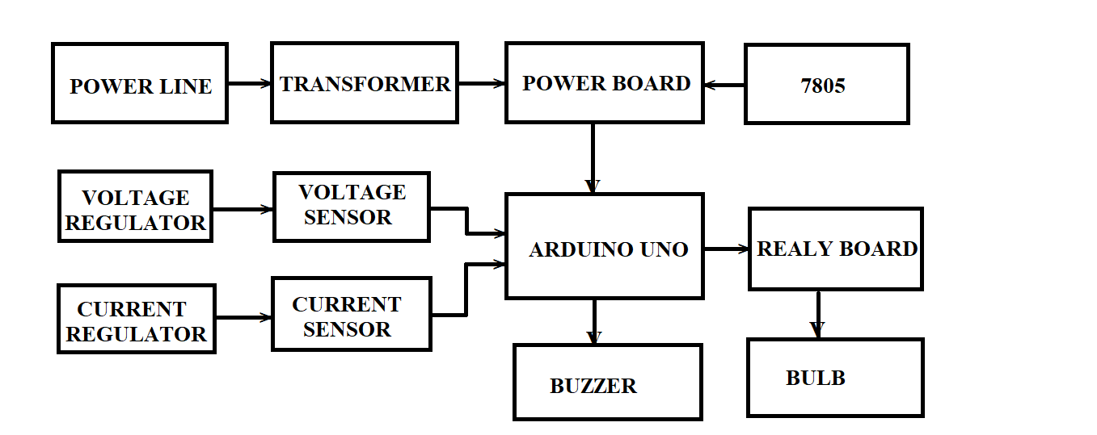
Block Diagram

Slide 8
SOFTWARE REQUIREMENTS:
Operating System : Windows 10
Platform : DOT NET TECHNOLOGY
Front End : ASP.Net 4.0
Back End : SQL SERVER 2014

Slide 9
HARDWARE REQUIREMENTS:
Keyboard
Mouse
Hard disk 500GB
Ram 4 Gb

Slide 10
CONCLUSION
In this paper, a great way of protecting loads from voltage fluctuations either under voltage or overvoltage has been practically implemented. It proves to be cheap, requires very less maintenance and fully automatic. The GSM modem SMS technology alerts the user so that operator can respond as soon as possible to save load and other important equipments from getting damaged. The objective of this paper is to access the load in safe condition even when the operator is far away from the load side. The possibilities are numerous and can be explored further. Further modifications can be done to improve it in a better way.

Slide 11
REFERENCE
[1] F. Shawki, M. El-Shahat Dessouki, A. I. Elbasiouny, A.N. Almazroui, F. M. R. Albeladi, “Microcontroller based smart home with security using GSM technology” in “Internatinoal Journal of Research in Engineering & Technology,” vol. 4, issue 6, June 2015.
[2] “IEEE Recommended Practice for Monitoring Electric Power Quality,” IEEE Std. 1159-1995, June 1995.
[3] Manish Paul, Antara Chaudhury, Snigdha Saikia,”Hardware implementation of Overvoltage and Undervoltage Protection,” “International journal of innovative research in Electrical, Electronics, Instrumentation and Control Engineering,” Vol. 3, issue 6, June 2015.
[4] Electricity World. Avalable at: http://electricity2all.blogspot.com/2013/05/over-voltageand-voltage-swell.html
[5] Manish Paul, Antara Chaudhury, Snigdha Saikia,”Hardware implementation of Overvoltage and Undervoltage Protection,” “International journal of innovative research in Electrical, Electronics, Instrumentation and Control Engineering,” Vol. 3, issue 6, June 2015.

Slide 12
[6] Over & Under Voltage protection circuit . Available: https://www.elprocus.com/under-and over voltage protection-circuit/
[7] Interfacing 16*2 LCD With Arduino. Available: https://circuitdigest.com/microcontrollerprojects/ardu ino-lcdinterfacing-tutorial
[8] Over & Under Voltage protection circuit. Available: https://www.eleccircuit.com/over-voltage-and-lowvoltage-protectioncircuit/
[9] Over/Under Voltage Protection of Electrical Appliances. Available: https://electronicsforu.com/ele ctronicsprojects/under-over-voltage-protection.
[10] Yaleinkaya, M. H. J. Bollen and P.A. Crossley (1999), “Characterization of voltage sags in industrial distribution systems”, IEEE transactions on industry applications, vol.34, no. 4, pp. 682-688, July/August.

