Slide 1
Monitoring & Analysis Of Hazardous Parameters In Coal Mines Using Smart Helmet System

Slide 2
Abstract
Coal mining has always been a necessary evil. We need the coal for various operations, especially electrical power generation. However mining the coal has proven to be very dangerous and has caused many accidental deaths over the years. Keeping this in mind we have designed an intelligent system which can be used on helmets of these underground coal miners and can monitor/analyze a few major hazardous parameters found in these mines in real time. This includes humidity, temperature and gas contents such as methane and sulfur dioxide. These parameters, if above a certain level, can cause choking, suffocation, flooding, gas poisoning, roof collapse or explosions. Our system can detect these parameters, analyze them in real time and alert the ground control and the worker about the situation using a buzzer. Compact sensors and radio frequency modules are used to ensure practicality.

Slide 3
Existing System
This present device A fee of effective Bluetooth based wireless mine supervising device with Bluetooth is offered right here.
We layout a clever helmet, which allow the helmet as a mobile sensor node of Bluetooth wi-fi sensor networks, accumulating parameters the temperature, humidity and illumination stage of underground environment and will alert the valuable management unit in case of extraordinary situation.
We additionally design a voice transmission system, based totally at the equal low-price wireless networks.
With environmental monitoring, the cool miners can talk with manage centres or with different miners through wireless Bluetooth verbal exchange.

Slide 4
Disadvantage of Existing System
The problem addressed is the improvement of a mining helmet in order to ensure more equipment, being aware of one’s surroundings can sometimes be challenging.

Slide 5
PROPOSED SYSTEM :
This technique allows the quick range of an person node to be accelerated and improved, covering a far larger region.
In mining industry worker safety is very important issue. Every year, thousands of miners die in accidents and many more get injured, especially in the processes of the coal mining and hard rock mining.
The proper supervision for worker wear the protective element is very important factor for consideration.
In coal mines carbon monoxide, methane, LPG gases existing and they are very harmful for human body. The proper supervision and proper communication is very important requirement of mining industries.

Slide 6
ADVANTAGE
The Smart Helmet prototype worked efficiently when connected to a power bank, and provided correct readings over long durations of time.
Based on the application use case, the same data could be used for training as well as predicting the output.

Slide 7
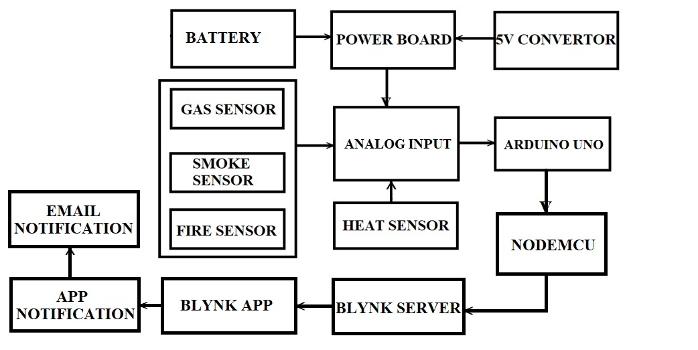
Block Diagram

Slide 8
SOFTWARE REQUIREMENTS:
Operating System : Windows 10
Platform : DOT NET TECHNOLOGY
Front End : ASP.Net 4.0
Back End : SQL SERVER 2014

Slide 9
HARDWARE REQUIREMENTS:
Keyboard
Mouse
Hard disk 500GB
Ram 4 Gb

Slide 10
CONCLUSION
The proposed system has been successfully tested and has shown quick response to the hazardous parameters variation. We can conclude that this system will greatly help in reducing future casualties caused by sudden changes in these parameters and help make the work safer. The compact and efficient design ensures the practical implementation of the system. The system was tested for following predetermined range. However, depending on the environment of various coal mines, it can be changed according to the requirements using easy software editing.

Slide 11
REFERENCE
[1] Pranoti Anandrao Salankar, Sheeja S. Suresh, “Zigbee Based Underground Mines Parameter Monitoring System for Rescue and Protection” . IOSR Journal of VLSI and Signal Processing (IOSR-JVSP) Volume 4, Issue 4, Ver. I (JulAug. 2014), PP 32-36 eISSN: 2319 – 4200, pISSN No. : 2319 – 4197
[2] CHENG Qiang, sun ji_ping, zhangzhe, zhang IEEE paper on “Zigbee based intelligent helmet for coal miners”, February [2009] CSIE2009.653
[3] Tanmoymaity, parthasarathidas, mithumukherjee, “Rescue and protection system for underground mine workers based on zigbee” vol.2 no.2 [June_December,2012] int.jr.of advanced computer eng. & architecture.
[4] A. Geetha, “Intelligent Helmet for Coal Miners with Voice over Zigbee and Environmental Monitoring” MiddleEast Journal of Scientific Research 20 (7): 825-827, 2014 ISSN 1990- 9233- 2014
[5] Shirish Gaidhane1, Mahendra Dhame, Rizwana Qureshi, “Smart Helmet for Coal Miners using Zigbee Technology” Imperial Journal of Interdisciplinary Research (IJIR) Vol-2, Issue6, 2016

Slide 12
[6] S. Wei, L. Li-li, “Multi-parameter Monitoring System for Coal Mine based on Wireless Sensor Network Technology”, Proc. International IEEE Conference on Industrial Mechatronics and Automation, pp 225-27, 2009.
[7] S. Jin-ling, G. Heng-wei, S. Yu-jun, “Research on Transceiver System of WSN Based on VMIMO Underground Coal Mines”, Proc. International Conference on Communications and Mobile Computing, pp 374-378, 2010.
[8] X. Ma, Y. Miao, Z. Zhao, H. Zhang, J. Zhang, “A novel approach to Coal and Gas Outburst Prediction Based on Multi-sensor Information Fusion”, Proc. IEEE international conference on automation and logistics, pp 1613-18, China 2008.
[9] Tanmoy Maity, Partha Sarathi Das, Mithu Mukherjee, "A Wireless Surveillance and Safety System for Mine Workers based on Zigbee", First International Conference on Recent Advances in Information Technology, RAIT, 2012.
[10]G. Ahalya et al “Development Of Coal Mine Safety System Using Wireless Sensor Networks”[IJESAT] [International Journal of Engineering Science & Advanced Technology] Volume-3, Issue-3, 74-78 ISSN: 2250-3676

