Slide 1
Fuzzy logic control for solar
PV fed modular multilevel inverter towards marine water pumping application

Slide 2
Abstract
This paper presents the design and implementation of Modular Multilevel Inverter (MMI) to control the Induction Motor (IM) drive using intelligent techniques towards marine water pumping applications.
The proposed inverter is of eleven levels and has the ability to control the speed of an IM drive which is fed from solar photovoltaics.
It is estimated that the energy consumed by pumping schemes in an onboard ship is nearly 50% of the total energy.

Slide 3
Considering this fact, this paper investigates and validates the proposed control design with reduced complexity intended for marine water pumping system employing an induction motor (IM) drive and MMI.
The analysis of inverter is carried out with Proportional-Integral (PI) and Fuzzy Logic (FL) based controllers for improving the performance.
A comparative analysis has been made with respect to better robustness in terms of peak overshoot, settling time of the controller and Total Harmonic Distortion (THD) of the inverter.

Slide 4
Simulations are undertaken in MATLAB/Simulink and the detailed experimental implementation is conducted with Field Programmable Gate Array (FPGA).
The results thus obtained are utilized to analyze the controller performance, improved inverter output voltage, reliable induction motor speed control and power quality improvement by reduction of harmonics.
The novelty of the proposed control scheme is the design and integration of MMI, IM drive and intelligent controller exclusively for marine water pumping applications.

Slide 5
Existing System
They designed a hybrid system with one inverter and the performance was compared with the existing methods.
It has very effective techniques for complicated and imprecise processes where there does not exist any mathematical model.
The proposed method consists of substituting the hysteresis controllers and the look-up table by fuzzy logic switching vector selection scheme.
The main advantages of Fuzzy logic controller are adapted to the nonlinear control command and not based on the model of the induction machine.

Slide 6
Disadvantage of Existing System
The two critical issues occurred in power converter are voltage digression and frequency deviations which leads to harmonics distortions.
The main impact of the proposed control scheme is to reduce the steady-state error of the induction motor speed control and deteriorate harmonics at the output voltage of modular multilevel inverter.
To overcome the drawback of DC motor, induction motor is highly preferred in the ship.

Slide 7
PROPOSED SYSTEM :
In this way, the proposed grid connected PV power conversion system generates seven-level output voltage and a sinusoidal output current which is inphase with the utility voltage and is fed into the grid.
This paper proposes a solar power generation system to convert the dc energy generated by a solar cell array into ac energy that is fed into the utility.
The proposed solar power generation system is composed of a dc–dc power converter and a seven-level inverter.

Slide 8
ADVANTAGE
A solar fed eleven level inverter with intelligent control techniques aimed to attain improved performance parameters for marine applications.
The performance of the multilevel inverter fed IM drive is examined with PI and FLC based controllers.
The solar photovoltaic’s based energy system is implemented in ship which delivers the required power incorporating a novel technique to decrease emissions to augment the renewable energy efficiency and also to perk up the stability of power.

Slide 9
TITLE | AUTHOR | DESCRIPTION
Modeling and stability analysis of hybrid PV/diesel/ESS in ship power system | H. Lan, Y. Bai, S. Wen, D. C. Yu, Y.-Y. Hong, J. Dai, and P. Cheng, | In this paper, a high-speed flywheel energy storage system (FESS) is modeled to smooth the PV power fluctuations and improve the power quality on a large oil tanker which contains a PV generation system, a diesel generator, a FESS, and various types of ship loads.
Single stage solar PV fed brushless DC motor driven water pump | R. Kumar and B. Singh, | A simple control technique capable of operating the solar PV array at its peak power using a common voltage source inverter is proposed for BLDC motor control.

Slide 10
TITLE | AUTHOR | DESCRIPTION
Review of ship microgrids: System architectures, storage technologies and power quality aspects | S. G. Jayasinghe, L. Meegahapola, N. Fernando, Z. Jin, and J. M. Guerrero, | Passive filtering is the commonly used technology for reducing harmonic distortions, which requires bulky capacitors and inductors.
Single-stage PV array fed speed sensorless vector control of induction motor drive for water pumping | S. Shukla and B. Singh, | The proposed system includes solar photovoltaic (PV) array, a three-phase voltage source inverter, and a motor-pump assembly.

Slide 11
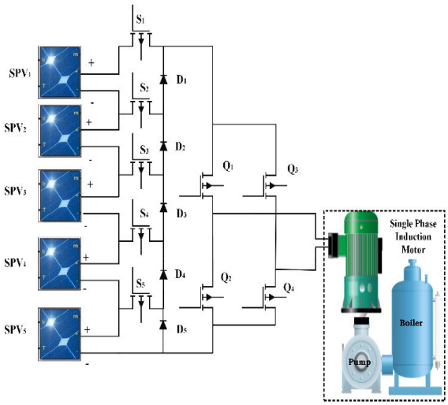
Block Diagram

Slide 12
SOFTWARE REQUIREMENTS:
Language: Java J2SE and JDK DE, Eclipse MARS.1
Operating System: Windows 10
Database required: MySQL
Apache Tomcat Server
Arduino 16.9

Slide 13
HARDWARE REQUIREMENTS:
Node MCU
4 GB RAM
500 GB Hard disk
GPS receiver
Jumper Wires
GPS antenna
Accelerometer

Slide 14
CONCLUSION
The relevance of the proposed work is to provide high quality of input power to the inverter drive pertaining to marine water pumping applications.
A solar PV fed MMI for speed control of induction motor drive has been examined at steady state and dynamic behaviors to investigate its suitability for water pumping system intended for the marine applications.
The solar PV array is connected with the proposed inverter when is then fed to an induction motor. The motor speed is sensed and feedback is given to the controller for generating optimal PWM pulses for the inverter switches.

Slide 15
The motor is started gradually and the speed is increased to achieve reference speed with aid of PI and FL based controllers.
The performance of PI and FL controllers for a feasible operation is verified and results are compared in both simulation and experiment. The results ensure that the FL based controller provides fast settling time and reduced harmonics when compared with the PI controller.
The main impact of the proposed control scheme is to reduce the steady-state error of the induction motor speed control and deteriorate harmonics at the output voltage of modular multilevel inverter.

Slide 16
REFERENCE
[1] H. Lan, Y. Bai, S. Wen, D. C. Yu, Y.-Y. Hong, J. Dai, and P. Cheng, ‘‘Modeling and stability analysis of hybrid PV/diesel/ESS in ship power system,’’ Inventions, vol. 1, no. 5, pp. 1–16, 2016.
[2] S. G. Jayasinghe, L. Meegahapola, N. Fernando, Z. Jin, and J. M. Guerrero, ‘‘Review of ship microgrids: System architectures, storage technologies and power quality aspects,’’ Inventions, vol. 2, no. 4, pp. 1–19, 2017.
[3] R. Kumar and B. Singh, ‘‘Single stage solar PV fed brushless DC motor driven water pump,’’ IEEE J. Emerg. Sel. Topics Power Electron., vol. 5, no. 3, pp. 1337–1385, Sep. 2017.

Slide 17
[4] S. Shukla and B. Singh, ‘‘Single-stage PV array fed speed sensorless vector control of induction motor drive for water pumping,’’ IEEE Trans. Ind. Appl., vol. 54, no. 4, pp. 3575–3585, Jul./Aug. 2018.
[5] C.-L. Su, W.-L. Chung, and K.-T. Yu, ‘‘An energy-savings evaluation method for variable-frequency-drive applications on ship central cooling systems,’’ IEEE Trans. Ind. Appl., vol. 50, no. 2, pp. 1286–1297, Mar./Apr. 2014.
[6] H.-L. Tsai, ‘‘Design and evaluation of a photovoltaic/thermal-assisted heat pump water heating system,’’ Energies, vol. 7, no. 5, pp. 3319–3338, May 2014.

Slide 18
[7] A. Dolatabadi and B. Mohammadi-Ivatloo, ‘‘Stochastic risk-constrained optimal sizing for hybrid power system of merchant marine vessels,’’ IEEE Trans. Ind. Informat., vol. 14, no. 12, pp. 5509–5517, Dec. 2018.
[8] B. Singh, U. Sharma, and S. Kumar, ‘‘Standalone photovoltaic water pumping system using induction motor drive with reduced sensors,’’ IEEE Trans. Ind. Appl., vol. 54, no. 4, pp. 3645–3655, Jul./Aug. 2018.

Slide 19
[9] M. G. Yu, Y. Nam, Y. Yu, and J. Seo, ‘‘Study on the system design of a solar assisted ground heat pump system using dynamic simulation,’’ Energies, vol. 9, no. 4, pp. 1–17, 2016.
[10] S. V. Giannoutsos and S. N. Manias, ‘‘A systematic power-quality assessment and harmonic filter design methodology for variable-frequency drive application in marine vessels,’’ IEEE Trans. Ind. Appl., vol. 51, no. 2, pp. 1909–1919, Mar. 2015,

