Slide 1
DESIGN AND FABRICATION OF FOUR WAY HACKSAW MACHINE

Slide 2
Abstract
Objective of the project is to fabricate a motorized high speed 4-way hacksaw machine and to automate and to modify the conventional power hacksaw machine in order to achieve high productivity of work-pieces than the power hacksaw machine using cam mechanism. The operator need not measure the length of the work-piece that is to be cut and to load and unload the work-piece from the vice each time after a piece has been cut. This machine is built with the 4 hacksaw machines such that tall the machines are operated simultaneously with the help of a motor and cam mechanism.

Slide 3
Existing System
The problem of cutting-off material to size is common to practically every industry.
Preliminary investigations by the author have revealed that existing blade testing methods were not independent of the machine characteristics, which could contribute to one of the reasons for the inconsistency in the test data.
Whilst these alternative processes are frequently, quicker than power hacksawing, their costs are in many applications higher.
Whilst the impact of these alternative processes on the application of power hacksawing cannot be denied there remains a significant field of application for power hacksawing which is likely to remain unchallenged.
A factor of prime interest to manufacturers is that, if the costs of power hacksawing can be reduced by developing the blade and the saw machine, the potential field of application will be widened.

Slide 4
Disadvantage of Existing System
More number of moving parts.
Must be handled with care.
The loading and unloading of the work pieces must be done manually.

Slide 5
PROPOSED SYSTEM :
This project consists of single phase vertical electric motor rigidly placed at the centre of metallic foundation provided. The shaft of gearbox rotates at 80- 90 rpm with the motor power 1 HP.
The circular disc is mounted on the shaft of the motor with the help of key and key slot arrangement.
The eccentric point on the plane of the disc is provided such that the desired cutting stroke is achieved. One end of each connecting rod is pivoted at this eccentric point by the use of the suitable bearing. Another end of each rod is connected to the hacksaw blade fame with the help of a universal joint to get vertical and horizontal Degree of Freedom of rotation for the proper cutting operation.
The hacksaw frame slides on the guideways provided. When the motor is ON and disc starts rotating, due to the reciprocating motion of hacksaw frame the metal rod is cut which is firmly fixed in a vice.

Slide 6
ADVANTAGE
Simple in construction.
Easy to fabricate.
The components used for the fabrication of the are easily available.
Repairing and replacing is not a difficult task.
Multiple work pieces can be cut simultaneously.
The time taken for cutting operation is less.
Increased productivity.

Slide 7
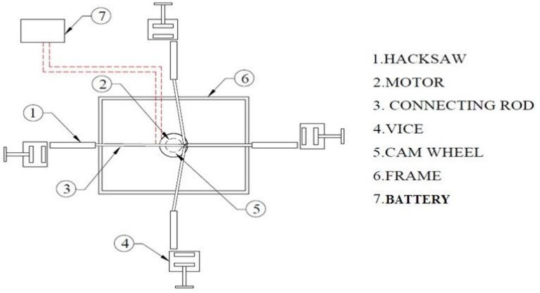
Block Diagram

Slide 8
SOFTWARE REQUIREMENTS:
Operating System : Windows 10
Platform : DOT NET TECHNOLOGY
Front End : ASP.Net 4.0
Back End : SQL SERVER 2014

Slide 9
HARDWARE REQUIREMENTS:
Keyboard
Mouse
Hard disk 500GB
Ram 4 Gb

Slide 10
CONCLUSION
A strong multidiscipline team with a good engineering base is necessary for the Development and refinement of advanced computer programming, editing techniques, diagnostic Software, algorithms for the dynamic exchange of informational different levels of hierarchy. This project work has provided us an excellent opportunity and experience, to use our limited knowledge. We gained a lot of practical knowledge regarding, planning, purchasing, assembling and machining while doing this project work. We are proud that we have completed the work with the limited time successfully. The “FABRICATION OF FOUR WAY HACKSAW MACHINE” is working with satisfactory conditions. We are able to understand the difficulties in maintaining the tolerances and also quality. We have done to our ability and skill making maximum use of available facilities. In conclusion remarks of our project work. Thus we have developed a “FOUR WAY HACK SAW MACHINE”. By using more techniques, they can be modified and developed according to the applications.

Slide 11
REFERENCE
[1] Prof. Kshirsagar Prashant R en all, “Theoretical Analysis of Multi-Way Power Hacksaw Machine,” International Journal of Research in Advent Technology, Vol.3, No.4, April 2015 E-ISSN: 2321-9637
[2] Rishi Anand,Khomesh,Shrawan Kumar,Prof. Alok Verma,” Theoretical Analysis Of Four Way Hacksaw Blade Machine”, International Journal of Advance Research and Innovative Ideas in Education, ISSN(O)-2395-4396, Vol2 ,Issue-2 ,April2016
[3] Prof. Nitinchandra R. Patel, Mohammad A. Vasanwala, Balkrushna B.Jani, Miteshkumar D. Rathwa, Ravi A. Thakkar,” Material Selection and Testing of Hacksaw Blade Based on Mechanical properties”, International Journal of Innovative Research in Science, Engineering and Technology, ISSN: 2319-8753, volume 2, Issue6, June 2013.
[4] D.V.Sabarinanda, V.Siddhartha, B. Sushil Krishnana, T.Mohanraj , “Design and Fabrication of Automated Hacksaw Machine”, International Journal of Innovative Research in Science, Engineering and Tech nology, ISSN (Online):2319-8753, volume 3, April 2014.

Slide 12
[5] Rakesh Ambade,Amit Sartabe,Meghraj Arekar,Vaibhav Khachane,Prajakta Gawali ,” Design & Fabrication of Human Powered Multi-Purpose Machine”, International Journal of Advanced Technology in Engine ering and Science,ISSN(Online):2348-7550,Volume No 03,Special Issue No.01,April 2015.
[6] Kshirsagar Prashant R, Rathod Nayan,Rahate Prashant P,Halaye Prashant P ,”Theoretical Analysis of Multi-way Power Hacksaw Machine”,International Journal of Research in Advent Technology,E-ISSN:2321- 9637,Vol.3,No.4,April2015.
[7] Muhammad Ali Mazidi, Janice Gillispie Mazidi, and Rolin D. McKinlay ‘The 8051 Micro Controller and Embedded Systems’, 2nd Edition, Pearson Education Inc. 2008
[8]http://www.ssiproject.com/mechanical_project.php?cool=160/mechanical/production projects

