Slide 1
Battery Charging and Discharge Control of a Hybrid Energy System using Microcontroller

Slide 2
ABSTRACT
This study aims to control charging and discharging the battery for hybrid energy systems.
The control system works by selecting the right energy source to supply voltage to the load. And also this control system can regulate charging and discharging the battery automatically.
The voltage source consists of two energy, namely from the battery and DC source.
The control system that has been designed has the ability to choose the right DC source when the battery capacity is less than 80%.
This system also has a good ability to choose a battery source when the battery reaches 100% capacity and the DC source has a voltage drop of more than 20%.
This control system is equipped with excessive electric current protection so that the security level is high.

Slide 3
OBJECTIVE
To improve the energy utilization rate of solar and wind energy and hence decrease of dependency on power grid
Reduction of uncertainty about energy produced by renewable sources
Improve the battery operations by implementing efficient battery management system.
The objective is to utilize as much energy as possible from various renewable sources, including solar and wind.
The objective of the proposed project is to increase the utility factor of the renewable sources such as PV and Wind turbines attached to the system.
Development of new real time Energy Management System (EMS) to improve energy utilization rate of solar and wind energy.
Design and implementation of cyber-physical controller based on improved minority game algorithm for real –time EMS of micro grid.
Design and implementation of efficient battery management system so as to keep the batteries within safe limits during charging and discharging and also to prolong the life of batteries.

Slide 4
SCOPE OF THE PROJECT
The renewable technologies have a vast scope in terms of research and development. However there are certain obstacles in terms of their efficiency and optimal use.
The renewable energy sources, such as solar PV and FCs, need modern technology to harness more amount of useful power from them. The less efficiency of solar is major disadvantage in encouraging its use.
The manufacturing cost of renewable energy sources need to be reduced because the high money cost leads to an increased payback time.
It should be ensured that there should be least amount of power loss in the power electronic devices.
The storage technologies need to increase their lifecycle through modern technologies.
These stand alone systems are less preferable to load fluctuations. Large variation in load might even lead to entire system collapse.

Slide 5
LITERATURE REVIEW 1 AUTHOR :Răzvan Florin Pantelimon, Maricel Adam, MihaiAndruşcă, CătălinPancu TITLE:Aspects Regarding Solar Battery Charge Controllers” | Energy produced by photovoltaic technology is clean and renewable. The actual problem is that currently the price of photovoltaic systems is relatively high. Research in this field is now focused on improving the efficiency of electricity production using photovoltaic technology. | RESULT The MPPT charge controller was tested for both algorithms for five different solar irradiation levels. with perturb and observe method the charge controller was closer to the output of the solar array.

Slide 6
LITERATURE REVIEW 2 AUTHOR : Aimie Nazmin Azmi, Norhafiz Salim, Aziah Khamis TITLE :Analysis of an energy storage sizing for grid-connected photovoltaic system | This paper present on the analysis of an energy storage sizing for a small grid-connected PV system. This project is to study the proper sizing of energy storage (battery) in a grid-connected PV system for consumers whom purchase and sell electricity from and to the utility grid. The goal is to minimize the total cost of the operation for a consumer with a PV system with a battery storage system. | RESULT These results represented that, the total annualised minimum operating cost tremendously depends on the size of the battery and the investment cost of the energy.

Slide 7
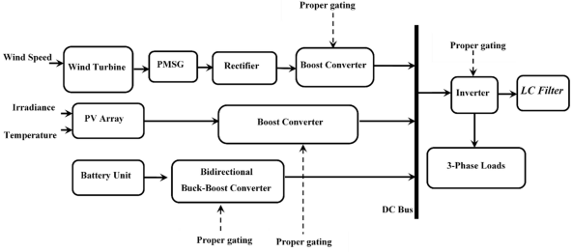
EXISTING BLOCK DIAGRAM

Slide 8
TRADITIONAL CHARGING CONTROL METHODS
The main goal of charging control methods is to increase the SOC.
However, specifications such as battery performance, charging time, battery protection from overcharging or over discharging, and increase of life are very important too.
As the battery charging process is nonlinear, different methods have been developed to effectively control battery charging.
Control methods commonly used in battery charging are: constant current (CC), constant voltage (CV), two-step charging (i.e., CC–CV), pulse charging (PC), reflex charging or negative pulse charging (NPC), trickle charge or taper-current (TC), and float charge (FC).
The voltage value will depend on the charging current, and one advantage is easy calculation of the charging time and the SOC.

Slide 9
SOLAR BATTERY CHARGERS
All solar battery charge controllers, no matter of what technology they use, have the same key function: they regulates the flow of energy from the solar modules to the battery bank.
Charge controllers prevent batteries from overcharging reducing the risk of damage to the battery.
The charge controller should monitor the charging state of the batteries and disconnect the photovoltaic modules when the batteries are fully charged. Also the charge controller prevents the over voltages, which can affect the battery performance and severely shorten its life.
Besides the main function, the charge controller can have also complementary functions, such as low voltage disconnect, data logging, temperature compensation function for safe and complete charging, parallel setup, excess energy management, adjustable battery type.
Charge regulation technology had evolved a lot in the last decades.

Slide 10
Shunt type charge controllers are the first type of chargers developed and are the simplest ones still on the market today.
They short circuit the energy from the solar panel when the battery reaches the full charge.
In general, shunt type charge controllers are low cost and reliable, with simple design and suitable for small off grid photovoltaic systems.
Shunt type charge controllers can only be used on photovoltaic systems because of the photovoltaic panels property to not be affected if they are short circuited.
Photovoltaic devices are current limited by their nature, so we can be short circuit them with no risk.
Shunt interrupting charge controllers can be used on all battery types, but the way they regulates the power to the batteries may not be always optimal for all battery types.
The manufactures of gelled and AGM (Absorbed Glass Mat) batteries recommend the constant voltage, PWM or linear charge controllers.

Slide 11
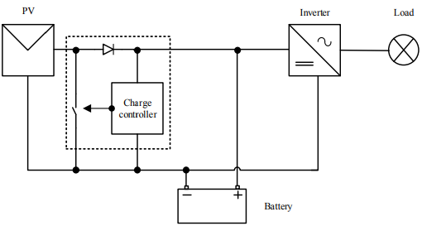
Shunt type charge controllers

Slide 12
MAXIMUM POWER POINT TRACKING SOLAR BATTERY CHARGERS
The electric power generated by PV systems changes continuously with weather conditions which varies over the day and also with seasons.
Generally, the voltage-current curve for a PV array is not linear so a specific point on the curve namely maximum power point needs to be tracked in order to operate the charging of the batteries at maximum efficiency and produces maximum output power.
At a given solar irradiation level and solar panel temperature, the output of the module is at its maximum at a particular operation point called the maximum power point.
This operation point varies over a wide range. Instantaneous shading conditions and ageing of photovoltaic cells also affect this maximum power operating point.
Because the MPPT charge controller always operates at the maximum power point of the solar panel, over the life time of the photovoltaic system, more energy is harvested.

Slide 13
ADVANTAGES
The main issue is to avoid grid interruptions when several EVs are simultaneously plugged into the system during very short period of time can be solved by implementing this technique.
It is envisaged that more sophisticated energy management system is required to manage the charging stations for large number of EVs. So by implementing this technique it is possible to overcome this problem up to some extent.
The proposed technique optimizes the EV charging based on the availability of the PV power, real time electricity demand and tariff structures.
This system leads to the safe charging of the battery that needs to be maintained to ensure long life of the EV batteries.
Maintenance cost will be negligible when compared to IC Engine vehicles.

Slide 14
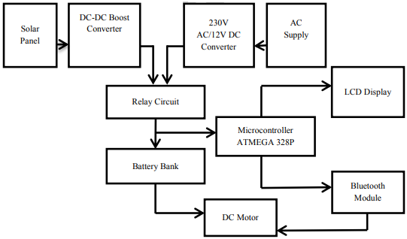
PROPOSED BLOCK DIAGRAM

Slide 15
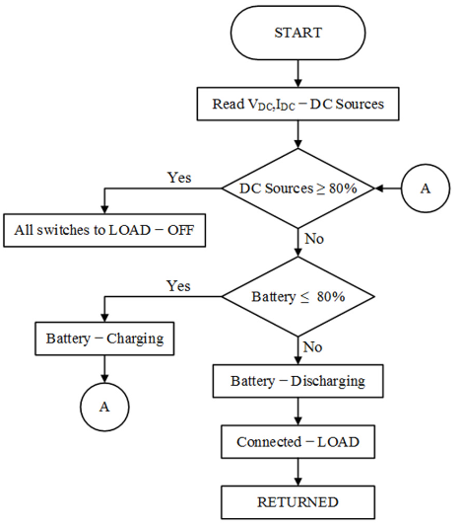
BATTERY CHARGING/DISCHARGING MANAGEMENT
A microcontroller was used in to control the hybrid energy system and the charge -discharge of the battery storages. The architecture of the developed system and explains the system operation.
The DC sources are used to charge the battery storages if their capacity is less than 80%, otherwise, the battery storage will be connected to the LOAD for discharging.

Slide 16
In a similar research,an intelligent algorithm based on ANFIS was developed to simultaneously perform two different tasks: to protect the connected battery against overcharging and deep discharging.
The ANFIS algorithm that has been developed in this research measures the Vpv, Ipv, SoC of the battery storage and Volt Direct Current (Vdc).
This measurement is vital to find the Maximum Power Point (MPP) from the resources and control the battery storage charging - discharging.
The algorithm process that controls the battery storage charging - discharging based on the power condition (Pc), battery SoC minimum (SoCmin) and battery SoC maximum (SoCmax).
When the measured Vpv and Ipv input from the photovoltaic panel is equal to the maximum, the photovoltaic power is compared with the initial Pc before starting the charging process.
Based on the calculation, when the photovoltaic panel power (Ppv) is equal to maximum photovoltaic power (Pmax), then the Ppv is equal to Pc. Otherwise, the ANFIS algorithm keeps searching for Pmax

Slide 17
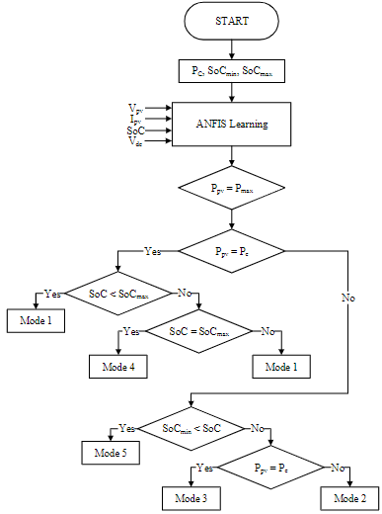
ANFIS algorithm – battery charging-discharging based on SoC

Slide 18
DISADVANTAGES
Hybrid transportation systems, unlike those in pure electric vehicles, cannot effectively utilize regenerative energy during braking.
Low power density and fast degradation of the cells in the battery under high charging currents
Even when using the battery management systems that directly control the charging and discharging rate, cell’s state of charge (SOC), voltage and temperature, the lifetime of the common electric vehicle batteries does not exceed 4–5 years.
The electrical vehicles are less economical as the battery is the most expensive part of electric vehicle.

Slide 19
REFERENCE
[1] Răzvan Florin Pantelimon, Maricel Adam, MihaiAndruşcă, CătălinPancu, “Aspects Regarding Solar Battery Charge Controllers” The 8th International Symposium On Advanced Topics In Electrical Engineering May, 2013.
[2] Aimie Nazmin Azmi, Norhafiz Salim, Aziah Khamis, ”Analysis of an energy storage sizing for grid-connected photovoltaic system,” Indonesian Journal of Electrical Engineering and Computer Science (IJEECS), vol. 16, no. 1, pp. 17~24, October 2019
[3] Jawahar M, Jayasankar V, Karthik Kumar K, Edward Rajan S,”Efficiency enhancement of solar PV powered micro-integrated high frequency isolated vehicle battery charging converter,” International Journal of Power Electronics and Drive System (IJPEDS), vol. 10, no. 2, June 2019
[4] D Sattianadan, K Saravanan, S. Murugan, N. Hari, P. Venkadesh, ”Implementation of quasi-z source inverter for grid connected PV based charging station of electric vehicle,” International Journal of Power Electronics and Drive System (IJPEDS), vol. 10, no. 1, March 2019
[5] M. Reyasudin Basir Khan, Jagadeesh Pasupuleti, Jabbar Al-Fattah, Mehrdad Tahmasebi, ”Energy management system for PV-Battery microgrid based on model predictive control,”Indonesian Journal of Electrical Engineering and Computer Science (IJEECS), vol. 15, no. 1, pp. 20~25, July 2019

