Slide 1
A HIGH-EFFICIENCY SEPIC BASED DC-DC CONVERTER DESIGN BY ROBUST PID CONTROLLER

Slide 2
ABSTRACT
This work addresses the problem of instability occurring in the voltage control mode of a non-minimum phase Quasi Resonant High Gain, High-Efficiency Single Ended Primary Inductor Converter -based DC-DC converter with continuous input current.
To solve this instability issue in the presence of uncertainties and the external disturbances, quantitative feedback theory (QFT) is adapted to systematically design a robust proportional integral derivative (PID) controller, which is realized using only sensed output voltage as feedback.
The advantages of the proposed PID design using the QFT are: (i) it eliminates the burden of tedious and ad-hoc tuning of PID gains using the conventional PID design approaches, (ii) current measurement is not required, (iii) disturbance dynamics (input voltage and load current variations) are included in the design stage itself, which further enhances the disturbance rejection performance of the output voltage.
Due to soft-switching operation in all switching components, the power dissipations in the converter are significantly alleviated.
Thus, the proposed SEPIC can provide high voltage gain whilst achieving a high efficiency.

Slide 3
OBJECTIVE
The conventional step-up DC-DC converters such as boost and SEPIC converters with a simple structure are theoretically able to provide a high voltage gain for the RES.
For this purpose, to increase the voltage gain ratio of the conventional DC-DC converters, some effective voltage boosting strategies such as Voltage Lift (VL), Voltage Multipliers (VM), Switched-Capacitors/Inductors (SC/SI), and also Cascading Techniques (CT) are applied .
Although these modified converters can achieve a high voltage gain, using a large number of passive components and operating in hard-switching condition, which limits the efficiency severely
The disturbance rejection capability of DC-DC converters can be improved by considering the disturbance dynamics in the controller design stage itself

Slide 4
SCOPE OF THE PROJECT
In this work, a computationally simple robust PID controller is designed using QFT to control the output voltage of a sepic DC-DC boost converter under voltage mode control.
The controller design for the disturbance rejection is formulated by including the disturbance dynamics of boost type sepic dc-dc converter in the design stage itself.
The proposed robust PID controller exhibits improvement in the output voltage response in the presence of uncertainty and external disturbances.

Slide 5
LITERATURE REVIEW 1 AUTHOR :N. Molavi, E. Adib, and H. Farzanehfard. TITLE : Soft-switched non-isolated high step-up DC–DC converter with reduced voltage stress. | This essay presents a non-isolated high gain boost soft switching DC to DC topology with persistent input and output power, light input current ripple and just an active switch with reduced voltage stress. In this low cost proposed converter the reverse recovery matter of the diodes is reduced via the leakage inductance of the coupled inductor. | RESULT To show the privilege of this converter, the main specifications of the proposed topology have been checked with other previous high-gain (HG) converters.

Slide 6
LITERATURE REVIEW 2 AUTHOR : H. Trazamni, E. Babaei, and M. Sabahi. TITLE : Full soft-switching high step-up DC–DC converter based on active resonant cell. | In this paper, a new full soft switching high step-up DC–DC boost converter is proposed. To achieve high voltage gain, a N-level voltage multiplier cell (VMC), and to achieve soft switching, a simple auxiliary resonant cell is implemented on a conventional pulse width modulation boost converter. All semiconductor devices are switched under soft switching conditions, which decrease the switching losses significantly. | RESULT These degrees of freedom lead the converter to operate in a wide output voltage range and have maximum power point tracking implementation or output voltage regulation capabilities.

Slide 7
EXISTING BLOCK DIAGRAM
DC SOURCE
CONVENTIONAL DC-DC CONVERTER
LOAD
CONTROLLER

Slide 8
DC-DC BOOST CONVERTER:
The growing applications of DC-DC boost converters in continuous conduction mode (CCM) have become prevalent in automotive, battery charging applications and so on, whose performance highly depends on the deployed control scheme [1].
The main objective is to always provide constant output voltage across the load despite input voltage and load variations.
However, the control strategies for these converters are not robust against model uncertainties as well as the external disturbances.
Thus, the closed-loop operation requires a robust control, which not only rejects the disturbance but also handles variations in the system parameters satisfactorily. Current mode control (CMC) exhibit current loop instability for a duty ratio > 50% regardless of the DC-DC converter [2].
In voltage mode control (VMC), there is no duty ratio restriction.
However, VMC operation provides a sluggish dynamic response for boost converters due to the presence of a right half plane (RHP) zero, thereby restricting the closed-loop bandwidth [2].
Hence, operating the non-minimum phase (NMP) boost converter close to the performance limits set by RHP zero is a challenging control task under VMC operation.

Slide 9
OPERATION AND WORKING PRINCIPLE:
The inductor in a boost converter plays the important of stepping up the input voltage.
The crucial aspect which becomes responsible for activating the boost voltage from an inductor is due to its inherent property of resisting or opposing a suddenly induced current across it, and due to its response to this with a creation of magnetic field and subsequently destroying of the magnetic field. The destroying leads to the releasing of the stored energy.
This above process results in the storing of the current in the inductor and kicking back this stored current across the output in the form of back EMF.
A relay transistor driver circuit can be considered a great example of a boost converter circuit.
The flyback diode connected across the relay is introduced to short circuit the reverse back EMFs from the relay coil and to protect the transistor whenever it switches OFF.
If this diode is removed and a diode capacitor rectifier is connected across the transistor's collector/emitter, the boosted voltage from the relay coil can be collected across this capacitor.

Slide 10
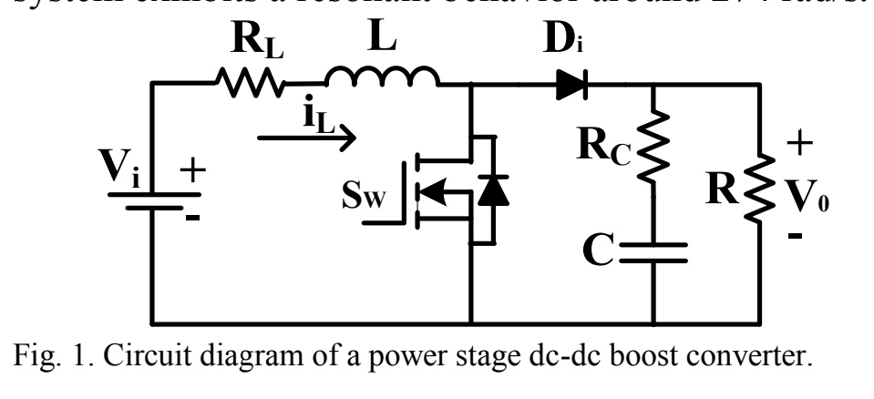

Slide 11
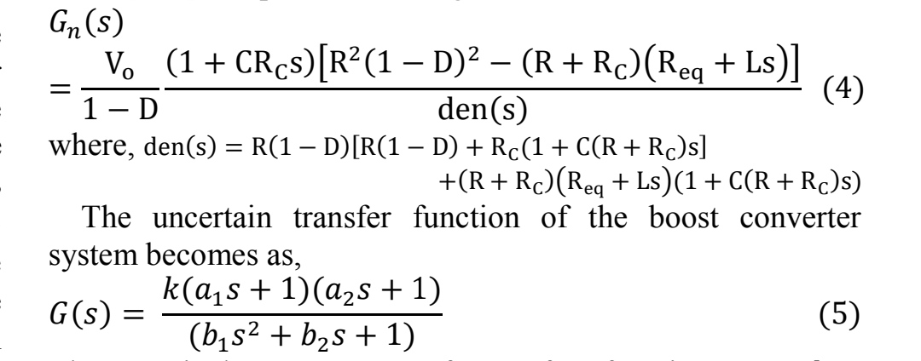
APPLICATION FOR NMP DC-DC BOOST CONVERTER
This section deals with the application of QFT design procedure outlined in section II to design a robust PID.controller for a boost converter.
The circuit diagram of a power stage boost circuit is shown in Fig. 1. The CCM operated DC-DC boost converter parameters are: L = 3.1 mH, RL = 0.3 Ω, and C =1930 μF, Rc=0.08 Ω.
The nominal load resistance is Rn= 90 Ω. Switching frequency is 25 kHz. The input voltage, Vi = 10 V and the output voltage, Vo = 15 V. From [2, 6], the plant model is given as:

Slide 12
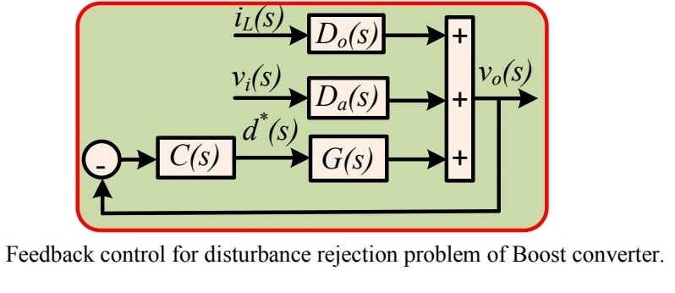
The nominal parameters of transfer function are,
𝑘 =22.0617, a1=1.5440 × 10−4,a2=−7.8287 × 10−5, 𝑏2 =1.8847 × 10−3, 𝑏1 = 1.3345 × 10−5, With an uncertainty of about 10% [20-23], k ∈ [19.85, 24.27], a1 ∈ [1.3896,1.6984] ×10−4, a2 ∈ [-7.04583,-8.61157] × 10−5,
b1 ∈ [1.20105, 1.46795] × 10−5, b2 ∈ [1.67,2.073] × 10−3.
The converter system exhibits a resonant behavior around 274 rad/s.
DESIGN SPECIFICATION OF DISTRIBUTION REJECTION PROBLEMS:

Slide 13
ADVANTAGEG OF TRANSFER FUNCTION OF BOOST CONVERTER:
➨It performs step-up or step-down of voltage using minimum components.
➨It offers lower operating duty cycle.
➨It offers high efficiency across wide input and output voltage ranges.
➨It is less expensive compare to most of the converters.

Slide 14
PROPOSED BLOCK DIAGRAM
DC SOURCE
SEPIC DC-DC CONVERTER
LOAD
QFT CONTROLLER

Slide 15
QRHGHE SEPIC based DC-DC CONVERTER:
The converter is composed of a CI with turns ratios of n, a single power switch (S), an input inductor (Lin), four diodes (D1-D3 and Do), and five capacitors (C1-C4 and Co).
Series interconnection between the input inductor and input DC voltage source leads to low input current ripple, which improves the RESs performance.
Moreover, the current waveform of the switch and the diode D3 change in sinusoidal form because of a QR operation among the leakage inductance of the CI, C1, C3, and C4.
This also helps to reduce the switch turn-off and the reverse recovery losses.
To simplify the converter analysis in Continues Conduction Mode (CCM) condition, the following assumptions are considered:
1) All switching components of the converter are ideal without parasitic components.
2) All capacitors are large enough so that their voltages are constant.
3) The CI is modeled by a parallel magnetizing inductor (LM) and a series leakage inductor (Lk) seen from the primary side with a turns ratio of n=n2/n1.
4) The input and magnetizing inductors are considered to be large enough so their current ripple is negligible.

Slide 16
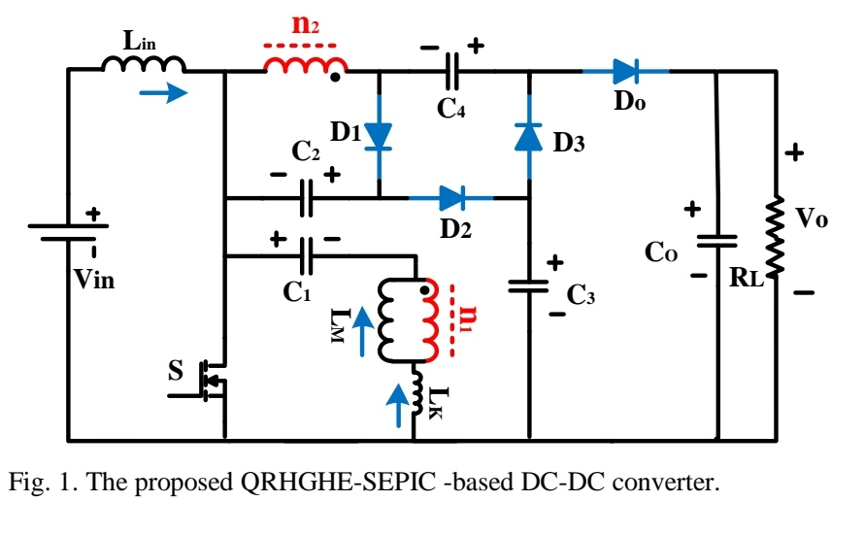

Slide 17
RELIABILITY AND EFFICIENCY
• The voltage drop and switching time of diode D1 is critical to a SEPIC's reliability and efficiency.
• The diode's switching time needs to be extremely fast in order to not generate high voltage spikes across the inductors, which could cause damage to components.
• Fast conventional diodes or Schottky diodes may be used.
• The resistances in the inductors and the capacitors can also have large effects on the converter efficiency and output ripple.
• Inductors with lower series resistance allow less energy to be dissipated as heat, resulting in greater efficiency (a larger portion of the input power being transferred to the load).
• Capacitors with low equivalent series resistance (ESR) should also be used for C1 and C2 to minimize ripple and prevent heat build-up, especially in C1 where the current is changing direction frequently

Slide 18
DISADVANTAGES
• Like the buck–boost converter, the SEPIC has a pulsating output current.
• The similar Ćuk converter does not have this disadvantage, but it can only have negative output
polarity, unless the isolated Ćuk converter is used.
• Since the SEPIC converter transfers all its energy via the series capacitor, a capacitor with high
capacitance and current handling capability is required.
• The fourth-order nature of the converter also makes the SEPIC converter difficult to control,
making it only suitable for very slow varying applications.
APPLICATIONS
• Battery-operated equipments and
• handheld devices.
• NiMH chargers.
• LED lighting applications

Slide 19
REFERENCE
1) R. Gules, W. M. Dos Santos, F. A. Dos Reis, E. F. R. Romaneli, and A. A. Badin, "A modified SEPIC converter with high static gain for renewable applications," IEEE Tran. on Power Electron., vol. 29, DOI 10/1109/TPEL.2013.2296053, no.11, pp. 5860-5871, Dec. 2014.
2) K. R. Babu, M. Ramteke, H. Suryawanshi, and K. R. Kothapalli, "High Gain Soft Switched DC-DC Converter for Renewable Applications," in TPEC, DOI: 10.1109/TPEC48276.2020.9042570, pp. 1-6, 2020.
3) Nag, Soumya Shubhra, and Santanu Mishra. "Coupled inductor based high gain current-fed DC-DC bridge converters." In 2015 IEEE Industry Applications Society Annual Meeting, pp. 1-6. IEEE, 2015.
4) T. Kobaku, S. C. Patwardhan and V. Agarwal, "Experimental Evaluation of Internal Model Control Scheme on a DC–DC Boost Converter Exhibiting Non minimum Phase Behavior," IEEE Trans. Power. Electron., vol. 32, no. 11, pp. 8880-8891, Nov. 2017.
5) F. Alonge, R. Rabbeni, M. Pucci and G. Vitale, "Identification and Robust Control of a Quadratic DC/DC Boost Converter by Hammerstein Model," in IEEE Transactions on Industry Applications, vol. 51, no. 5, pp. 3975-3985, Sept.-Oct. 2015.

