Slide 1
Digital Media Marketing using Trend Analysis On Social Media

Slide 2
Abstract
Social Media has quickly gained prominence as it provides people with the opportunity to communicate and share posts and topics. Tremendous value lies in automated analysing and reasoning about such data in order to derive meaningful insights, which carries potential opportunities for businesses, users, and consumers. Many events in the world are accompanied by the Hash-Tag trends on social media. The whole idea behind this is to create such an application that would help in marketing of products and services over social media platforms. The technique is known as Social Media Marketing and is a sub-set of Digital Media Marketing. As of now there is no personalize engagement between marketers and clients. We aim to provide such data by Personal Engagement by providing a deep insight into the user's’ content and thus would generate quality data resulting in better customer base, high conversion and lower bounce rates.

Slide 3
Existing System
The concept of Digital Media Marketing has become very popular in the recent times mainly because of the increasing use of social media by more and more people day by day. With the growing usage of social media platforms, the digital media marketing importance has increased over the time. Hence, there are a number of marketing tools that helps the marketing agencies to target users and sell their products and services. There exists a number of applications that provides analysis of the social media usage.
A good example of such a system is Google Analytics, Facebook Insight and Audience Insights by Twitter. Google Analytics tracks down the activities of a website where as Facebook or Twitter Analytic Tool use social science and computer science together to show the valuable insights gathered from stakeholders and use the same for business development decisions.

Slide 4
Disadvantage of Existing System
The role of social media and its impacts on branding
The challenges facing companies using social media today and how they can be managed or minimized.
Outline the traditional advertising channels for branding and determine whether they are still relevant today in the era of social media
Determine whether social media networks are the best tools for creating brand awareness.

Slide 5
PROPOSED SYSTEM :
The proposed system aims at utilizing the data collected from the three of the most popular social media platforms that are Facebook, Twitter and Instagram[5]. The users would be classified into different categories based on the preferences. The sufficient data for classification is obtained from the APIs from all the three platforms. The data from all the three platforms is integrated and combined for a specific user.
The analysis is performed on the combined data that was generated for a user. The user is then accordingly classified on the basis of the analysis performed. The classification is done using the classifier algorithm. The categorized users could then be targeted for Marketing. This would lead to better results as the categorized users would be targeted for only those advertisements that match with their interests. A user may also be categorized into two or more categories as a user can have multiple interests.

Slide 6
ADVANTAGE
Social media has gained a lot of popularity over the past few years and as a result of this popularity, other traditional Media have experienced decline in both business and popularity. Palmer and Lewis (2009) argued that the main stream media channels have faced many challenges in recent times that have led to closure with TV facing down turn in their profits levels. Palmer and Lewis are correlating the performance of these traditional channels to the rise of social media in marketing and brand management. As a result of completion and tough economic environment, companies have tightened their budgets especially advertising budgets which have shifted to online channels.

Slide 7
TITTLE | AUTHOR | DESCRIPTION
Storytelling; emergence of a New Genre (2008) | Alexander.B and Levine.A, | A story is told by one person or by a creative team to an audience that is usually quiet, even receptive. Or at least that’s what a story used to be, and that’s how a story used to be told.
Consumer purchasing on the internet: Processes and prospects (1998) | Butler.P and Peppard. J; | A set of measurement frameworks, that have been developed to fully exploit the research potential of Internet panel data, are designed for this research.

Slide 8
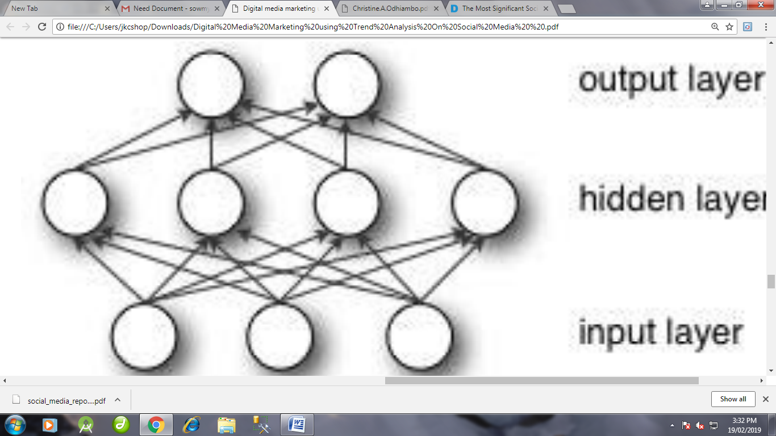
Block Diagram

Slide 9
SOFTWARE REQUIREMENTS:
Operating System : Windows 10
Platform : DOT NET TECHNOLOGY
Front End : ASP.Net 4.0
Back End : SQL SERVER 2014

Slide 10
HARDWARE REQUIREMENTS:
Keyboard
Mouse
Hard disk 500GB
Ram 4 Gb

Slide 11
CONCLUTION
The process of collecting social media data presents a number of challenges for researchers as we attempt to add rigor to the field. In this dissertation I developed the concept of ephemerality as it relates to social media data sets – quantifying the levels of reliability and authenticity within three cases studies observed over a 90 day to 3 year timeframe. To me, the most surprising results were the levels of change of user profile metadata with over 50% of users in the RuPual’s Drag Race case study changing their profile images and a large number of users completely rewriting their profile descriptions.

Slide 12
REFERENCE
AlexaBezjian.A, Calder.B and Lacobucci. D; New Media Interactive Advertising vs. Traditional Advertising, Journal of advertising research (July. August 1998)
Alexander.B and Levine.A, Storytelling; emergence of a New Genre (2008)
A.J. Veal: Research Methods for Leisure and tourism; A practical guide,3rd Ed. Prentice Hall(2006)
Barwise.P and Meehan.S: The one thing you must get right when building a brand (2010)
Butler.P and Peppard. J; Consumer purchasing on the internet: Processes and prospects (1998)

