Slide 1
Fall detection using accelerometer and GSM GPS

Slide 2
Abstract
Falls are the main source of injury for elderly patients with epilepsy and Parkinson’s disease. Elderly people who carry battery powered health monitoring systems can move unhindered from one place to another according to their activities, thus improving their quality of life.
This paper aims to detect when an elderly individual falls and to provide accurate location of the incident while the individual is moving in indoor environments such as in houses, medical health care centers, and hospitals.
Fall detection is accurately determined based on a proposed sensor-based fall detection algorithm, whereas the localization of the elderly person is determined based on an artificial neural network (ANN).

Slide 3
In addition, the power consumption of the fall detection system (FDS) is minimized based on a data-driven algorithm. Results show that an elderly fall can be detected with accuracy levels of 100% and 92.5% for line-of-sight (LOS) and non-line-of-sight (NLOS) environments, respectively. In addition, elderly indoor localization error is improved with a mean absolute error of 0.0094 and 0.0454 m for LOS and NLOS, respectively, after the application of the ANN optimization technique. Moreover, the battery life of the FDS is improved relative to conventional implementation due to reduced computational effort. The proposed FDS outperforms existing systems in terms of fall detection accuracy, localization errors, and power consumption.
Fall detection is a major challenge in the public healthcare domain, especially for the elderly as the decline of their physical fitness, and timely and reliable surveillance is necessary to mitigate the negative effects of falls. This paper develops a novel fall detection system based on a wearable device. The system monitors the movements of human body, recognizes a fall from normal daily activities by an effective quaternion algorithm, and automatically sends request for help to the caregivers with the patient's location.

Slide 4
Existing System
The sensors of the last method are attached to the subject of interest. The wearable sensor-based method usually depends on accelerometer sensors, which are connected to the body and provide an extraordinary level of obtrusiveness. Accelerometers are popular wearable sensors embedded in FDSs to detect the position and movement of the subject. The advantages of wearable accelerometer sensors are their small size, lower cost than external sensors, ability to be easily carried by the body , and ability to measure acceleration in three coordinates or angles of incidence. Thus, among the above three methods, the wearable sensor-based method using accelerometer sensors is considered in this study.

Slide 5
Disadvantage of Existing System
Fall detection of elderly people is accurately detected based on FDS carried by the patient
The location of the fall is determined with minimum localization error based on ANN technique in indoor environments for LOS and NLOS scenarios.
The power consumption of the FDS carried by the subject is minimized based on DDA.
Fall detection accuracy achieved using sensor-based fall detection algorithm (S-BFDA), localization error based on ANN technique, and FDS power consumption based on DDA are compared with those of state-of-the-art systems.

Slide 6
PROPOSED SYSTEM :
The structure of proposed fall detection system whose core structure is based on a Micro programmed controller unit. The accelerometer sensor along with cardio tachometer is integrated on one single board, recording real time acceleration and pulse rate. Both acceleration and pulse rate are first captured using an analog-to-digital converter. Then the digital signal is transmitted to the MCU for further processing. The heart rate is captured by a pulse pressure sensor and also passed directly to the MCU and the location is detected using GPS and communicated using GSM. The message can be set to reach the nearest hospital and the relatives. The message contains latitude and longitude values of accident place. Thus, wearable sensor based methods are considered in this research. By using information from an Accelerometer and cardio tachometer, the impacts of falls can successfully be distinguished from activities of daily lives reducing the false detection of falls.

Slide 7
ADVANTAGE
This system has a unique way of tracking location through GPS,
GPS system is used to measure latitude and longitude values of the location, so that tracking can be easy
GSM used to communicate the nearest hospital and relatives,
Message to the hospital means immediate aid can be provided without any human intimation.

Slide 8
TITTLE | AUTHOR | DESCRIPTION
Radar signal processing for elderly fall detection: The future for in-home monitoring | Amin, M.G.; Zhang, Y.D.; Ahmad, F.; Ho, K.D. | These signals are nonstationary in nature, inviting time-frequency analysis in both its linear and bilinear aspects, to play a fundamental role in motion identification, including fall features determination and classification.
Energy-efficient architecture for wireless sensor networks in healthcare applications | Saleh, N.; Kassem, A.; Haidar, A.M. | The system will reduce the consumption of energy in the transmission phase due to the increased bits transmitted per symbol. Moreover, a neural network static random access memory (NN-SRAM) implementation in a clustering-based system for energy-constrained wireless sensor networks is proposed.

Slide 9
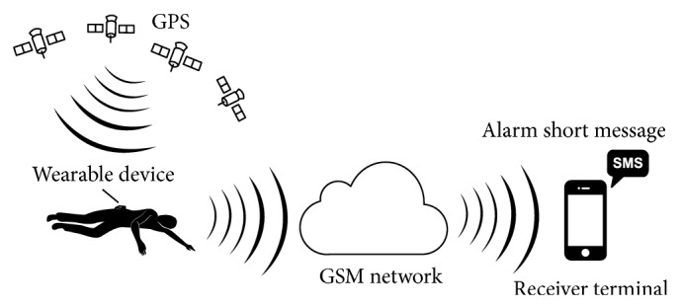
Block Diagram

Slide 10
SOFTWARE REQUIREMENTS:
Operating System : Windows 10
Platform : DOT NET TECHNOLOGY
Front End : ASP.Net 4.0
Back End : SQL SERVER 2014

Slide 11
HARDWARE REQUIREMENTS:
Keyboard
Mouse
Hard disk 500GB
Ram 4 Gb

Slide 12
CONCLUTION
There is various fall detection systems detect effectively, but not Suitable for real time application. The proposed system will be a portable device mounted on the waist of user, having sensors consisting of accelerometer. The propose fall detection system can be regarded as alternative device to the existing detection approaches, since the device provides the comfortable wearing, is less complex as compared to other devices, fast fall response and will be more accurate and economical. These systems overcome the limitation of limited range of object tracking.

Slide 13
REFERENCE
1. Amin, M.G.; Zhang, Y.D.; Ahmad, F.; Ho, K.D. Radar signal processing for elderly fall detection: The future for in-home monitoring. IEEE Signal Process. Mag. 2016, 33, 71–80. [CrossRef]
2. Shinmoto Torres, R.L.; Visvanathan, R.; Hoskins, S.; van den Hengel, A.; Ranasinghe, D.C. Effectiveness of a batteryless and wireless wearable sensor system for identifying bed and chair exits in healthy older people. Sensors 2016, 16, 546. [CrossRef] [PubMed]
3. Chen, M.-C.; Chiu, Y.-W.; Chen, C.-H.; Chen, E.-J. Implementation of fall detection and localized caring system. Math. Probl. Eng. 2013, 2013, 217286. [CrossRef]
4. Naranjo, P.G.V.; Shojafar, M.; Mostafaei, H.; Pooranian, Z.; Baccarelli, E. P-sep: A prolong stable election routing algorithm for energy-limited heterogeneous fog-supported wireless sensor networks. J. Supercomput. 2017, 73, 733–755. [CrossRef]
5. Saleh, N.; Kassem, A.; Haidar, A.M. Energy-efficient architecture for wireless sensor networks in healthcare applications. IEEE Access 2018

