Slide 1
Forecasting Cloud Application Workloads with Cloud Insight for Predictive Resource Management

Slide 2
Abstract
Predictive cloud resource management has been widely adopted to overcome the limitations of reactive cloud auto scaling. The predictive resource management is highly relying on workload predictors, which estimate short-/long-term fluctuations of cloud application workloads. These predictors tend to be pre-optimized for specific workload patterns. However, such predictors are still insufficient to handle real-world cloud workloads whose patterns may be unknown a priori, may dynamically change over time and maybe irregular. As a result, these predictors often cause over-/under-provisioning of cloud resources.
To address this problem, we create Cloud Insight, a novel cloud workload prediction framework, leveraging the combined power of multiple workload predictors. Cloud Insight creates an ensemble model using multiple predictors to make accurate predictions for real workloads.

Slide 3
The weights of the predictors in Cloud Insight are determined at runtime with their accuracy for the current workload using multi-class regression. The ensemble model is periodically optimized to handle sudden changes in the workload. We evaluated Cloud Insight with various real workload traces. The results show that Cloud Insight has 13%–27% higher accuracy than state-of-the-art predictors. Moreover, there sults from trace-based simulations with a cloud resource manager show that Cloud Insighthas 15%–20% less under-/over-provisioning periods, resulting in high cost-efficiency and low SLA violations.

Slide 4
Existing System
Infrastructure as a service clouds hide the complexity of maintaining the physical infrastructure with a slight disadvantage: they also hide their internal working details. Should users need knowledge about these details e.g., to increase the reliability or performance of their applications, they would need solutions to detect behavioral changes in the underlying system.
Existing runtime solutions for such purposes offer limited capabilities as they are mostly restricted to revealing weekly or yearly behavioral periodicity in the infrastructure.

Slide 5
Disadvantage of Existing System
The application runs long enough so that the time taken by a potential virtual infrastructure rearrangement is negligible.
The application is executed repeatedly over a period of time.

Slide 6
PROPOSED SYSTEM :
This paper proposes a technique for predicting generic background workload by means of simulations that are capable of providing additional knowledge of the underlying private cloud systems in order to support activities like cloud orchestration or workflow enactment. Our technique uses long-running scientific workflows and their behavior discrepancies and tries to replicate these in a simulated cloud with known (trace-based) workloads.
We argue that the better we can mimic the current discrepancies the better we can tell expected workloads in the near future on the real life cloud. We evaluated the proposed prediction approach with a biochemical application on both real and simulated cloud infrastructures. The proposed algorithm has shown to produce significantly (20%) better workload predictions for the future of simulated clouds than random workload selection.

Slide 7
ADVANTAGE
The result of this prediction subsequently enables to steer current and future cloud usage accordingly, including the option of resource rearrangement if indicated.
The concept of a private-cloud level load prediction method based on the combination of historic traces, aimed at improving execution quality.

Slide 8
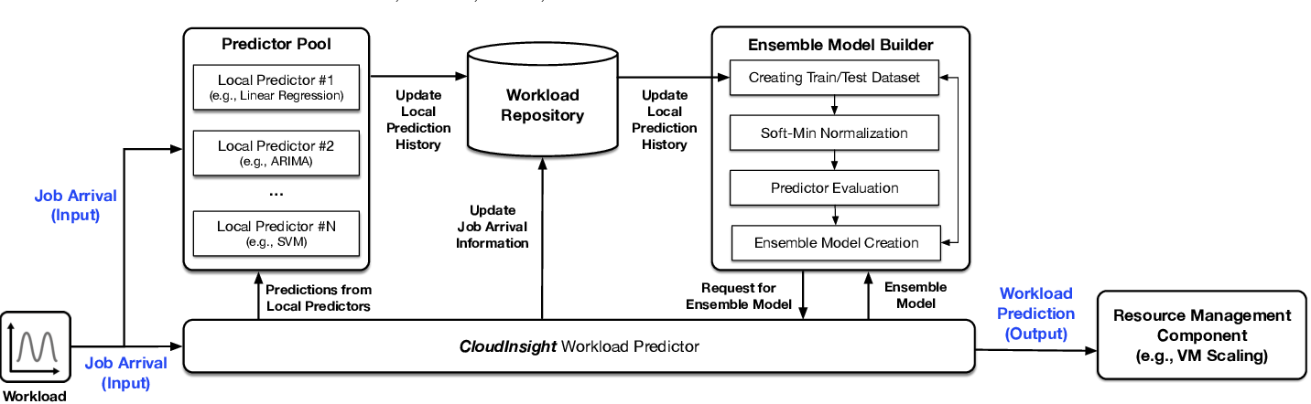
Architecture Diagram

Slide 9
Literature Survey
TITTLE | AUTHOR | CONCEPT
Empirical Evaluation of Workload Forecasting Techniques for PredictiveCloud Resource Scaling | In Kee Kim, Wei Wang, Yanjun Qi, and Marty Humphrey. | Many predictive resource scaling approaches have been proposed to overcome the limitations of the conventional reactive approaches most often used in clouds today.
A First Step Towards Comprehensive Traffic Forecasting in Cloud Computing. | Yang Peng, Kai Chen, Guohui Wang, Wei Bai, Zhiqiang Ma, andLin Gu. | We present our effort towards comprehensive traffic forecasting for big data applications using external, light-weighted file system monitoring. Our idea is motivated by the key observations that rich traffic demand information already exists in the log and meta-data files of many big data applications, and that such information can be readily extracted through runtime file system monitoring.

Slide 10
TITTLE | AUTHOR | CONCEPT
Cloud Computing Patterns: Funda-mentals to Design, Build, and Manage Cloud Applications. | Christoph Fehling, Frank Leymann, Ralph Retter, Walter Schu-peck, and Peter Arbittera. | The current work provides CIOs, software architects, project managers, developers, and cloud strategy initiatives with a set of architectural patterns that offer nuggets of advice on how to achieve common cloud computing-related goals.
Workload Predicting-Based Automatic Scalingin Service Clouds. | Jingqi Yang, Chuanchang Liu, Yanlei Shang, Zexiang Mao, andJunliang Chen. | Service platforms have disadvantages they have long construction periods, low resource utilizations and isolated constructions.

Slide 11
SOFTWARE REQUIREMENTS:
Operating System : Windows XP.
Platform : DOT NET TECHNOLOGY
Front End : ASP.Net 3.5
Back End : SQL SERVER 2005

Slide 12
HARDWARE REQUIREMENTS:
Keyboard
Mouse
Hard disk 500GB
Ram 4 Gb

Slide 13
REFERENCES
[1] In Kee Kim, Wei Wang, Yanjun Qi, and Marty Humphrey. Empiri-cal Evaluation of Workload Forecasting Techniques for PredictiveCloud Resource Scaling. InIEEE International Conference on CloudComputing (CLOUD ’16), 2016.
[2] Nilabja Roy, Abhishek Dubey, and Aniruddha Gokhale. EfficientAutoscaling in the Cloud using Predictive Models for WorkloadForecasting. InIEEE International Conference on Cloud Computing(CLOUD ’11), Washington DC, USA, June 2011.
[3] Yang Peng, Kai Chen, Guohui Wang, Wei Bai, Zhiqiang Ma, andLin Gu. HadoopWatch: A First Step Towards ComprehensiveTraffic Forecasting in Cloud Computing. InIEEE Conference onComputer Comm. (INFOCOM), Toronto, ON, Canada, April 2014.
[4] Marwin Z ̈ufle, Andr ́e Bauer, Veronika Lesch, Christian Krupitzer,Nikolas Herbst, Samuel Kounev, and Valentin Curtef. Autonomicforecasting method selection: Examination and ways ahead. In2019 IEEE International Conference on Autonomic Computing, ICAC2019, Ume ̊a, Sweden, June 16-20, 2019, 2019.
[5] In Kee Kim, Wei Wang, Yanjun Qi, and Marty Humphrey. Empiri-cal Evaluation of Workload Forecasting Techniques for PredictiveCloud Resource Scaling. In IEEE International Conference on Cloud Computing (CLOUD ’16), 2016.

Slide 14
[ 6] Christoph Fehling, Frank Leymann, Ralph Retter, Walter Schu-peck, and Peter Arbittera. Cloud Computing Patterns: Funda-mentals to Design, Build, and Manage Cloud Applications. 2014.
[7] Yu Hen Hu, Surekha Palreddy, and Willis J. Tompkins. A Patient-Adaptable ECG Beat Classifier Using a Mixture of Experts Ap-proach.IEEE Trans. on Biomedical Engineering, 44(9):891–900, 1997.
[8]In Kee Kim, Wei Wang, and Marty Humphrey. PICS: A PublicIaaS Cloud Simulator. InIEEE International Conference on CloudComputing (CLOUD ’15), New York, NY, USA, 2015.
[9] Jingqi Yang, Chuanchang Liu, Yanlei Shang, Zexiang Mao, andJunliang Chen. Workload Predicting-Based Automatic Scalingin Service Clouds.InIEEE International Conference on CloudComputing (CLOUD ’13), Santa Clara, CA, USA, June 2013.
[10]Siddhant Kumar, Neha Muthiyan, Shaifu Gupta, Dileep A.D.,and Aditya Nigam. Association Learning based Hybrid Modelfor Cloud Workload Prediction . InIJCNN ’18.

