Slide 1
ANDROID AND BLUETOOTH BASED VOICE CONTROLLED WIRELESS SMART HOME SYSTEM

Slide 2
Abstract
In this paper, a design is proposed using IR and LDR sensor for automation of lights and fans using PIC with Internet of Things for smart homes. Nowadays we’re having automation of every little electrical device in our homes. Internet of Things is the concept of basically connecting any device with an on and off switch to the internet. IOT is more than smart homes and connected appliances; however, it scales up to include smart cities with connected sensors. Using IR sensors, the lights will automatically turn on and off according to the intensity of light. Temperature sensors will detect the room temperature and turn on and off fans. The security challenges being encountered in many places today require electronic means of controlling access to secured premises in addition to the available security personnel. Various technologies were used in different forms to solve these challenges. The Radio Frequency Identification (RFID) Based Access Control Security system with IOT technology presented in this work helps to prevent unauthorized access to controlled environments (secured premises).

Slide 3
Existing System
There are several automatic identification technologies including barcode, magnetic stripe and Radio Frequency Identification (RFID) applied in security system. Radio-Frequency Identification (RFID) is an emerging technology and one of the most rapidly growing segments of today’s automatic identification data collection industry.
RFID technology, offers superior performance over other automatic identification systems. Because it is not an optical technology like bar coding, no inherent line of sight is required between the reader and the tagged RFID object

Slide 4
Disadvantage of Existing System
There was not much problem observed during development. However, commands involving the word “fan” give some problem since it has a close resemblance to the word “fen” and “fend”. The word “off” also has a resemblance to the word “of”. If the command “Fan Off” is said too fast, the system will detect it as “fanoff”. The accuracy for all commands except for fan-related commands is 100% accurate. For fan-related commands, the accuracy is 66.67%. The solution for this is to implement extra commands that will do the same action.

Slide 5
PROPOSED SYSTEM :
A relay is an electrical switch that uses an electromagnet to move the switch from the off to on position instead of a person moving the switch. It takes a relatively small amount of power to turn on a relay but the relay can control something that draws much more power. A relay is used to control the air onditioner in your home. The AC unit probably runs off of 220VAC at around 30A. That's 6600 Watts! The coil that controls the relay may only need a few watts to pull the contacts together.A relay switch can be divided into two parts: input and output. The input section has a coil which generates magnetic field when a small voltage from an electronic circuit is applied to it. This voltage is called the operating voltage.

Slide 6
ADVANTAGE
PORTE has three pins (RE0/RD/AN5, RE1/WR/AN6and RE2/CS/AN7) which are individually configurable as inputs or outputs. These pins have Schmitt Trigger input buffers. The PORTE pins become the I/O control inputs for the microprocessor port when bit PSPMODE (TRISE<4>) is set. In this mode, the user must make certain that the TRISE<2:0> bits are set and that the pins are configured as digital inputs. Also, ensure that ADCON1 is configured for digital I/O. In this mode, the input buffers are TTL.

Slide 7
TITTLE | AUTHOR | DESCRIPTION
Inside the Smart Home | Richard Harper (2003) | The Social Context of Home Computing.- Design with Care: Technology, Disability and the Home.- The Home of the Future.- Towards the Unremarkable Computer: Making Technology at Home in Domestic Routine
The Georgia Tech aware Home | Juile A Kietz, Shwetak N. Patel, Brian Jones, Ed Price, Elizabeth D.Mynatt, Greogory A. Abowd(2008) | With specific expertise in health, education, entertainment and usable security, we are able to apply our research to problems of significant social and economic impact.

Slide 8
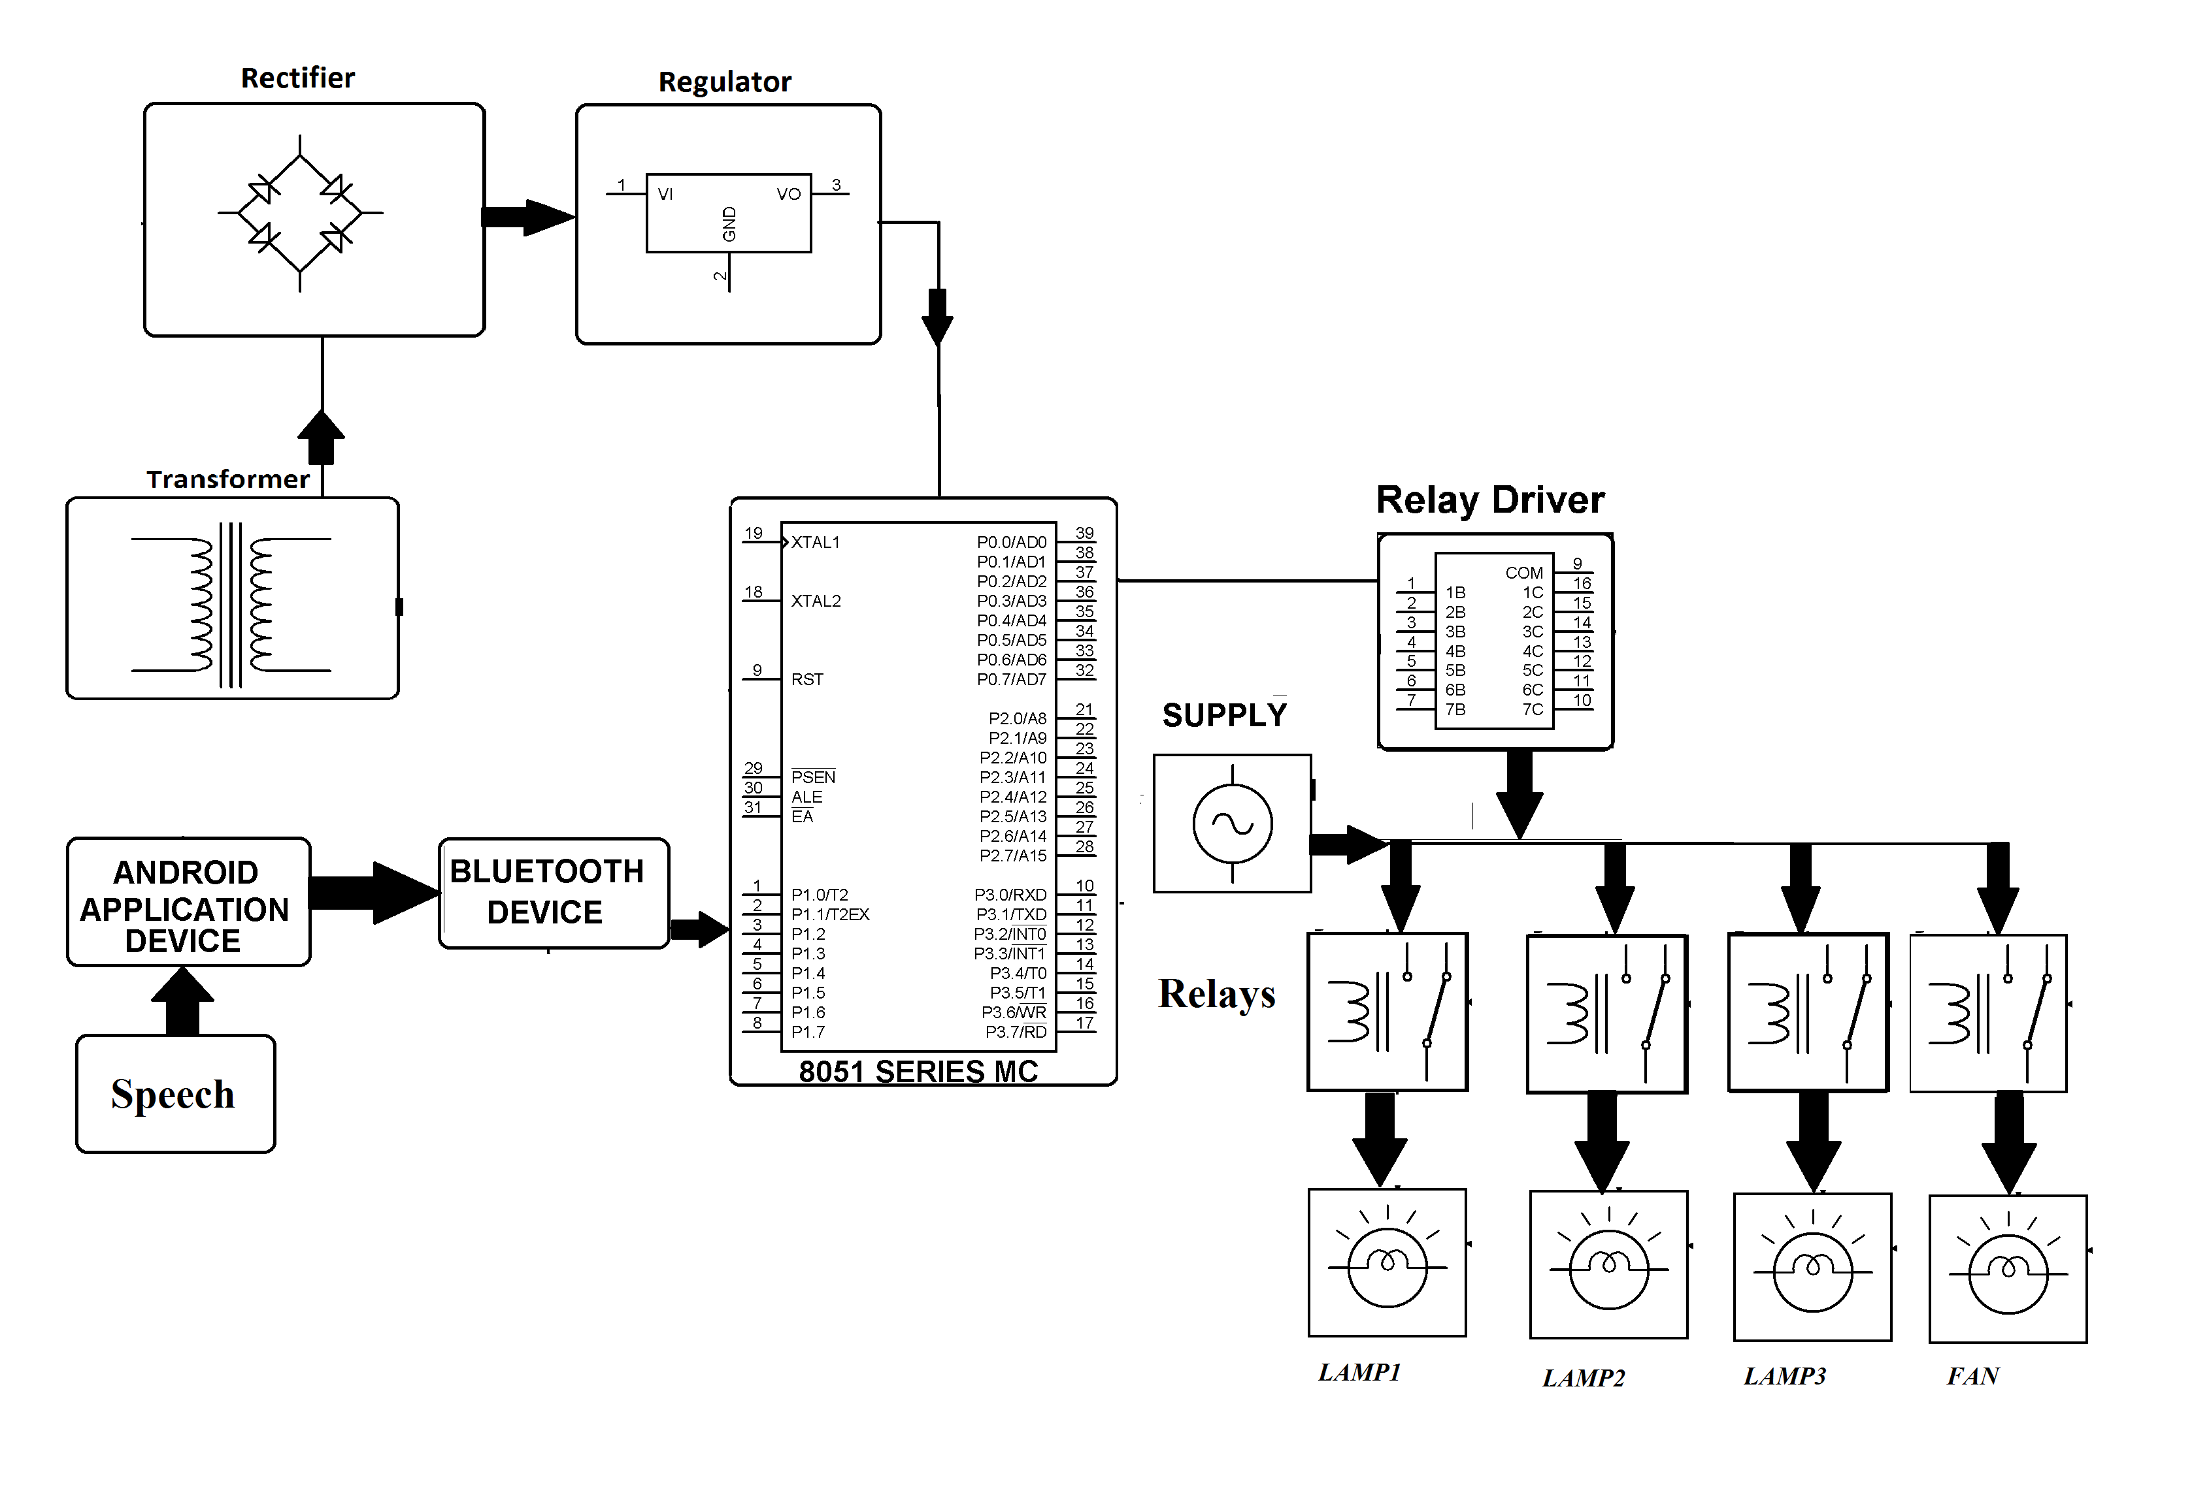
Block Diagram

Slide 9
SOFTWARE REQUIREMENTS:
Operating System : Windows 10
Platform : DOT NET TECHNOLOGY
Front End : ASP.Net 4.0
Back End : SQL SERVER 2014

Slide 10
HARDWARE REQUIREMENTS:
Keyboard
Mouse
Hard disk 500GB
Ram 4 Gb

Slide 11
CONCLUTION
The purpose of the system is to use mobile phone’s inbuilt Bluetooth facility for automation. Different hardware and software unit of the system are described. The complete application software has been designed using Android, using JAVA Language. The HAS furnishes a good paradigm for any Automation System based on Android Mobile Phone and Bluetooth.

Slide 12
REFERENCE
[1] ABI Research on home automation.
[2] Richard Harper (2003) “Inside the Smart Home”, Springer-Verlag London Limited 2003
[3] Juile A Kietz, Shwetak N. Patel, Brian Jones, Ed Price, Elizabeth D.Mynatt, Greogory A. Abowd(2008)“The Georgia Tech aware Home”, The 26th CHI Conference, April 5-10, Florence, Italy,2008, pp. 3675-3680
[4] TiiuKoskela and Kaosa-vaananen-vainio-Mattila (2004)“Evolution towards smart home environments: empirical evaluation of three users interfaces, International Journal of Personal and Ubiquitous Computing, July, Vol. 8, No. 3-4
[5] Tom Rodden and Steve Benford (2003) “ The evolution of buildings and implications for the design of ubiquitous domestic environments”, Proceedings of the SIGCHI Conference on Human Factors in Computing Systems”, April 5-10, Fort Lauderdale, Florida

