Slide 1
LABVIEW BASED ENGINE CONTROL UNIT USING RELAY

Slide 2
CONTENTS
Abstract
Components
Existing System
Block Diagram
Working
Disadvantage
Proposed System
Block Diagram
Flow Chart
Working
Advantage
Justification
Conclusion

Slide 3
ABSTRACT
The aim of the project is to test the Engine Control Unit by switching the relay based on the user’s commands.
Because this product is used to test by different voltage with same terminal with same product.
There are two modes
                Automatic Mode.
                Manual Mode.

Slide 4
COMPONENTS
LabVIEW Software version 2017.
Solid State relay board with 8 channel and 24 volts.
RS232 Cable.
Power supply.

Slide 5
EXISTING SYSTEM
The ECU is an extremely reliable piece of hardware which has the capability to receive and process information hundreds of times per second.
At the heart of the ECU is the microprocessor.
It is the processing center of the ECU where input information is interpreted and output commands are issued.

Slide 6
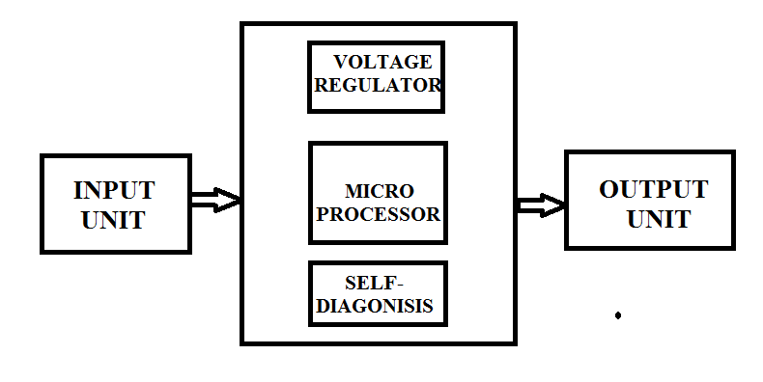
BLOCK DIAGRAM

Slide 7
DISADVANTAGE
It is so complicated for switching purpose and it have less reliability.
High cost.
In Electronics control system have less speed when compare to control systems using DAQ
The speed of operations is limited by the mechanical inertia of the moving components.

Slide 8
PROPOSED SYSTEM
An Engine Control Unit (ECU), also commonly called an engine control module (ECM).
It is a type of electronic control unit that controls a series of actuators on an internal combustion engine to ensure optimal engine performance.
It does this by reading values from a multitude of sensors, interpreting the data using multidimensional performance maps and adjusting the engine actuators accordingly.

Slide 9
CONTINUE….
It is one of the Automotive based industrial project.
The project is mainly based upon the Automotive Testing purpose for ECU (Engine Control unit) with different supply voltage such as 12v and 24v using LabVIEW.

Slide 10
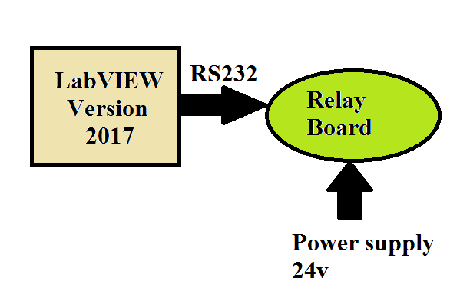
BLOCK DIAGRAM

Slide 11
WORKING:
we can the test the product using SSR relay for giving different voltages to the same product.
This relay can be fully programmed by LabVIEW and then data from the relay board is send to the Engine Control unit.

Slide 12
Continue.....
In this we have two modes,
Automatic Mode.
Manual Mode.
In Automatic Mode, we can already assign the sequence which relay has to been ON or OFF. The program will run based upon the sequence.
In Manual Mode, We can select which relay has to been ON or OFF while running the program.

Slide 13
Continue.....
Generally we can transmit the data using DAQ or NI products while using LabVIEW program. Because, we can alter the different data by using DAQ.
But, in our project we can directly transmit the data to the hardware relay board without using DAQ. This is one of the major advantage.

Slide 14
Continue.....
Because, in that Solid State Relay we have MCP22OO IC.
The input of MCP2200 is from the Dynamic Link Library file because in that library file we can already assign the basic port values.
That values will call from the LabVIEW and send the data to the relay board using RS232 cable.

Slide 15
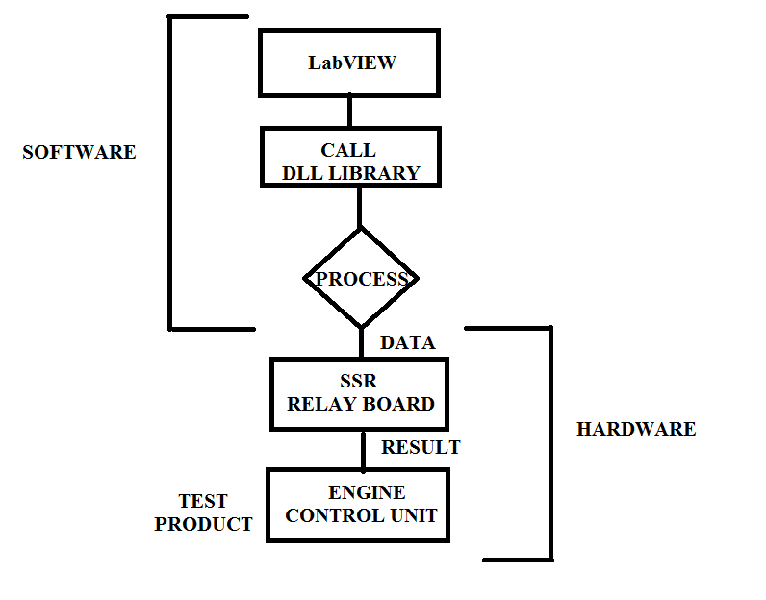
FLOW CHART

Slide 16
SOFTWARE TOOLS USED AND ITS FEATURES
LabVIEW is a tool used in this proposed systems.
FEATURES:
Simple
  LabVIEW is a simple language program.
  Easy to learn
  LabVIEW is a tool which can easily learn for any user and it can implement in any automation based application.
  It is a Lower Cost and it can support all languages.

Slide 17
SOFTWARE TOOLS USED AND ITS FEATURES
USER INTERFACE
The output are shown in the Graphically for user requirements. Before goes to the hardware, the output are all shown in simulation.
Any process should be workout in LabVIEW software itself. It does not require or call any other platform to perform such operations such as audio and video processing etc.,

Slide 18
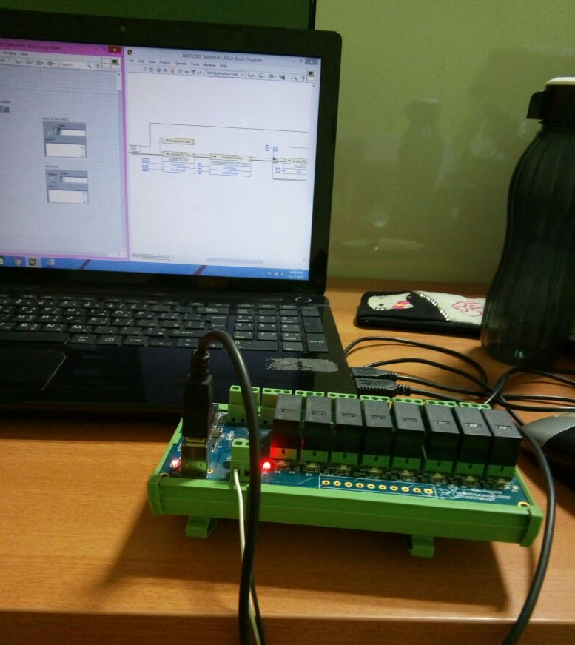
CONNECTIONS

Slide 19
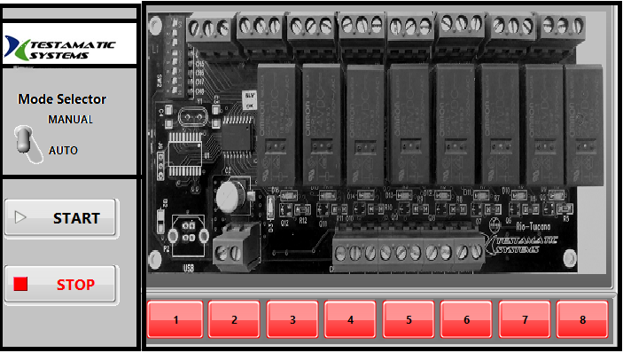
LABVIEW BASED ENGINE CONTROL UNIT USING RELAY

Slide 20
ADVANTAGE
By using LabVIEW, we can switch the relay
easily and high reliable.
Low Cost
SSR relay having microprocessor and the output data will be high accuracy.
By using this relay the speed of the operation is high.

Slide 21
JUSTIFICATION
EXISTING SYSTEM | PROPOSED SYSTEM
Embedded system | LabVIEW
Mechanical Relay | Solid State Relay
No Modes are available | Automatic Mode Manual Mode.

Slide 22
CONCLUSION
This project has described the main areas where Hitachi is active in the field of environmentally friendly engine control systems.
In the real time, SSR will used in the industries because it has to control the high voltage circuit by low voltage circuit. It is easy for switching purpose also.

Slide 23
REFERANCE
E.V Vijay, C.V.R. Rao, E.V. Kumar and G.N. Swamy, “Electronic control unit for an adaptive cursive control systems and engine management system in a vehicle using electronic fuel injection”, 2010 IEEE International Conference on Emerging Trends in Robotics Communication Technologies (INTERACT), INSPEC Accession Number: 11822592, Chennai, India, 3-5 Dec 2010, PP 143-146.
http://pdf1.alldatasheet.com/dataheet.pdf/view/348690/MICROCHIP/MCP2200.html and http://www.microchip.com.
G. Gonzalez, J.A. Florez and S. Arab, “Development of the management strategies of the ECU for an internal combustion engine computer simulation”, Mechanical Systems and Signal Processing Vol22, 2008, PP 1356-1373.

Slide 24
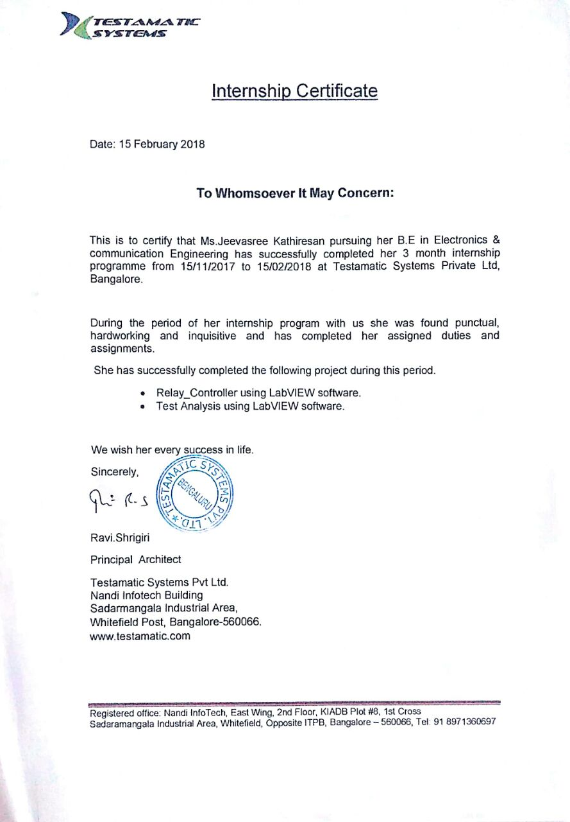
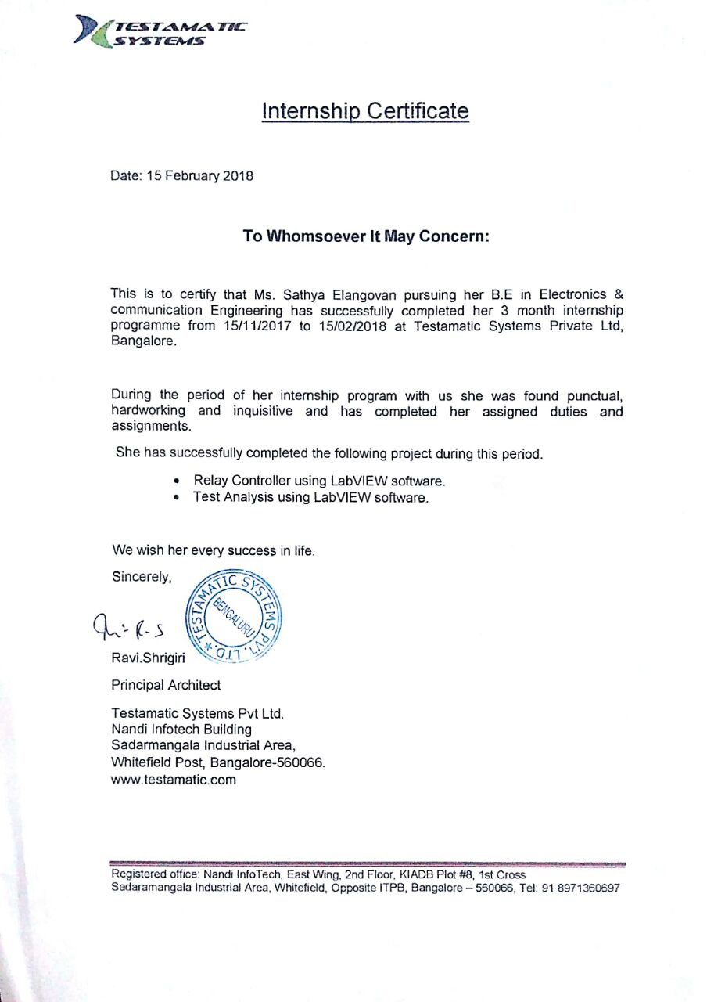
INTERN CERTIFICATES

Slide 25
QUERIES??

Slide 26
THANK YOU

