Slide 1
  FAST AND PROVABLY ACCURATE FIRE DETECTION USING IMAGE PROCESSING

Slide 2
CONTENTS
ABSTRACT
EXISTING SYSTEM
BLOCK DIAGRAM OF PROPOSED SYSTEM
WORKING PRINCIPLE OF PROPOSED SYSTEM
FLOW CHART
MATHEMATICAL MODELING
SOFTWARE TOOLS AND ITS FEATURES
RESULTS
CONCLUSION AND FUTURE SCOPE
REFERENCES

Slide 3
ABSTRACT
Fire that affects the ecological systems across globe has positive effects and negative effects.
The only way to minimize the damage is to early detection and analysis of fire.
In a vast area, it is a trouble to find the location of fire and wasting more resources due to many false alarms.
To avoid the above problem and get accuracy , Fire growth is analyses and calculated based on frame differences using approximating the bilateral filter.

Slide 4
EXISTING SCHEME
Method : Fuzzy c-means-based clustering algorithm . A gray level co-occurrence matrix is used.
Model : HSV model.
Input : Back-propagation neural network.
Outputs : Alarms(may be false alarms).
Surbhi Narwani –”Real-time Fire Detection For Video Surveillance Applications Using A Combination Of Experts Based On Color, Shape And Motion” International Journal Of Scientific Research Publications, pp 423-454 Volume 6. 4 April 2016

Slide 5
EXISTING SCHEME Cont..
Fuzzy C-means-based Clustering Algorithm Is Employed To Extract Candidate Regions Of Fire From All Of The Movement-containing Regions.
A Gray Level Co-occurrence Matrix Is Used To Extract Texture Parameters By Tracking Red-colored Objects In The Candidate Regions.
These Texture Features Are, Subsequently, Used As Inputs Of A Back-propagation Neural Network To Distinguish Between Fire And Non-fire Detect Output Fire Image

Slide 6
PROPOSED SYSTEM WITH BLOCK DIAGRAM
CAMERA WITH IR SENSOR
PROCESSING CENTRE
REFERENCE FRAME
GPS
USING MATLAB,IMAGE PROCESSING IS DONE FOR FIRE FRAMES FOR BETTER ACCURACY
DISPLAY AND ALARMS

Slide 7
WORKING PRINCIPLE OF
PROPOSED SYSTEM
The RGB image is given as a input image and is converted into YCbCr image.
YCbCr color models with given conditions to separate orange, yellow, and high brightness light from background and ambient light.
Fire growth is analyses and calculated based on frame differences using approximating the bilateral filter when the range kernel is Gaussian.
The algorithm has a simple implementation involving N + 1 spatial filtering, where N is the approximation order.
Sobel operator is used to detect the vertical and horizontal edge.
Background and foreground separation is used to separate the fire image.

Slide 8
WORKING PRINCIPLE WITH FLOW CHART
RGB COLOR IMAGE
YCbCr COLOR CONVERSION PROCESSING
BILATERAL FILTERING USING REDUCED NOISE PIXEL
BACKGROUND AND FOREGROUND ANALYSIS FIRE DETECTION PROCESSING
FIRE SEGMENTATION OUTPUT
RED BOX AT FIRE FLAME AT DETECT IMAGE
8

Slide 9
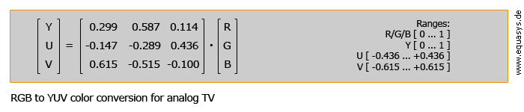
MATHEMATICAL MODELING
M, is given by
E = 2πMR2/(R2+D2)
When R<<D then the relation reduces to the (inverse) square law
E ≈ 2πMR2/D2

Slide 10
SOFTWARE TOOLS USED AND ITS FEATURES
MATLAB is a high-performance language for technical computing.
It integrates computation, visualization, and programming in an easy-to-use environment where problems and solutions are expressed in familiar mathematical notation.
MATLAB is an interactive system whose basic data element is an array that does not require dimensioning.
This allows you to solve many technical computing problems, especially those with matrix and vector formulations, in a fraction of the time it would take to write a program in a scalar non-interactive language such as C or FORTRAN.

Slide 11
SOFTWARE TOOLS USED AND ITS FEATURES Cont..
APPLICATION DEVELOPMENT TOOLS
Image Processing
Signal Processing
Control System
Communications
Neural Network
Instrument Control
Fuzzy Logic
Embedded MATLAB

Slide 12
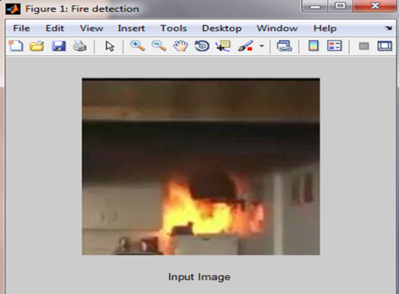
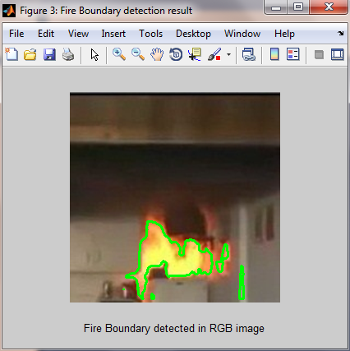
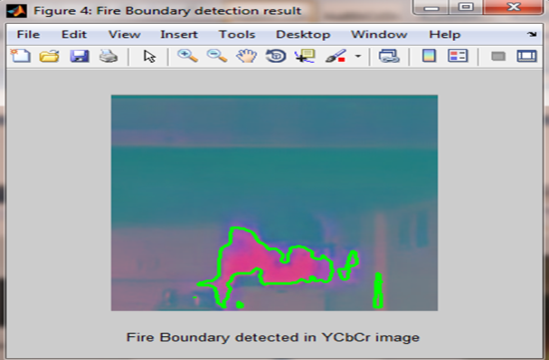
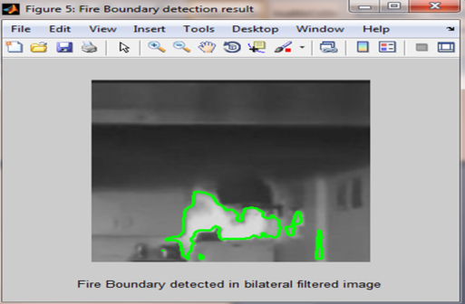
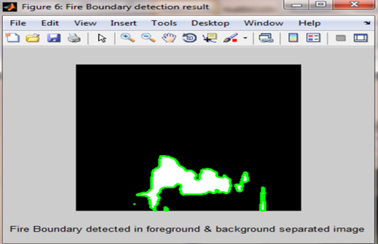
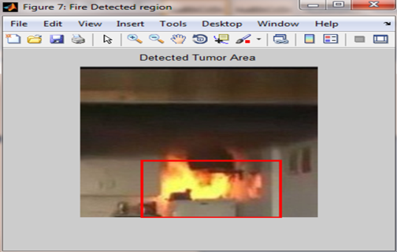
OUTCOMES AND RESULTS
Affected area in sq. mm :3986
Total area in sq. mm :65536
Fire Affected area :60.8215
Specificity :75
Ppv :0.75
Npv :0.75
Accuracy :95

Slide 13
CONCLUSION AND FUTURE SCOPE
Our system works very well when fire occurs, by providing significantly faster detection based on light detection and analysis.
The obvious outcome is significant reduction in loss of life and property. Overall accuracy from the experiments is more than 90%, demonstrating its effectiveness and usefulness.
In future work, objects and shapes, such as shirts, bags, or other objects with orange color, which are approaching the camera will be analyzed. The change is size and intensity caused by relative proximity to the camera may cause false alarms.

Slide 14
REFERENCES
M. Li, W. Xu, K. Xu, J. Fan, and D. Hou, “Review of fire detection technologies based on video image”, JATIT, vol. 49, no. 2, pp. 700-707, Mar. 2013.
W. Wenhao, Z. Hong, “Fire detection based on flame color and area”, 2012 IEEE Int. Conf. on Computer Science and Automation Engineering, pp. 222-226, 2012.
C. Juan, H. Yaping, W. Jian, “Multi-feature fusion based fast video flame detection”, Building and Environment, vol. 45, pp. 1113-1122, 2010.
T. Celik, and H. Demirel, “Fire detection in video sequences using a generic color model”, Fire Safety J, 2008, doi: 10.1016/j.firesaf.2008.05.005
Z. Junying, and D. Xiaoxiao, “Image recognition technology in fire detection”, Fire Science and Technology, vol. 26, no. 4, pp. 417-420, 2007.

Slide 15
REFERENCES Cont..
Y. Y. Yan, S. B. Gao, H. Y. Wang, and Z. B. Guo, “Contour extraction of flame for fire detection”, Advanced Materials Research, Manufacturing Science and Technology, vol, 383-390, pp. 1106-1110, 2012.
J. Rong, D. Zhou, W. Yao, W. Gao, J. Chen, and J. Wang, “Fire flame detection based on GICA and target tracking”, Optics & Laser Technology, vol. 47, pp. 283-291, 2013.
W. Lei, and J. Liu, “Early fire detection in coalmine based on video processing”, Advances in Intelligent Systems and Computing, vol. 181, pp. 239-245, 2013
T. Celik, “Fast and efficient method for fire detection using image processing”, ETRI Journal, vol. 32, no. 6, pp. 811-890, 2010.
R. C. Gonzalez, and R. E. Wood, “Digital image processing”, Prentice Hall, 3rd edition, 2007.

Slide 16
THANK YOU

