Slide 1
  WEB BASED REMOTE TEST SOLUTION

Slide 2
ABSTRACT
In industry field testing is one of the mandatory to check the quality of the product. The aim of developing this project is to make the testing of device more flexible and user friendly. Traditionally testing is made at one place both user and researcher must in same location to do the test but this project neglect that issue and make the testing in remotely through the help of internet.
In case of equipment unavailability, the testing can’t be done but the equipments are available in the different location from the testing location means, the testing can be done by the programming scripts.
This project reduces the need of memory space in CPU by storing and retrieving the data from the database here the communication protocol is socket communication. This make the communication better responsive manner because socket communication is event based duplex communication protocol in which the changes are updated immediately.

Slide 3
EXISTING SCHEME
Wuzhi Xu,J. Offutt,Juan Luo from Info. & Software Eng., George Mason
Univ.,Fairfax, VA, USA “Testing Web services by XML perturbation”
IEEE Xplore 05 December 2015
Fei Wang,Wencai Du from Coll. of Inf. Sci. & Technol., Hainan Univ., Haikou,China” A Test Automation Framework Based on WEB”
IEEE Xplore 08 June 2012

Slide 4
EXISTING SCHEME cont..
TESTING
In general, testing is finding out how well something works.
Testing
Manual testing
Automated testing
Web based remote testing

Slide 5
EXISTING SCHEME Cont..
MANUAL TESTING
Manual testing is a testing process that is carried out manually in order to find defects without the usage of tools or automation scripting. A test plan document is prepared that acts as a guide to the testing process in order to have the complete test coverage.
AUTOMATED TESTING
Automated testing is well automated. This differs from manual testing where a human being is responsible for single-handedly testing the functionality but automated testing is done through an automation tool, less time is needed in exploratory tests and more time is needed in maintaining test scripts while increasing overall test coverage.

Slide 6
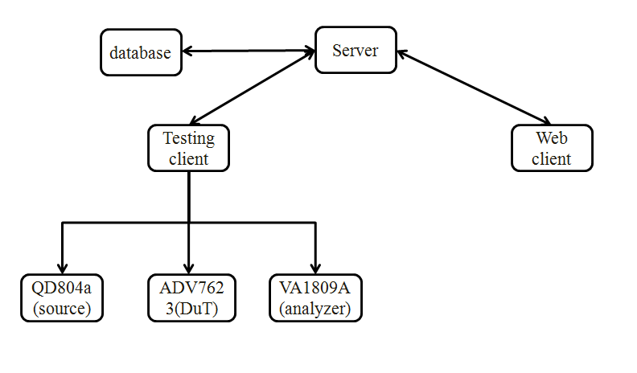
PROPOSED SYSTEM WITH BLOCK DIAGRAM

Slide 7
WORKING PRINCIPLE OF
PROPOSED SYSTEM
The hardware used in this project is
QD804a(Source):
The 804 series instruments feature four (4) HDMI outputs—all active simultaneously—for testing HDTVs with multiple HDMI inputs.
ADV7623(DUT):
ADV7623 is a high performance 4 input, 1 output, High-Definition Multimedia Interface (HDMI®) transceiver that integrates HDMI receiver and transmitter with digital audio inputs and outputs onto one chip.
VA1809A(Analyzer):
VA-1809A is protocol analyzer used to inspect/measure various HDMI (High-Definition Multimedia Interface) signal functions meet interface standards for digital AV equipment. It visually confims operation status for each HDMI input picture signal function.

Slide 8
SOFTWARE TOOLS USED AND ITS FEATURES Cont..
PYTHON 3.6
IDLE is the Python IDE built with the Tkinter GUI toolkit.
IDLE has the following features:
coded in 100% pure Python, using the Tkinter GUI toolkit
cross-platform: works on Windows and Unix
multi-window text editor with multiple undo,Python colorizing and many other features, e.g. smart indent and call tips
Python shell window (a.k.a. interactive interpreter) debugger

Slide 9
OUTCOMES
The proposed system is run the node.js application in server,python application runs in testing client,at the time of URL put in the browser at web client.the testing client’s python application identifies the device name and its baudrate then it send the information.
To the server.the server send that to the web client.when the web client decides to execute the testcase means the server fetch the testcase from the database and it pass it to the tsting client,then the testing client execute the test commands and get the response from the devices that response are move to server and database.the testing result are stored in the data base in JSON format.

Slide 10
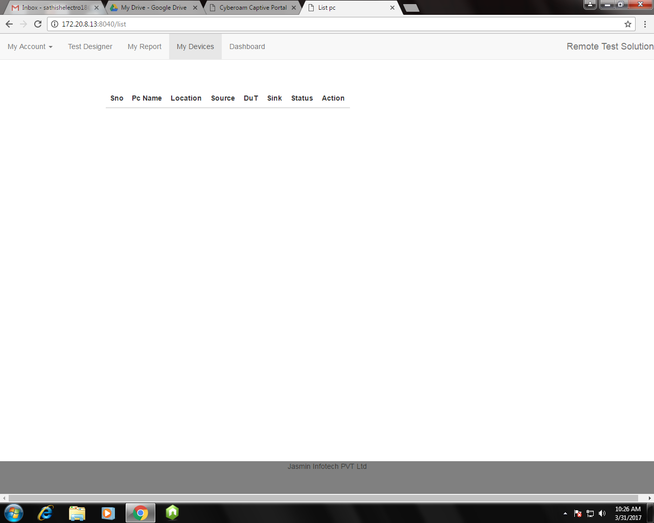
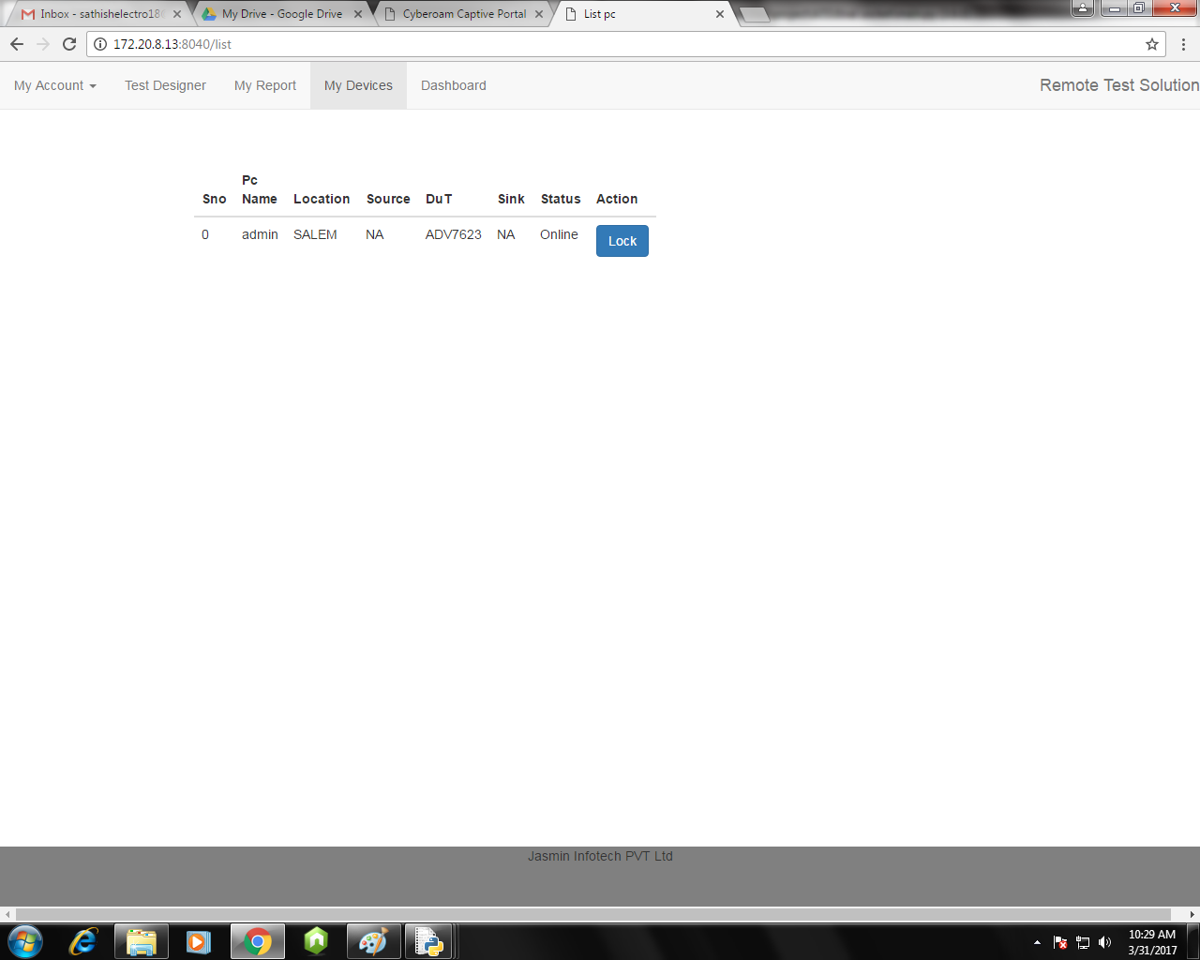
RESULTS Cont..
At Web Client :Login To The Testing Website
Available testing pc setup shown in the web page

Slide 11
CONCLUSION
This project developed by those programming languages python, java script and markup languages HTML,CSS. Then the data storage is done by the couchDB database.
This system has script to automatically identify the device which is connected and its baudrate,if connected device unfortunately unplugged means the script detect and give the alert to the tester and researcher.
Under the proposed system we can test both audio and video signal,in the case that tester not need the equipment at his place to do the testing.he simply do the test via web to communicate with the equipments which is the tester want to test.the system reduces the distance barrier for the user and researcher at the testing process

Slide 12
REFERENCES
Dennis G. Jerz (July 19, 2000).”Usability Testing: What IS It?”. Jerz's Literacy Weblog.Retrieved June 29, 2016.
Ardentia Technologies : Providing Cutting Edge Software Solutions And Comprehensive Testing Services Published by CIO Review, April 2016
kaner,cem(November 17, 2006). ”Exploratory Testing” . Florida Institute of Technology, Quality Assurance Institute Worldwide Annual Software Testing Conference, Orlando, FL. Retrieved November 22, 2014
“Heuristic Evaluation”. Usability First. Retrieved April 9, 2013.
Bossavit, Laurent (2013-11-20). The Leprechauns of Software Engineering--How folklore turns into fact and what to do about it. Chapter 10: leanpub.

