Slide 1
SMART IRRIGATION SYSTEM FOR AGRICULTURE USING IOT

Slide 2
ABSTRACT
The aim of the project is to develop an automatic irrigation system for optimize water usage in agricultural crops
The proposed automatic irrigation system consists of six sensors such as soil moisture sensor, temperature senor and water level sensor, Humidity sensor, PIR sensor, Current sensor
Initially a program with threshold values of soil moisture, temperature and water level was developed and then it programmed into a pic microcontroller
The signals from the sensors are compared with the threshold value and the ensuing data is transmitted through IOT module

Slide 3
EXISTING SCHEME
  In the existing system GSM is used for remote monitoring and controlling the devices via messages
If the moisture or temperature exceeds the predefined threshold values then the system informs the user via SMS from the GSM Module to the user's smartphone and actions will be taken by the user accordingly
But this system was not efficient for automatic monitoring and controlling
Mrs.M.S.Ghute, Mr.S.Soitkar, Mrs.K.P.Kamble, “Smart Irrigation System using GSM Module,” International Journal of Advanced Research in Computer and Communication Engineering, vol.6, issue 7,July 2017

Slide 4
PROPOSED SCHEME
The proposed project includes system structure, hardware circuits and software program for IoT based automatic irrigation system.
In this project, soil moisture sensor, temperature sensor, humidity sensor, water level sensor and PIR sensor, current sensor are used
The main aim of this system is to develop low cost automatic irrigation system to monitor the condition of the soil
This system reduces manpower and water wastage

Slide 5
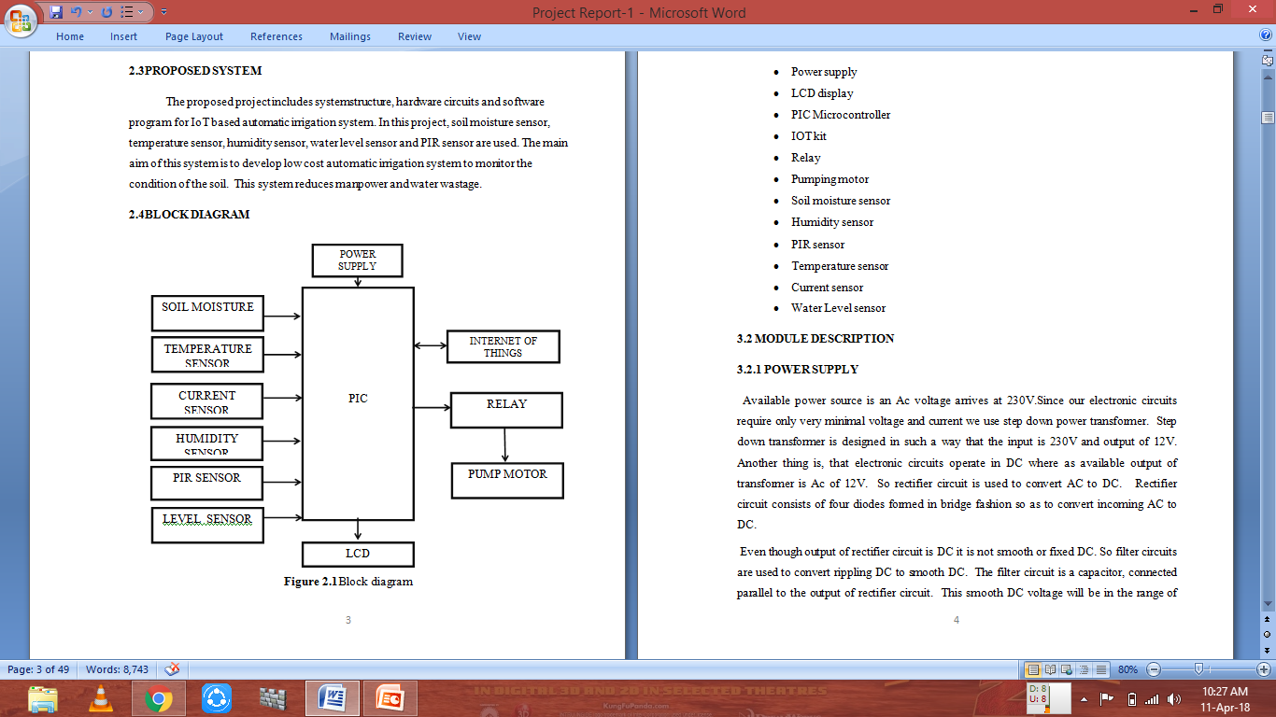
PROPOSED SYSTEM WITH BLOCK DIAGRAM:

Slide 6
CONCLUSION AND FUTURE SCOPE
Agricultural monitoring is very much needed to reduce much of human labour and at the same time minimize on water usage. Lot of system been developed employing Wireless Sensor in monitoring and predicting the soil condition for irrigating the field.
In Future, an Intelligent IoT based Automated Irrigation system can be extended not just for irrigating the field with water but also for deciding on spraying appropriate chemicals for proper growth of crop.

Slide 7
REFERENCES
Joaquín G, Juan F , Alejandra N.G, and Miguel Ángel, “Automated Irrigation System Using a Wireless Sensor Network and GPRS Module”, IEEE Transactions On Instrumentation and Measurement, Vol.63, no.1, pp.166-176, 2013.
Karandeep K, “Machine Learning : Applications in Indian Agriculture”, International Journal of Advanced Research in Computer and Communication Engineering, Vol.5, no.4, pp.342- 344, 2016.
Mrs.M.S.Ghute, Mr.S.Soitkar, Mrs.K.P.Kamble, “Smart Irrigation System using GSM Module,” International Journal of Advanced Research in Computer and Communication Engineering, vol.6, issue 7,July 2017.
Sandip Rukhmode, Gayatri Vyahare, Sharda Banot, Abhilash Narad, Dr.R.M.Tugnayat, “IoT based agriculture monitoring system using Wemos”, International conference on Emanations in modern engineering Science and management(ICEMESM-2017), Volume:5, Issue:3,March 2017, Available @http://www.ijritcc.org(conference issue).

