Slide 1
A CLOUD-EDGE COLLABORATION FRAMEWORK FOR
COGNITIVE SERVICE

Slide 2
Abstract
Cloud computing has significantly enhanced the growth of the Internet of Things (IoT) by ensuring and supporting the Quality of Service (QoS) of IoT applications. However, cloud services are still far from IoT devices. Notably, the transmission of IoT data experiences network issues, such as high latency. In this case, the cloud platforms cannot satisfy the IoT applications that require real-time response. Yet, the location of cloud services is one of the challenges encountered in the evolution of the IoT paradigm.

Slide 3
Recently, edge cloud computing has been proposed to bring cloud services closer to the IoT end-users, becoming a promising paradigm whose pitfalls and challenges are not yet well understood. This paper aims at presenting the leading-edge computing concerning the movement of services from centralized cloud platforms to decentralized platforms, and examines the issues and challenges introduced by these highly distributed environments, to support engineers and researchers who might benefit from this transition.

Slide 4
Existing System
Current Computer Science educational settings are traditional and often unable to face the demand of rapid changes in technologies in an interactive learning environment. The same is true for e-learning which appears to have numerous limitations starting from use of local surroundings. In addition, the infrastructure limitations often force institutions to avoid using multimedia contents in synchronized form due to the cost. Because of these limitations and many others, institutions often eliminate the use of sophisticated educational platforms. This research is intended to create a framework for Computer Science education to remove some of the above limitations and challenges by harnessing the power of Cloud Computing..

Slide 5
The framework removes the locality constraints, allowing students and faculty to collaborate in a distributed and interactive surrounding. In addition, (Vouk, 2008). The new Cloud-based E-learning environment can be solid, hold more sophisticated packages, and support synchronized contents without much concern about the infrastructure limitations. The resources, when they are needed, can be rented from the Cloud.

Slide 6
Disadvantage of Existing System
Cloud Computing provides a set of tools to help educators explore subject complexities in a manageable manner without the risk of harming the system because of the virtualization technology within the Cloud Computing preventing the damage.
..

Slide 7
PROPOSED SYSTEM :
In this paper, we propose a cloud-guided feature extraction approach for image retrieval in MEC, as shown in Fig. 2. We first, propose a Weight-Adaptive Projection matrix Learning algorithm (WAPL) to learn a projection matrix, which issued to extract discriminative features from the image dataset on cloud servers to generate a low-dimensional feature data set. That is, we use the matrix to multiply each image data in the image data set. The multiplying result can be interpreted as the discriminative features of the correspond-ing image. Then, cloud servers send the matrix to edge servers. When receiving the image data, edge servers firstpre-process it, such as objection detection and gray scale.
.

Slide 8
Then, the edge servers use the matrix to multiply thepre-processed image. The resultPTx,i.e., feature data, is uploaded to cloud servers to find the label of an image with the most similar multiplying result. The label is regarded as the retrieval result and returned to mobile users. Since the matrix can extract effective discriminative features from the image, edge servers just upload a small amount of feature data to cloud servers. Compared with existing MEC-based image retrieval approaches, our approach hassles network traffic and faster responses. In addition, our approach can achieve higher retrieval accuracy.

Slide 9
ADVANTAGE
The technical depth of this paper is to learn a projection matrix, automatically determine the dimension of the feature data set, and meet various requirements of users.
Experimental results reveal that the proposed approach reduces the network traffic by 93%.
The image retrieval accuracy is improved by 6.9%

Slide 10
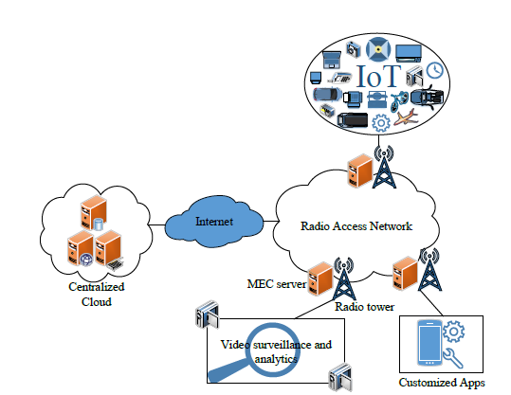
Architecture Diagram

Slide 11
Literature Survey
TITTLE | AUTHOR | CONCEPT
Cloud-vision: Real-time face recognition using a mobile-cloudlet-cloudacceleration architecture,” | T. Soyata, R. Muraleedharan, C. Funai, M. Kwon, and W. B. Heinzelman, | With a large number of commercially-available non-invasive health monitoring sensors today, remote health monitoring of patients in their homes is becoming widespread. In remote health monitoring
A new deep learning-based food recognition system for dietary assessment on an edge computing service infrastructure,” | C. Liu, Y. Cao, Y. Luo, G. Chen, V. Vokkarane, Y. Ma, S. Chen, and P. Hou, | Literature has indicated that accurate dietary assessment is very important for assessing the effectiveness of weight loss interventions.

Slide 12
TITTLE | AUTHOR | CONCEPT
Edge provisioning with flexible server placement. | H. Yin, X. Zhang, H. H. Liu, Y. Luo, C. Tian, S. Zhao, and F. Li, | Edge computing extends the boundary of the cloud to the network edge, providing low latency and high bandwidth computing paradigm. Computation is trending to be offloaded to the edge to reduce service response time and energy consumption.
A cloud-guided feature extraction approach for image retrieval in mobile edge computing. | S. Wang, C. Ding, N. Zhang, X. Liu, A. Zhou, J. Cao, and X. Shen, | Mobile Edge Computing (MEC) can facilitate various important image retrieval applications for mobile users by offloadingpartial computation tasks from resource-limited mobile devices to edge servers.

Slide 13
SOFTWARE REQUIREMENTS:
Operating System : Windows XP.
Platform : DOT NET TECHNOLOGY
Front End : ASP.Net 3.5
Back End : SQL SERVER 2005

Slide 14
HARDWARE REQUIREMENTS:
Keyboard
Mouse
Hard disk 500GB
Ram 4 Gb

Slide 15
REFERENCES
1. T. Soyata, R. Muraleedharan, C. Funai, M. Kwon, and W. B.
Heinzelman, “Cloud-vision: Real-time face recognition using a mobilecloudlet-cloud acceleration architecture,”.
2.C. Liu, Y. Cao, Y. Luo, G. Chen, V. Vokkarane, Y. Ma, S. Chen, andP. Hou, “A new deep learning-based food recognition system for dietary assessment on an edge computing service infrastructure,”.
3.W. Wang, P. Xu, L. T. Yang, and J. Chen, “Cloud-assisted key distribution in batch for secure real-time mobile services,”.
4. K.-C. Wu, W.-Y. Liu, and S.-Y. Wu, “Dynamic deployment and
cost-sensitive provisioning for elastic mobile cloud services,”.

Slide 16
5. H. Yin, X. Zhang, H. H. Liu, Y. Luo, C. Tian, S. Zhao, and
F. Li, “Edge provisioning with flexible server placement,”.
6. Y. Sarikaya, H. Inaltekin, T. Alpcan, and J. S. Evans, “Stability
and dynamic control of underlay mobile edge networks,”.
7. ] X. Chen, L. Jiao, W. Li, and X. Fu, “Efficient multi-user computation
offloading for mobile-edge c.loud computing,”

