Slide 1
  OPERATION AND PROTECTION OF INDUCTION MOTOR BY USING GSM TECHNOLOGY

Slide 2
ABSTRACT
Automation is the process of handling various parameters of process like voltage, current, etc. without presence of responsible person.
The project is designed to protect an induction motor from variation in current ,voltage and over temperature.
Providing a protection system is very important in industries, using lot of motors such that production is not hampered owing to failure of any motor.
The basic idea for the development of this project is to provide safety to the industrial motor/pump/lift Motor etc.

Slide 3
EXISTING SYSTEM
  In Existing system induction motor has to be monitored and controlled by human to check whether the motor is running properly.
  In several cases running of motor may take even 24 hours , so monitoring of motor for 24 hours is impossible.
  In this existing scheme human monitorisation is must.
  Ramazan Bayindir, Member IEEE, Ibrahim Sefa , Member IEEE,Ilhami Colak, Member IEEE and Askin Bektas (May 2015) (Faults Detection and Protection of Induction Motor Using Sensor)

Slide 4
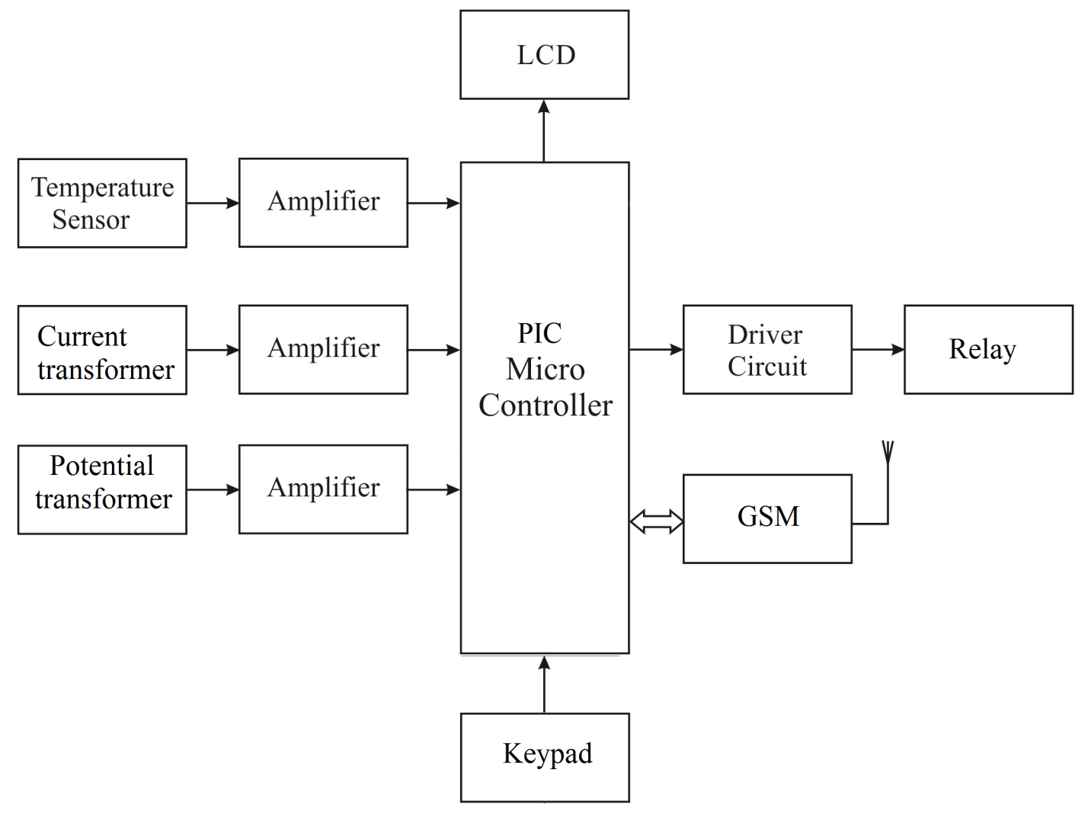
PROPOSED SYSTEM WITH BLOCK DIAGRAM

Slide 5
WORKING PRINCIPLE OF
PROPOSED SYSTEM
Manual systems is used in the existing scheme and it is replaced by automation system.
If there is any increase or decrease in voltage and current, the motor will be turn off.
When problem occurs, it send a message to the operator regarding to that failure with the help of GSM module.
Similarly , in case of temperature , when temperature is beyond 60 degree then it will stop its working and message will send as overheated.

Slide 6
HARDWARE TOOLS USED
PIC MICROCONTROLLER
TEMPARATURE SENSOR
POTENTIAL TRANSFORMER
CURRENT TRANSFORMER
GSM MODEM
RELAYS
LCD DISPLAY

Slide 7
CONCLUSION AND FUTURE SCOPE
Monitoring of voltage and current by employing GSM based system was a radical step towards automation. Different approaches have been developed, for induction motor control and parameter estimation, but only partial results were obtained.
After going through this entire project it was concluded that the GSM based protection system of the induction motor is viable and can be safely implemented for the use of industrial automation.
Further this can be enhanced by using phase sequence sensor for protecting the motor from applying wrong phase sequence.

Slide 8
REFERENCES
Prof. R.R. Jadhav, Prathmesh P Pandit, Shubham D Pal, Vineet H. Risbud (May 2015) “Three Phase Motor Control Using GSM” - international journal of innovative research in electrical, electronics, instrumentation and control engineering vol. 3.
Kamrul Hassan, Raziul Islam Siddiqui , Md. Takdirul Islam , Nahid Alam Siddique , Syed Mohammad Enam Uddin (April 2014) “GSM Based Automatic Motor Control and Protection System”-International Journal of Advancements in Research & Technology, Volume 2.
Snehal Lande1, Pooja Jaiswal, Priyanka Rajgure (May-June 2012)“An analytical approach of Parametric Monitoring of Induction Motor Using GSM” IOSR Journal of Electronics and Communication Engineering (IOSRJECE) Volume 1.
Gang Z, Shuguang L, (2010) “Study on electrical switching device junction temperature monitoring system based on Zigbee technology” International Conference on Computer Application and System Modeling (ICCASM), Taiyuan, China.

Slide 9
REFERENCES Cont..
Baran L,(2009) “A PLC based monitoring and control of power factor of a three phase induction motors”, MSc Thesis, Ghazi University, Institute of Science and Technology, Ankara.
Ramazan bayindir, Mehmet Sen2 (2011) “A Parameter Monitoring System for Induction Motors Based on Zigbee Protocol” Ghazi University Journal of Science GU.
P.E Elavenil , Dr.R.Kalaivani M.E (Embedded Systems) (February 2014) “Speed monitoring and protection of motor using zigbee communication”-International Journal of Scientific Research Engineering & Technology (IJSRET) Volume 2.
Prof. M. S. Badmera1, Pradip M. Ambore, (June 2016)S “An Efficient Parameter Monitoring & Controlling System for Three Phase Induction Motor”-International Journal of Advanced Research in Electrical, Electronics and Instrumentation Engineering Vol. 5.

