Slide 1
  HOME AUTOMATION CONTROL USING
  RASPBERRY PI

Slide 2
ABSTRACT
Automation or automatic control means the use of various control systems for operating equipment.
Now a days Automation is an important milestone in achieving smart gird.
The main advantage of this is small device can be part of internet so it is easy to communicate, manage and control without human interferences.
Also it provides high degree of security, safety, comfort and energy saving with the help of Raspberry Pi.

Slide 3
EXISTING SCHEME
Concepts for home automation were around for decades before becoming reality and featured in the writing of the 19th century.
Homes of the 21st century will become more and more self controlled and automated due to the comfort it provides, especially when employed in a private home. A home automation system is a means that allow users to control electric appliances of varying kind.

Slide 4
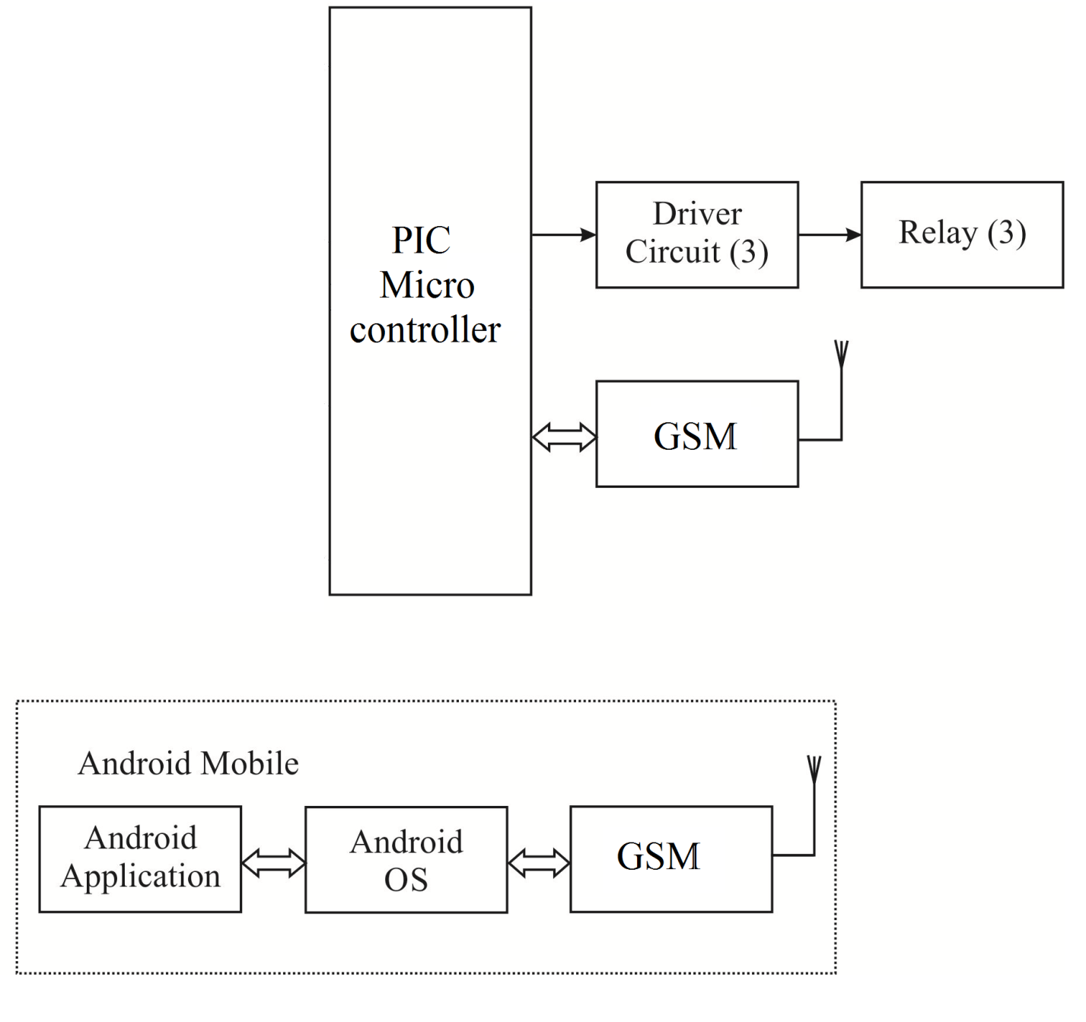
BLOCK DIAGRAM OF EXISTING SYSTEM

Slide 5
PROBLEMS IDENTIFIED IN EXISTING SYSTEM
Time delay.
Hard to handle.
Expensive.
High power consumption

Slide 6
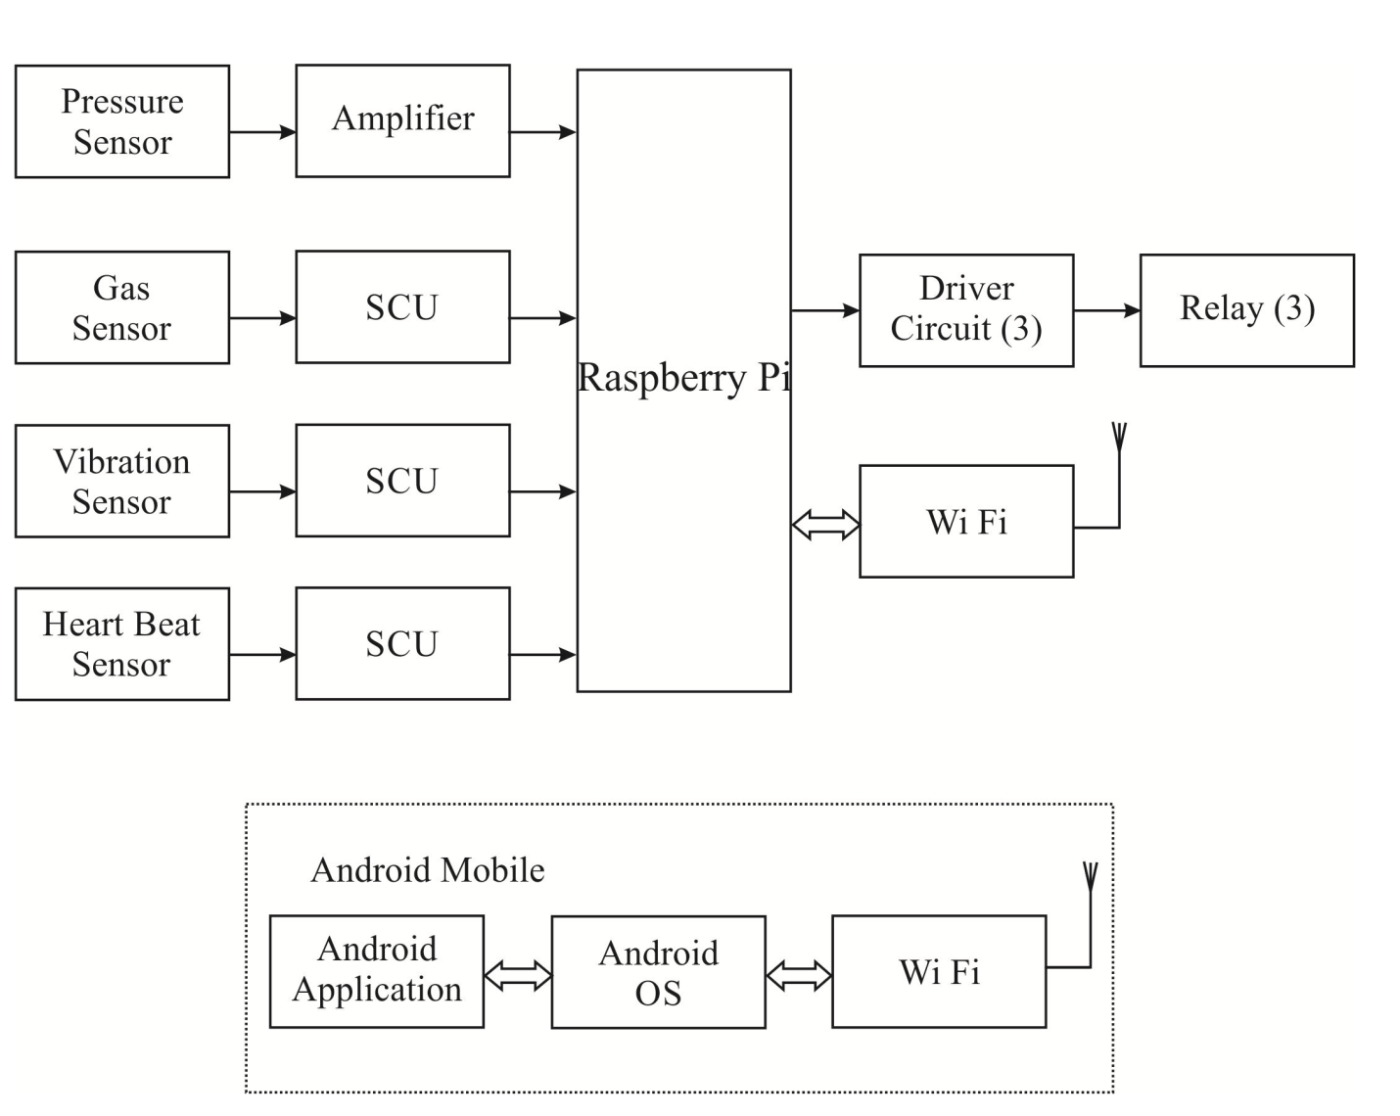
BLOCK DIAGRAM OF PROPOSED SYSTEM

Slide 7
WORKING PRINCIPLES OF PROPOSED SYSTEM
Using Raspberry Pi we are controlling home appliances with the help of sensors
We can monitor the humans heart beat and pressure level with the help of sensors
We are controlling all the home appliances with the an android app

Slide 8
ADVANTAGES
Low power consumption.
We can monitoring and control the home automation using WIFI

Slide 9
APPLICATION
Monitoring the human heart beat
Increasing the security level
Monitoring gas level

Slide 10
FUTURE SCOPE
The platform of the system is EMBEDDED SYSTEM along with Raspberry pi with sensors, relay, wifi and android mobile .
These kinds of home automation systems are required because human can make mistakes and forgot to switch off the appliances when there is no use and in this case, they are useful in order to utilize the power effectively and also in a secured manner.

Slide 11
CONCLUSION
The progress in science & technology is a non-stop process. New things and new technology are being invented. As the technology grows day by day, we can imagine about the future in which thing we may occupy every place.
The principle of the development of science is that “nothing is impossible”. So we shall look forward to a bright & sophisticated world.

Slide 12
REFERENCES
Mr.Eswaravel.E, Mr.Lokeshwaran.V, Mr.Prabhu .D, Mr.SyedGhouse
Mr.sundar Ganesh.C.S. April 2015 “Micro processor based Home Auto system”, Volume.4 Issue 4,
R.A.Khan,Upadhey Madhuri Ganesh, 2015, Raspberry Pi Home Auto Based On IOT , Volume 4, Issue 12
Amit Narote, Abhishek Dsilva, Selma Misquitta, Palak Khandelwal, 2015, “Smart Home Automation Using ARM11”, Volume 5,
Vijay P Jadhao, 2013, “ARM based Smart Home Automation”, volume 1,

