Slide 1
ENERGY EFFICIENT FAST CARRY SELECT ADDER

Slide 2
ABSTRACT
Carry Select Adder (CSLA) is one of the fastest adder which performs complex arithmetic functions quickly
It is used to many data processing units for realizing faster arithmetic operations
It is used to reduce the size of the square root
CSLA new logic is proposed by reducing redundant logic operations present in conventional CSLA
Final sum and carry is calculated by using pipelining structure

Slide 3
EXISTING SCHEME
Priya H. Agarwal and Prashanth R.Rothe, “Energy efficient fast carry select adder” International Journal of Innovative Research in Electrical, Electronics, Instrumentation and Control Engineering Vol.3, Issue7, pp 163-166, 2015
B.Ramkumar and Harish M Kittur,"Low-Power and Area-Efficient Carry Select Adder", IEEE Transactions on Very Large Scale Integration (VLSI) Systems Volume: 20,Issue: 2, pp 371 - 375 Feb. 2012

Slide 4
PROBLEMS IDENTIFIED IN EXISTING SYSTEM
The existing RCA system is to consume more power and area.
To consume more time for carry generation process.
To affect the overall adder architecture performance level.

Slide 5
PROPOSED SCHEME
Different logic formulation is used to reduce delay and area so that speed is increased.
The expressions of full adder
SUM=A xor B xor C
CARRY = (A.B) + (B.C) + (C.A)
Proposed RCLA before calculation of final sum CS operation is schedule and pipelining structure is used to calculate final sum and final carry
It have less delay and power than BEC Based CSLA and CBL based CSLA.

Slide 6
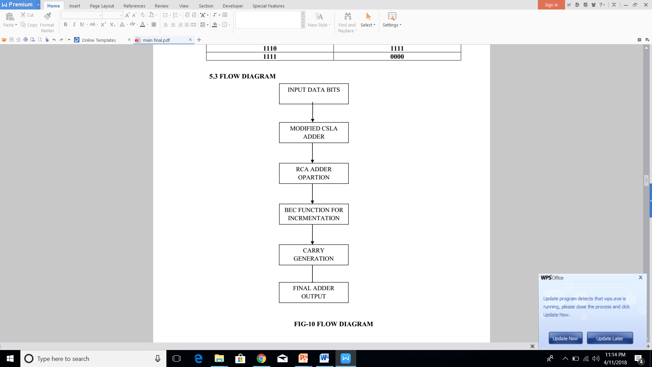
FLOW DIAGRAM

Slide 7
BLOCK DIAGRAM OF PROPOSED SCHEME

Slide 8
WORKING PRINCIPLE
The 32 bit Reconfigurable Carry look adder is used.
In RCLA the AND gate block is removed from the existing system.
The removed AND gate concist of many inputs.
By removing the AND gate the input carry time is reduced
By calculating propagation and generation the input carry time is reduced.
The time delay is reduced to 34.762ns.

Slide 9
ADVANTAGES
The proposed BEC function is to consume less power and area.
To consume less time for carry generation process.
Do not affect the overall adder architecture performance level

Slide 10
CONCLUSION
The time delay to do arithmatic calculations faster.
The redundant calculations is reduced.
The system works more faster than the existing system because the time dealy is reduced from 43.136ns to 34.762ns.
The adder process is fast and we get approximate values.

Slide 11
REFERENCE
[1] B. K. Mohanty and S. K. Patel, "Area–Delay–Power Efficient Carry-Select Adder," IEEE Transactions on Circuits and Systems II: Express Briefs, vol. 61, no. 6, pp. 418-422, June 2014.
[2] B. Shao and P. Li, "Array-Based Approximate Arithmetic Computing: A General Model and Applications to Multiplier and Squarer Design," IEEE Transactions on Circuits and Systems I: Regular Papers, vol. 62, no. 4, pp. 1081-1090, April 2015.
[3] A. Raha, H. Jayakumar, and V. Raghunathan, "Input-Based Dynamic Reconfiguration of Approximate Arithmetic Units for Video Encoding," IEEE Transactions on Very Large Scale Integration (VLSI) Systems, vol. 24, no. 99, pp. 1-1, May 2015.
[4] M. S. Khairy, A. Khajeh, A. M. Eltawil and F. J. Kurdahi, "Equi-Noise: A Statistical Model That Combines Embedded Memory Failures and Channel Noise," IEEE Transactions on Circuits and Systems I: Regular Papers, vol. 61, no. 2, pp. 407-419, Feb. 2014.
[5] R. Ye, T. Wang, F. Yuan, R. Kumar and Q. Xu, "On reconfiguration-oriented approximate adder design and its application," Proceedings of IEEE/ACM International Conference on Computer Aided Design (ICCAD), 2013, pp. 48-54.

