Slide 1
  WOMENS SAFETY WEARABLE DEVICE

Slide 2
CONTENTS
ABSTRACT
EXISTING SCHEME
PROBLEMS IDENTIFIED IN EXISTING SYSTEM
PROPOSED SCHEME
BLOCK DIAGRAM
FLOW CHART
HARDWARE TOOLS
SOFTWARE TOOLS USED AND ITS FEATURES
APPLICATIONS
OUTCOMES AND RESULTS
CONCLUSION AND FUTURE SCOPE
REFERENCES

Slide 3
ABSTRACT
The idea behind our project is that women should be free to live in the society without the fear of violence or attack. She must be able to come out of the house anytime fearlessly
Whenever lady feels she is in danger, she has to just press the emergency switch which would activate the entire circuitry to function as desired.
The switch would trigger the microcontroller board along with GPS and GSM module, at last shock generator is triggered.

Slide 4
EXISTING SCHEME
Safetipin
VithU
Raksha
Himmat
Chilla
Chand D, Nayak S, Bhat KS, Parikh S (2015). A mobile application for Women’s Safety: WoS App. 2015 IEEE Region 10 Conference TENCON; Macao. 2015 Nov 1-4. p. 1–5.

Slide 5
PROBLEMS IDENTIFIED IN EXISTING SYSTEM
The existing model requires the user to always carry a smartphone with her
It is only a safety alert system with no defense technology example vithU mobile application

Slide 6
PROPOSED SCHEME
The proposed scheme does not nessaciate the user to carry smartphone with her.
When the emergency switch is press, the location message is send to the pre-saved contacts and it can be viewed through Google map.
It also includes a defense technology integrated in it a shock generator circuit.

Slide 7
BLOCK DIAGRAM
POWER SUPPLY
MICRO CONTROLLER
PIC16F874A/877A
SWITCH
GSM MODULE
SHOCK GENERATOR CIRCUIT
GPS MODULE
7

Slide 8
HARDWARE TOOLS
MICROCONTROLLER PIC16F877A
Programming and coding is easier.
Main advantage is that it can be write-erase as many times as possible because it use “Flash memory”.
EEPROM – which makes it possible it store some of the information permanently like transmitter codes, receiver frequency and some other data.
Its very convenient to use.

Slide 9
GPS MODULE
GPS : GLOBAL POSITIONING SYSTEM
It’s a stand alone device.
It is designed with high sensitivity navigation.
It is small, high performance.
FEATURES:
It support jamming removing function.
Low noise amplifier has been integrator.

Slide 10
GSM MODULE
GMS: GLOBAL SYSTEM FOR MOBILE COMMUNICATION
It is a complete Quad-band GSM/GPRS solution in SMT type.
It can transmit voice, sms and data information with low power consumption.
It control via at commands.
FEATURES:
Jamming detection
Sms cell broadcast
Audio record

Slide 11
WORKING PRINCIPLE OF PROPOSED SCHEME
The proposed project describes “Women Safety Wearable Device” that provides the combination of GPS device and specialized software to track the victims location as well as provide alerts and messages with an emergency button trigger.
And also include shock generator circuit, there is a transistor in which diodes,two switches, LED light connecting wires are placed by pressing one button the shock generator circuit will be activated which is indicated by a red LED light and by pressing a second button the girl can give a shock to the person posing a threat.

Slide 12
Flow Chart For Women Safety Wearable Device
Switch is pressed
System turns ON
If Force sensor sensed
No
Yes
Collect co-ordinates through GPS&send Through GSM
Diffence switch is pessed
NO
Yes
Generate shock
Panic switch is pressed twice
System is turned off

Slide 13
SOFTWARE TOOLS USED AND ITS FEATURES
MPLAB
MP SIMULATOR
IC PROG
PIC START PLUS PROGRAMMER

Slide 14
MP LAB
It is a proprietary freeware integrated development environment for the development of embedded applications on PIC Microcontroller and developed in Microchip Technology.
It support project management, code editing, debugging and programming of microchip 8- bit, 16-bit, 32-bit PIC microcontroller.
It supports automatic code generation with the MPLAB code configurator.

Slide 15
FEATURES
Higher performance
Low power consumption
Slimmer and more compact
Mission-critical functions
Reduced design and development time
Lower system cost

Slide 16
APPLICATIONS
It is used for women’s safety.
It is used for child tracking during school time.
It is used in vehicle tracking and safety system.
It can be used for wild life tracking.

Slide 17
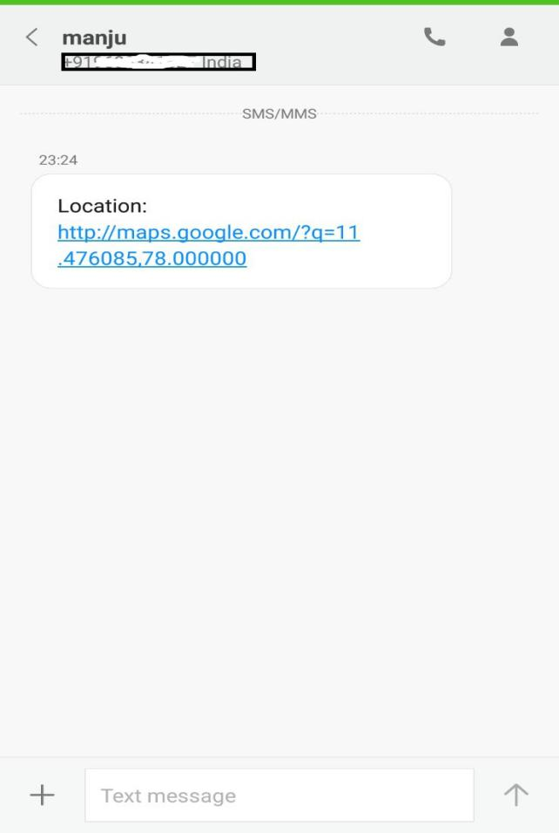
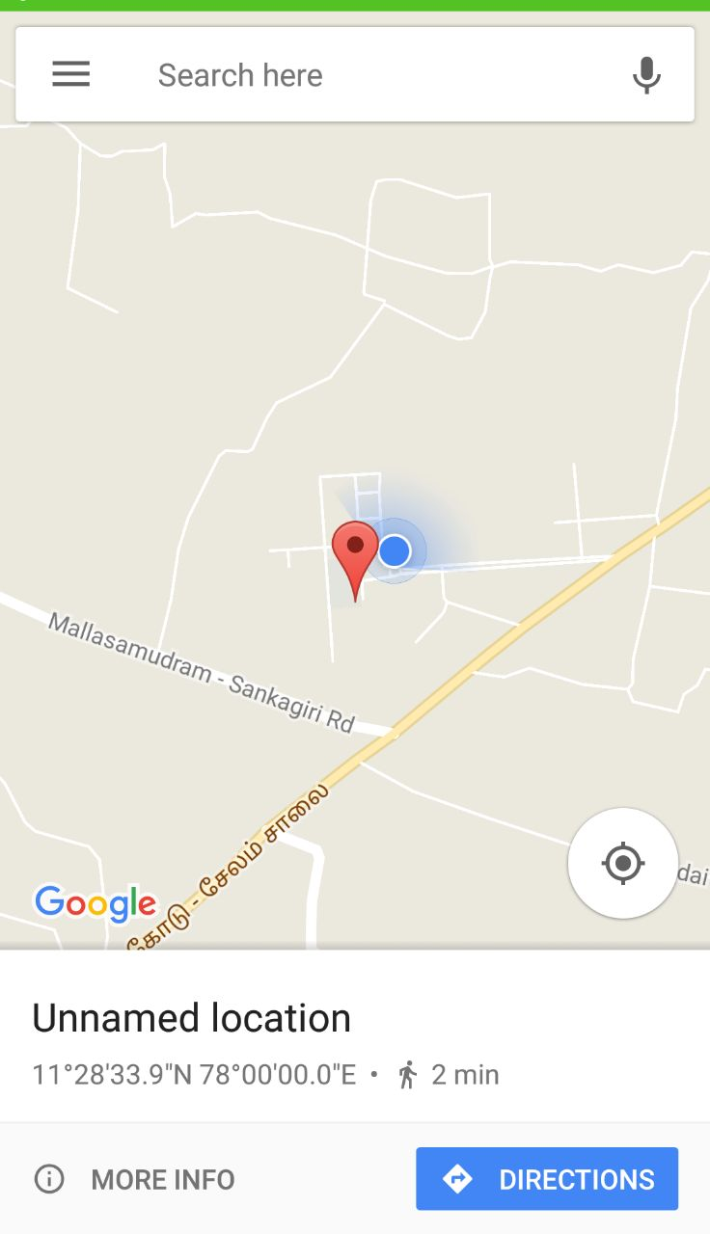
OUTCOMES AND RESULTS

Slide 18
CONCLUSION AND FUTURESCOPE
It can be concluded that the system helps to supports the gender equality by providing safe environment to women in the society,the allows them to work til late nights.
The proposed system provides the tool for intrusion detection inside the home where senior citizen,handicapped person or women leaving alone and after detection takes necessary preventive measure action to ensure safety.

Slide 19
FUTURE SCOPE
Primary school children safety.
Vehicle safety system module.

Slide 20
REFERENCES
B.chougula(2014),”smart girls security system”,International Journal of Application or innovation in Engineering &Management,vol.3,no4.
Chand D,Nayak S,Bhat KS,Parik S(2015).A mobile application for Women’s safety:wos app.2015 IEEE Region 10 conference TENCON;

Slide 21
THANK YOU

