Slide 1
  WIRELESS DC MOTOR SPEED AND DIRECTION CONTROL
  USING GSM

Slide 2
CONTENTS
Abstract
Existing Scheme
Block Diagram
Working principle
Hardware/Software components and Tools used
Outcome and Results
Conclusion and Future scope
References

Slide 3
ABSTRACT
The main aim of the project is to design a versatile device that can control dc motor by using GSM technology of wireless communication.
A GSM modem provides the communication interface. It transports device protocols transparently over the network through a serial interface.

Slide 4
EXISTING SCHEME
Mazidi, Muhammad ali, The 8051 Microcontroller and Embedded Systems,Second Edition, Prentice Hall.
Abu Zaharin Ahmad and MohdNasirTaib. A study On the DC Motor Speed Control by Using Back-EMF Voltage. Asia SENSE SENSOR.

Slide 5
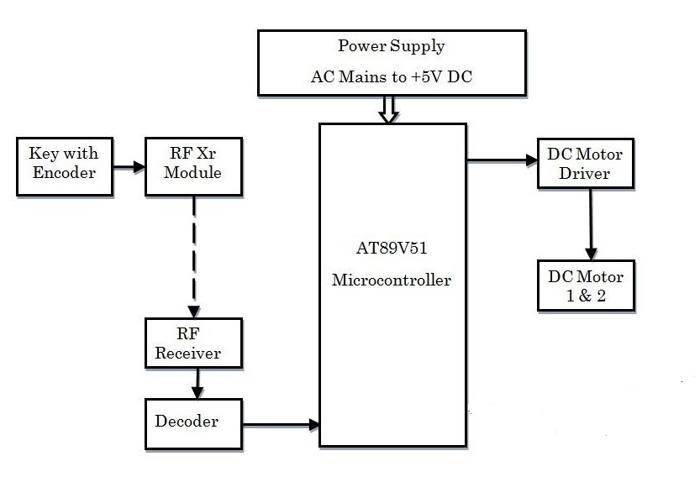
PROPOSED SYSTEM
(BLOCK DIAGRAM)

Slide 6
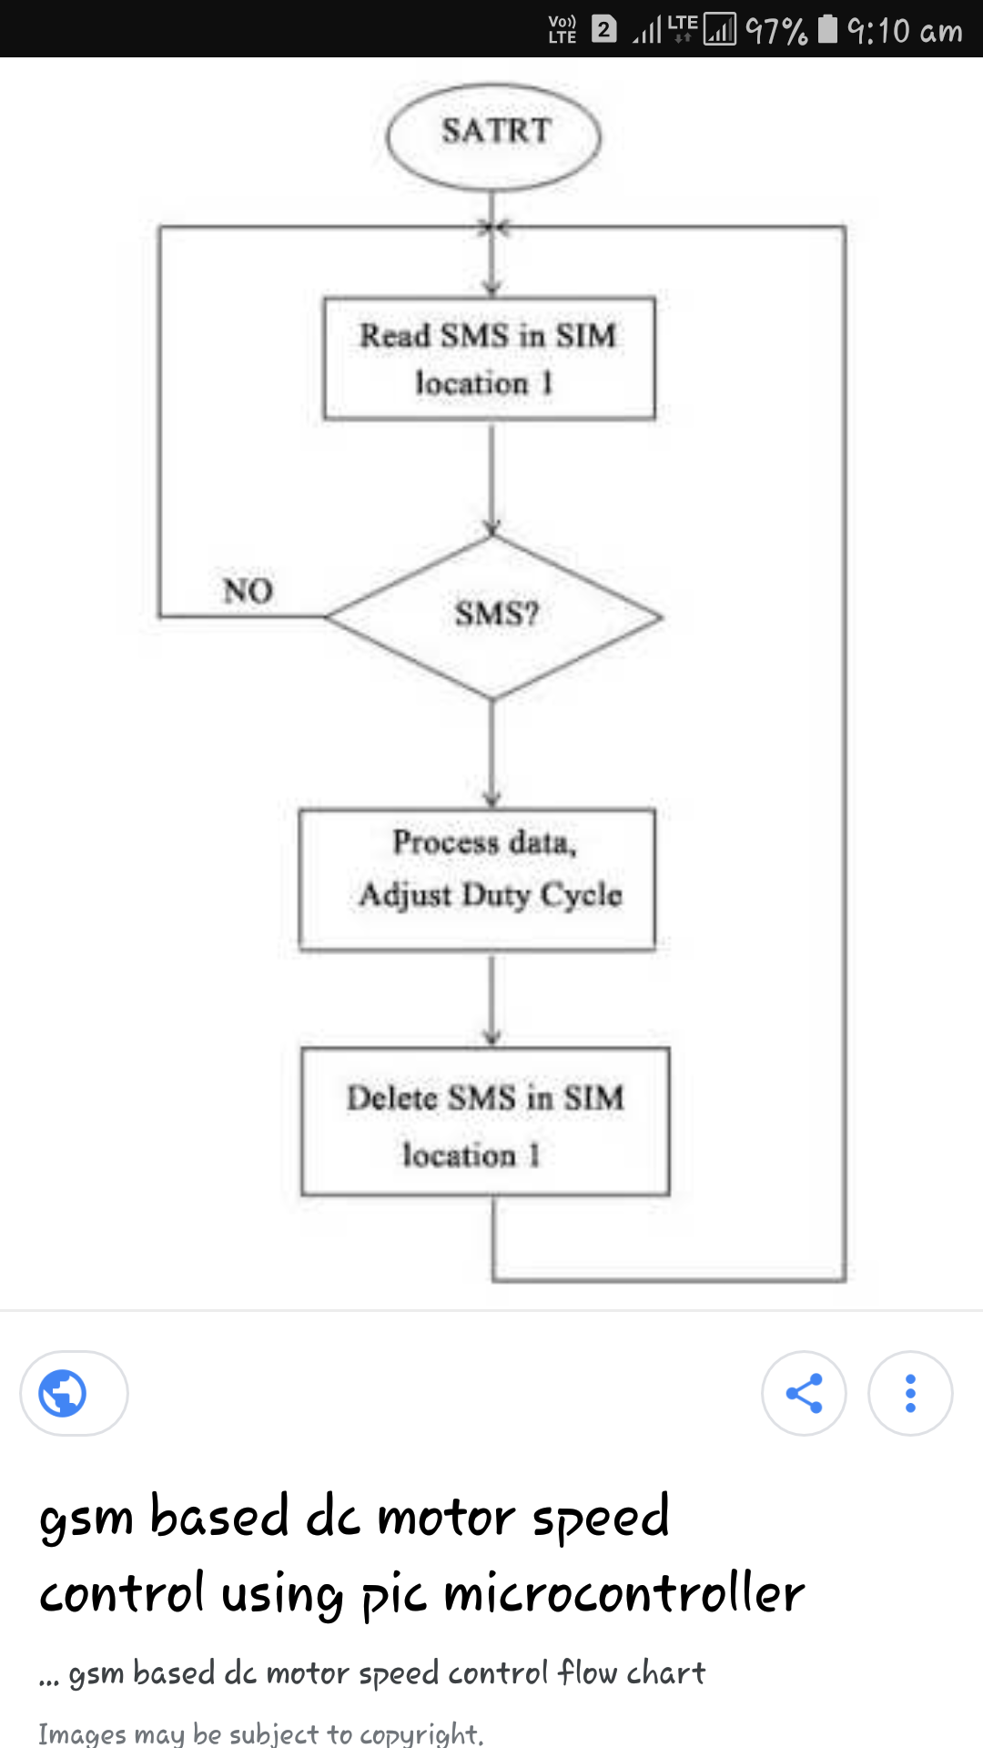
FLOW CHART

Slide 7
WORKING PRINCIPLE OF
PROPOSED SYSTEM
A simple DC motor works on the principle that when a current carrying conductor is placed in a magnetic field, it experiences a mechanical force. In a practical DC motor, the armature is the current carrying the conductor, and the field.
Through GSM module we can control the speed of the motor with interefacing software such as embedded C .

Slide 8
Hardware
Power supply unit
Microcontroller – ATMEL
GSM module
Drives
Mobile Phones

Slide 9
Software
Platform - AVR STUDIO
Compiler – Win AVR
Embedded C language

Slide 10
Power supply
A regulated power supply is the power supply with rectification, filtering and regulation being done on the AC mains to get a regulated power supply for microcontroller and for the other devices being interfaced in it.
A power supply can be passed evenly to each block, each block performs a particular function.

Slide 11
Microcontroller
ATmel is the microcontroller used in this project.
The controller has peripheral features like inbuilt ADC, required to get the signals from the sensors.
Maximum clock frequency is 20MHz and hence faster than 8051.
Based on RISC and Harvard architecture and hence even more faster.
Embedded C is used for programming the microcontroller.

Slide 12
Software Tool
Embedded C is generally an extension of the C language, they are more or less similar. However, some differences do exist, such as C is generally used for desktop computers, while embedded C is for microcontroller based applications. C can use the resources of a desktop PC like memory, OS, etc.

Slide 13
Features of Tool
Possesses of cross development in nature
Dependent on hardware architecture(microcontroller or other devices)
Used to limited resource like RAM,ROM and I/O peripherals on embedded controller

Slide 14
Outcome
Through gsm module after getting authentication passing on commands through embedded C software controls DC motor speed and direction.
To cover long range distance gsm is interfaced and also to secure the system

Slide 15
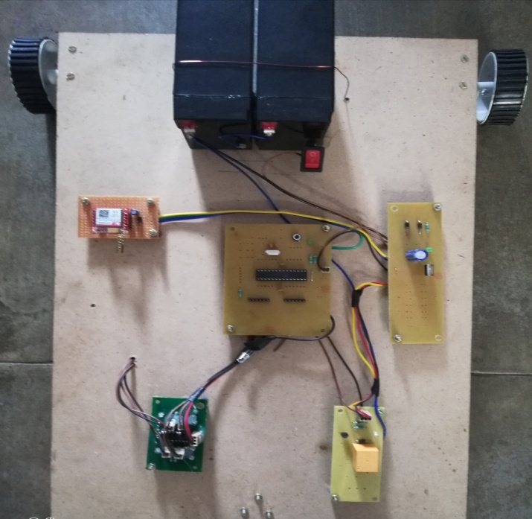
Results
GSM module is used to control the speed and direction over long range distances

Slide 16
Conclusion
The proposed system based on Atmel microcontroller interfaces with the DC motor to control speed and direction.
An embedded C software is used to pass the commands through mobile phones and works under the conditions registed in the controller.

Slide 17
Future scope
In future ,people can control the motor through android mobiles where technology is growing as sophisticated.
Long range distances can be observed with aditional image processing scheme and can control the motor with ease.

Slide 18
References
Theodore S. Rappaport, Wireless Communications, second edition, PHI. New Delhi 2014.
R.S. Sedha, 2002. A Text Book of Applied Electronics, S. Chand and Company Ltd., New Delhi 2014.
Lu, Willie w, open wireless architecture and Enhanced performance, guest Editorial, IEEE Communication Magazine, June 2016

Slide 19
THANK YOU

