Slide 1
VEDIC MULTIPLIER USING HALF ADDER AND FULL ADDER FOR MODERN PROCESSORS

Slide 2
CONTENTS
Introduction
Abstract
Existing scheme
Problems identified in existing scheme
Proposed Scheme
Block diagram of proposed scheme
Working principle
Software tools
Applications
Outcome and results
Conclusion
References

Slide 3
INTRODUCTION
Goal - To decrease the propagation delay thereby increasing the speed and performance of the processor.
High Speed multiplication is an essential requirement to increase the performance of the processor.
Multiplication is a critical operation of DSP applications, arithmetic & logic unit and MAC unit
The multiplication operation for higher order numbers can be easily calculated by using “Vedic Mathematics” concept.

Slide 4
ABSTRACT
The mathematical operations using Vedic Method are very fast and requires less hardware.
The use of Vedic Mathematics lies in the fact that it reduces the typical calculations in conventional mathematics to very simple ones.
Vedic Mathematics is based on 16 sutras, out of which we are using "Urdhva triyagbhyam" sutra.
In this technique intermediate products are generated in parallel, that makes multiplication faster.

Slide 5
EXISTING SCHEME
  Anannya Maiti, Koustuv Chakraborty, Razia Sultana, Santanu Maity, “Design and implementation of 4-bit vedic multiplier”, International Journal of Emerging Trends in Science and Technology- Vol.03, Issue05, Pages 3865-3868, May 2016, ISSN 2348-9480.
  Existing Scheme using Array Multiplier:
    An array multiplier is very regular in structure
    It is the combination of Full adders and Half adders
    The terms are summed by an array of “n(n-2)” full adders and “n” half adders

Slide 6
PROBLEMS IDENTIFIED IN EXISTING SCHEME
The delay associated with the array multiplier is the time taken by the signal to propagate through the AND gates and adders
The main disadvantage of the array multiplier is the worst-case delay of the multiplier proportional to the width of the multiplier that form the multiplication array
The speed will be slow for a very wide multiplier.

Slide 7
PROPOSED SYSTEM
In this proposed system, the number of logic levels are reduced, thus reducing the logic delay
This proposed multiplier is based on vedic mathematics
There are two sutras in Vedic Mathematics used for multiplication:
  Nikhilam Navatascaramam Dastah and Urdhva Tiryagbhyam
Proposed system includes “Urdhva Tiryagbhyam”
Urdhva – triyakbhyam is the general formula applicable to all cases of multiplication. It means “Vertically and cross wise”.

Slide 8
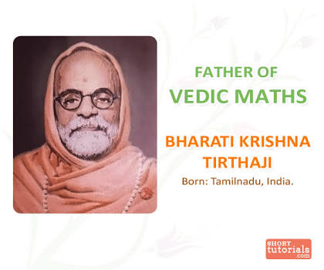
URDHVA TIRYAGBHYAM
  These sutras have been traditionally used for the multiplication of two numbers in the decimal number system.
  In this work, the same idea is applied to the binary number system to make the proposed algorithm compatible with the digital hardware.
  It is a general multiplication formula applicable to all cases of multiplication.

Slide 9
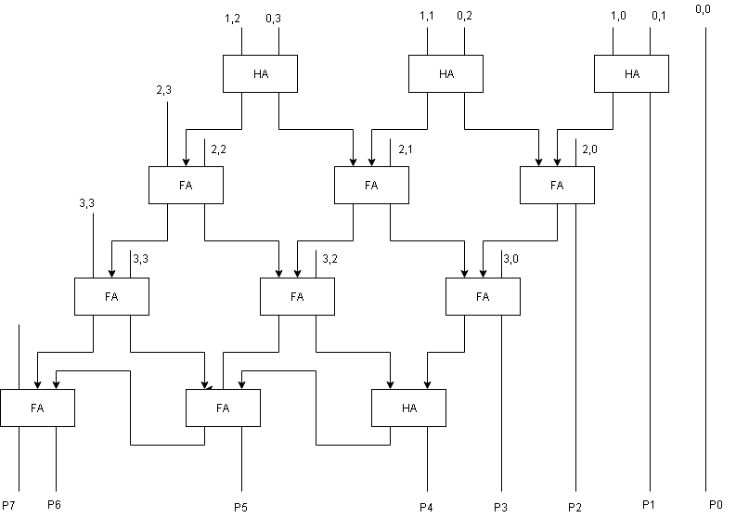
BLOCK DIAGRAM OF ARRAY MULTIPLIER

Slide 10
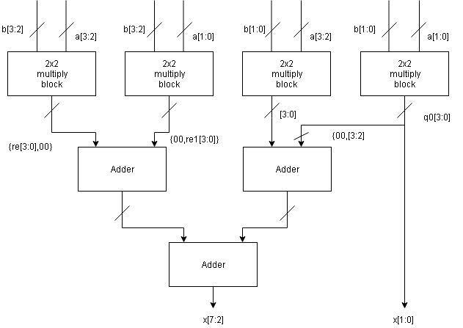
BLOCK DIAGRAM
4 x 4 Vedic Multiplier Block Diagram

Slide 11
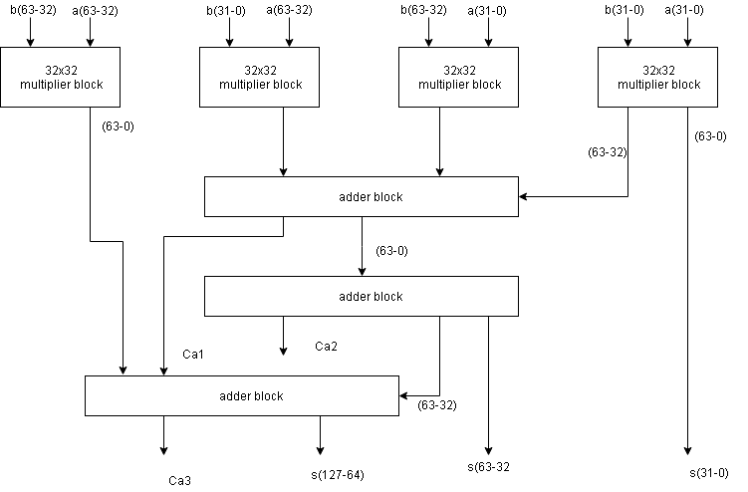
BLOCK DIAGRAM OF 64-BIT VEDIC MULTIPLIER

Slide 12
WORKING PRINCIPLE
The multiplier is based on the principle of “Urdhva Triyakbhyam”
It involves the following major steps
  The digits on the ends of the line are multiplied and result is stored
  Then the previous carry is added to it
  The LSB is considered as the answer bit of the multiplication and all other digits are considered as a previous carry for the next step
  When the number of lines becomes more than one in the same step, then all the outcomes are accumulated with the previous carries
  The same way is extended to the binary digit multiplication

Slide 13
METHODOLOGY
STEP-1:
2 1 9 Result = 18
3 1 2 Prev. carry = 0
_________________________
8 18
STEP-3:
2 1 9 Result = 27+1+4 = 32
3 1 2 Prev. carry = 1
_________________________
3 2 8 33
STEP-2:
2 1 9 Result = 2+9 = 11
3 1 2 Prev. carry = 1
____________________________
2 8 12

Slide 14
STEP-4:
2 1 9 Result = 2+3 = 5
3 1 2 Prev. carry = 3
_________________________
8 3 2 8 08
STEP-5:
2 1 9 Result = 6
3 1 2 Prev. carry = 0
________________________
6 8 3 2 8 6
The above method explains the three digit multiplication with “Vertically and Crosswise” technique

Slide 15
SOFTWARE TOOL USED
Xilinx ISE is a software tool produced by Xilinx for synthesis and analysis of HDL designs
It enables the developer to synthesize ("compile") their designs, perform timing analysis, examine RTL diagrams, simulate a design's reaction to different stimuli and configure the target device with the programmer
ModelSim or ISIM used to perform the following types of simulations
  Logical verification, to ensure the module produces expected results.
  Behavioral verification, to verify logical and timing issues.
  Post-place & route simulation, to verify behavior after placement of the module within the reconfigurable logic of the FPGA

Slide 16
APPLICATIONS
It find applications in Fast Fourier Transforms(FFTs)
To provide universal multiplication with low power high speed
Applications in system on chip design as technology scales
In public key cryptography like AES encryption and decryption
Laptop, Handheld, Wearable Computers
Implanted Medical Devices
Wallets “Smart Cards”

Slide 17
OUTCOME AND RESULT
When comparing with Array multiplier the combinational path delay is reduced.
This reduced delay will increase the speed of the multiplier as well as the performance of the processor
The usage of Half adders and Full adders reduce the circuit complexity

Slide 18
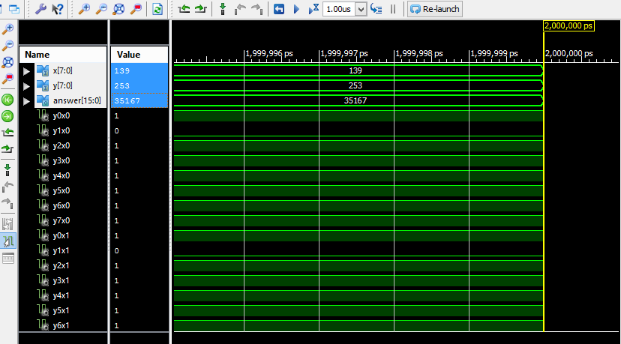
ARRAY MULTIPLIER

Slide 19
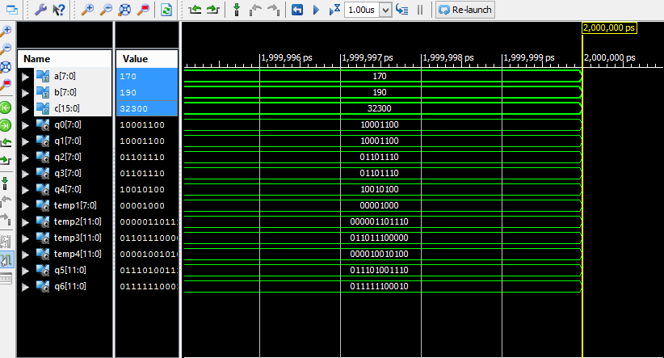
VEDIC MULTIPLIER

Slide 20
CONCLUSION
Hence it can be concluded that the performance of 8x8 Vedic Multiplier seems to be highly efficient in terms of speed when compared to Array Multipliers
So using 8x8 Vedic Multiplier the 64x64 Vedic Multiplier is designed
Comparison between Array Multiplier and Vedic Multiplier
Parameters | Array Multiplier | Vedic Multiplier
Delay (ns) | 31.114 | 22.489
Number of Logic Levels | 22 | 18
Power Consumption (W) | 0.034 | 0.034

Slide 21
REFERENCE
Anannya Maiti, Koustuv Chakraborty, Razia Sultana, Santanu Maity, “Design and implementation of 4-bit vedic multiplier”, International Journal of Emerging Trends in Science and Technology- Vol.03, Issue05, Pages 3865-3868, May 2016, ISSN 2348-9480.
Surbhi Bhardwaj, Ashwin Singh Dodan, “Design of High Speed Multiplier using Vedic Mathematics”, International Journal of Engineering Research and General Science- Vol.02, Issue04, June-July 2014, ISSN 2091-2730.
Savita Patil D.V. Manjunatha Divya Kiran “Design of Speed and Power Efficient Multipliers using Vedic Mathematics with VLSI implementation” 2014 IEEE International Conference on Advances in Electronics, Computers and Communications.

Slide 22
THANK YOU

Slide 23
QUERIES???

