Slide 1
  SYSTEM AND HOME APPLIANCES CONTROL USING MEMS ACCELEROMETER

Slide 2
CONTENTS
ABSTRACT
EXISTING SYSTEM
PROBLEM IDENTIFIED IN EXISTING SCHEME
EXISTING SCHEME BLOCK DIAGRAM
PROPOSED SCHEME WITH BLOK DIAGRAM
WORKING PRINCIPLE OF PROPOSED SCHEME
WORKING PRINCIPLE WITH FLOW CHART
MATHEMATICAL MODELING
SOFTWARE TOOLS USED AND ITS FEATURES
OUTCOMES AND RESULTS
CONCLUSION AND FUTURE SCOPE
REFERENCES

Slide 3
ABSTRACT
Due to the rapid development and research in the field of computer technology, human-computer interaction techniques have become an indispensable system in our daily life
The objective of this project is to control the system without touching mouse by using hand movement
The Circuit control the System and Home appliances

Slide 4
EXISTING SYSTEM
Ahmad Akl ,Chen Feng and Shahrokh Valaee(2011) , “A Novel Accelerometer-Based Gesture Recognition System”, IEEE Transactions On Signal Processing, Vol. 59, No. 12.
ShiguoLian , Wei Hu,Kai Wang,(2014) “Automatic User State Recognition for Hand Gesture Based Low-Cost Television Control System”,IEEE.

Slide 5
PROBLEMS IDENTIFIED IN EXISTING SCHEME
Accelerometers are generally used in mobiles ,vehicle, health monitoring application
System was generally controlled by wired mouse
Now a days wireless(Bluetooth) mouse also available but the coverange is 10 to 20 meters
In Bluetooth,the main problem is power consumption

Slide 6
EXISTING SCHEME BLOCK DIAGRAM
This circuit only for controlling the home appliances.
Power supply
PIC micro
controller
Accelerometer
Interfacing Circuit
LCD display
Relay
Appliances
Keypad

Slide 7
PROPOSED SYSTEM
In this project, the system mouse is Controlling by using hand movements
In this proposed system the zigbee technology is used which cover more distance compare to bluetooth technology
It not only perform the normal mouse operation also perform the keyboard operation(by using Visual Keyboard)
The circuit is also control the home appliances by using hand movements

Slide 8
BLOCK DIAGRAM OF PROPOSED SCHEME
Mode select
Mode 1:System
Mode 2:Appliances control
Power supply
txTX
PIC
Micro
controller
Driver
circuit
Relay
Appliances
Accelerometer
Matrix key
RS 232
Zigbee
RX
LCD display
Zigbee
RS 232
PC

Slide 9
WORKING PRINCIPLE OF
PROPOSED SYSTEM
Here the accelerometer is fixed with user’s hand. From this we can track the user’s hand movement
This sensor’s output is given to the PIC microcontroller. Then PIC transmits this value to the PC via Zigbee
In PC we create a application based on Visual Basic
This application control the cursor’s movement due to the signal from PIC
It also control the home appliance via relay

Slide 10
WORKING PRINCIPLE
WITH FLOW CHART
START
Initialize accelerometer x,,y,z axis
If mode 1 select?
no
yes
if mode 2 select
No operation
no
Mouse control
yes
Home appliance control
STOP
10

Slide 11
MATHEMATICAL MODEL
Bluetooth power consumption is rated at
V=5V,I=0.25
P=V*I
P=5*(0.25)
P=1.25W
Zigbee power consumption is,
V=3.5V,I=0.25A
P=V*I
P=3.5*(0.25)
P=0.875W
When use Zigbee 0.375W power is saved.

Slide 12
SOFTWARE TOOLS USED AND ITS FEATURES
The software tool MPLAB(IDE V 8.33) is used
The MPLAB C compiler produces files in a format which is compatible with the PIC simulator/debugger which they call studio and whose running program in this software tool
MPLAB SIMULATOR
MPLAB SIM is a discrete-event simulator for the PIC microcontroller (MCU) families. It is integrated into MPLAB IDE integrated development environment. The MPLAB SIM debugging tool is designed to model operation of Microchip Technology's PIC microcontrollers to assist users in debugging software for these devices

Slide 13
SOFTWARE TOOLS USED AND ITS FEATURES
PROCEDURE
Create source code using the built-in editor
Assemble, compile and link source code using various language tools. An assembler, linker and librarian come with MPLAB IDE. C compilers are available from Microchip and other third party vendors.Debug the errors
FEATURES
Easy to implement
Low cost
It makes the process simple

Slide 14
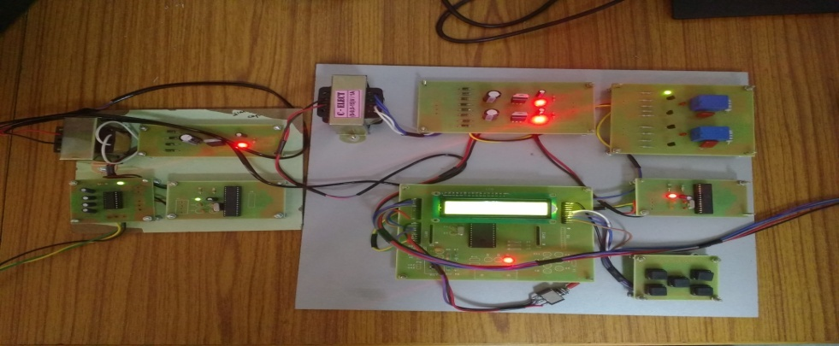
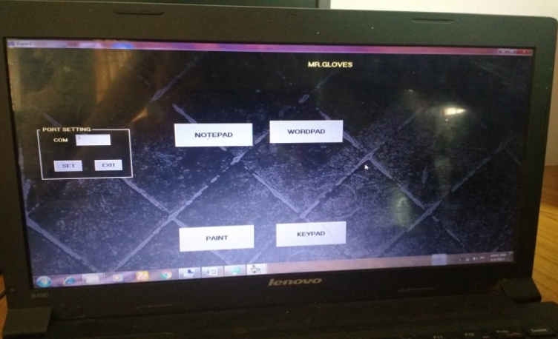
OUTCOMES AND RESULTS
In output ,user select the mode 1, the accelerometer control the mouse operation.
User select the mode 2,the accelerometer control the home appliance connected to the relay
In this the circuit saves both battery and time
It cover more distance compared to bluetooth

Slide 15
CONCLUSION
The proposed system of controlling the system and home appliances are succesfully controlled by using hand movements
The power consumption is also reduced
The progress in science & technology is a non-stop process. New things and new technology are being invented. As the technology grows day by day. The principle of the development of science is that “nothing is impossible”. So we shall look forward to a bright & sophisticated world

Slide 16
FUTURE SCOPE
In future work is to extend the proposed system to incorporate gesture spotting
In our proposed system, the starting point of a gesture trace was marked by pressing and holding the ‘trigger’ button on the bottom of the hand.
In future it can operate as handwritten recognition for identifying the digits and characters and also it provides static authentication for the system by recognizing the characters and digits
Therefore, a more realistic scenario would be to detect meaningful gesture traces from a stream of hand movements and recognizing the gesture traces accordingly

Slide 17
REFERENCES
Ahmad Akl ,Chen Feng and Shahrok Valaee ,(2010)“A Novel Accelerometer-Based Gesture Recognition System”, IEEE Transactions On Signal Processing, Vol. 59, No. 12.
Zhuxin Dong,Wejinya U.C. and LiW.,(2010)“An Optical-Tracking Calibration Method for MEMS-Based Digital Writing Instrument”, IEEE Sensors Journal, pp. 1543-1551 .
Yilun Luo, Chi Chiu Tsang, Guanglie Zhang, Zhuxin Dong,Guangyi Shi,Sze Yin Kwok, Li W., Leong P.H.W. and MingYiu Wong,(2006) “An Attitude Compensation Technique for a MEMS Motion Sensor Based Digital Writing Instrument”, Proceedings of the IEEE International Conference onNano/Micro Engineered and Molecular Systems, pp. 909-914.

Slide 18
REFERENCES
Bassam Sayed, Issa Traor´e, Isaac Woungang, and Mohammad S.Obaidat(2013) “Biometric Authentication Using Mouse Gesture Dynamics”, IEEE systems journal, Vol. 7, pp. 262-274.
Z. Dong, U. C. Wejinya, and W. J. Li,(2010) “An optical-tracking calibration method for MEMSbased digital writing instrument,” IEEE Sens. J.vol. 10, no. 10, pp. 1543–1551.
Shiguo Lian,Wei Hu, Kai Wang,(2014) “Automatic User State Recognition for Hand Gesture Based Low-Cost Television Control System”,IEEE.
Mansour H. Assaf, Ronald Mootoo, Sunil R. Das, Emil M.Petriu, Voicu Groza, and Satyendra Biswas,(2012) “Sensor Based Home Automation and Security System”, IEEE.

Slide 19
THANK YOU

