Slide 1
REAL TIME AUDIO UPSAMPLING AND FILTERING

Slide 2
CONTENTS
Abstract
Existing Scheme
Project Outline
Block Diagram
ADSP-21479 SHARC Processor
AD1939 Codec
Asynchronous Sample Rate Converter
Serial Ports
Serial Peripheral Interface Ports
FIR Filter Accelerator
Software Tool Used and its Features
Flow Chart
Real Time View of Project

Slide 3
ABSTRACT
This project is 'Up sampling and filtering the Real time audio signal' using ADSP-21479 EZ-Kit.
The 48 KHz analog audio signal is given as an input to the ADSP-21479 EZ-Kit and the audio CODEC converts it to digital samples prior to send to DSP.
Digital audio samples are received to the processor via the SPORT interface connected to the CODEC.
Asynchronous Sample Rate Converter inside the processor is programmed to up-sample the 48KHz signal into192KHz.
Subsequently the Up sampled audio signal is fed into the FIR accelerator in order to filter the noise of the audio signal.
Finally the filtered audio output samples are converted to analog via DAC in the CODEC, which be audible through Headphone or Speaker attached to the EZ-Kit.

Slide 4
EXISTING SCHEME
Prof . J .Bilmes “Digital Signal Processing Lecture 9 : Upsampling and Downsampling” , University of Washington.
In this Paper Upsampling and Downsampling techniques can be used in Audio Signal.
Upsampling increase the Sampling Rate of the Audio Signal and Downsampling decrease the Sampling Rate .
Upsampling technique is known as Interpolation and Decimation means Downsampling.

Slide 5

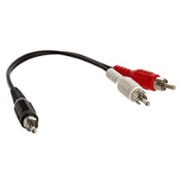
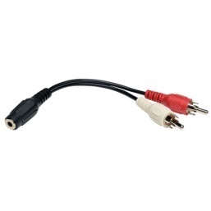
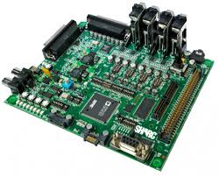
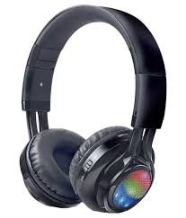
PROJECT OUTLINE
RCA Connector
Computer
RCA Connector
ADSP-21479 Ez-Kit
Head Set

Slide 6
PROPOSED SYSTEM WITH BLOCK DIAGRAM
Audio IN
RCA CONNECTORS
AD1939 CODEC
RCA CONNECTORS
Audio OUT
ADC
DAC
SPI
4
SPORT
SPORT
ADSP-21479
Processor
266 MHz 176-Lead LQFP
ASRC
FIR Filter Accelerator
Clock
Oscillator
SPORT
Push Button
RESET
JTAG port
JTAG connector
DPI
SPI flash
ADSP-21479 Ez-Kit Rev 2.0

Slide 7
PROPOSED SYSTEM WITH BLOCK DIAGRAM
Audio IN
RCA CONNECTORS
AD1939 CODEC
RCA CONNECTORS
Audio OUT
ADC
DAC
SPI
4
SPORT
SPORT
ADSP-21479
Processor
266 MHz 176-Lead LQFP
ASRC
FIR Filter Accelerator
Clock
Oscillator
SPORT
Push Button
RESET
JTAG port
JTAG connector
DPI
SPI flash
ADSP-21479 Ez-Kit Rev 2.0

Slide 8
ADSP-21479 SHARC PROCESSOR
Features:
High Performance Fourth Generation DSP of Analog Devices
Supports both 32-bit fixed-point and 32-/40-bit floating-point
processing
It supports Serial peripherals like SPI, SPORT etc…
266 MHz core clock speed
Power Supply - 3.3 V
5 Mega bits of on-chip RAM
FIR, IIR, and FFT accelerators

Slide 9
AD1939 CODEC
The AD1939 is a high performance, single-chip codec that provides four analog-to-digital converters (ADCs) with differential input and eight digital-to-analog converters (DACs) with differential output.
Supports 24-bits and 8 kHz to 192 kHz sample rates
Master clock 12.288 MHz (48 kHz fS, 256 × fS mode)
Applications:
Automotive audio systems
Home Theater Systems
Set-top boxes
Digital audio effects processors

Slide 10
Analog to Digital Converter :
Digital outputs are supplied through two serial data output pins (one for each stereo pair) and a common frame clock (ALRCLK) and bit clock (ABCLK).
ALRCLK – ADC Left Right Clock
ABCLK – ADC Bit Clock
a
ALRCLK
Analog input
ADC
ABCLK
ASDATA 1
ASDATA 2

Slide 11
Digital to Analog Converter :
Digital inputs are supplied through four serial data input pins (one for each stereo pair) and a common frame clock (DLRCLK) and bit clock (DBCLK).
DLRCLK – DAC Left Right Clock
DBCLK – DAC Bit Clock
DLRCLK
a
DBCLK
DSDATA 1
DAC
Analog output
DSDATA 2
DSDATA 3
DSDATA 4

Slide 12
ASYNCHRONOUS SAMPLE RATE CONVERTER
Sample-rate conversion is the process of changing the sampling rate of a discrete signal to obtain a new discrete representation of the underlying continuous signal
Controllable muting options (hardware, software and automatic)
Supports left-justified, I2S, right-justified (16-,18-, 20-, 24-bits), and TDM serial port modes.
Input
Output
Clock
aa
Clock
Frame sync
ASRC
Frame sync
Input Data
Output Data

Slide 13
SERIAL PORTS (SPORTS)
The processors have eight independent, synchronous serial ports (SPORTs)
that provide an I/O interface to a wide variety of peripheral devices and
are optimized for multichannel audio applications
Two bidirectional channels (A and B) per serial port, configurable as either
transmitters or receivers
s
Clock
SPORT
Frame Sync
Data A
Data B

Slide 14
SERIAL PERIPHERAL INTERFACE PORTS
The SPI ports support communication with a variety of peripheral devices
including codecs, data converters, sample rate converters etc…
A simple 4-wire interface consisting of two data pins, a device select pin,
and a clock pin
CLOCK
SPI
MOSI
MISO
FLAG

Slide 15
FIR FILTER ACCELERATOR
Finite Impulse Response (FIR) are used in a wide array of applications and
can be used in multirate processing in conjunction with an interpolator or
decimator
FIR supports Fixed Point and IEEE Floating Point Format
Various Rounding Modes Supported
Change the rates with decimation or interpolation mode
Single rate or multi-rate window processing
Up to 32 filter channels available in TDM

Slide 16
SOFTWARE TOOLS USED AND ITS FEATURES
Visual DSP ++5.1 is a tool used for this SHARC Processor.
It is easy to install and easy to use integrated software development and debugging environment (IDDE) that enables efficient managements of projects from start to finish from within a single interface.
Support variety of debug targets (Emulation , Simulation , Compiled Simulation and 3rd party offerings

Slide 17
FLOW CHART
Start
Initialize the PLL
Initialize the Input Output Pins
Initialize the SPI
Initialize the SRC
Enable the SPORT
SPORT 1
Interrupt
No
Yes
A

Slide 18
CONT…
A
Process AD1939 Samples
SPORT 3 Transmit to SRC
SPORT 4 Receives and send to memory
Then FIR samples the data and stores into the memory
B

Slide 19
CONT…
B
From the memory SPORT 0 & SPORT 2 Transmit to DAC
DAC send the Filtered output to RCA
Getting output through headset
Stop

Slide 20
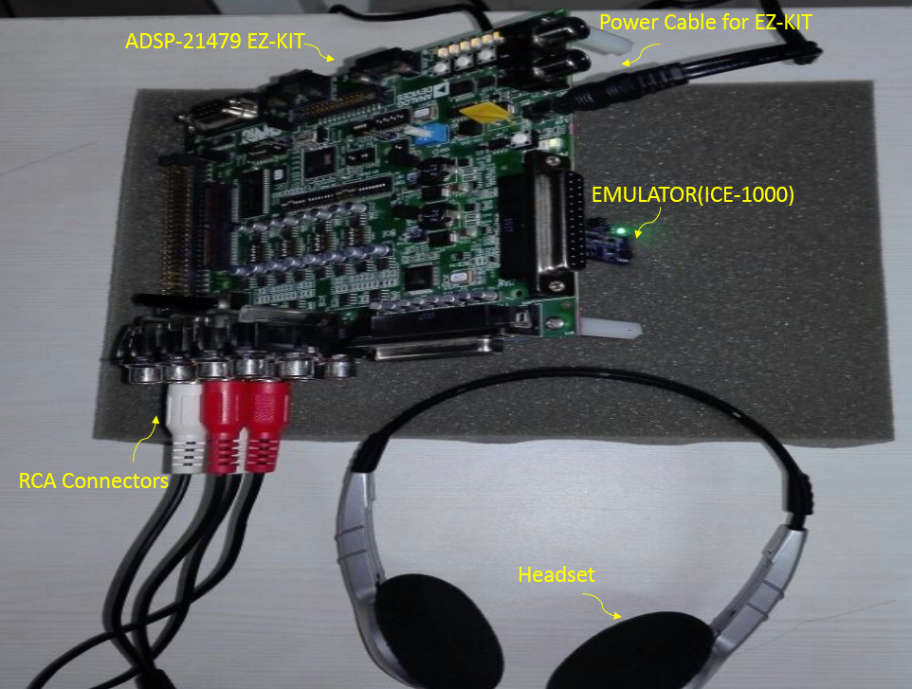
Real Time view of project

