Slide 1
Enabling Cost-Effective, SLO-Aware MachineLearning Inference Serving on Public Cloud

Slide 2
Abstract
The remarkable advances of Machine Learning (ML) have spurred an increasing demand for ML-as-a-Service on public cloud: developers train and publish ML models as online services to provide low-latency inference for dynamic queries. The primary challenge of ML model serving is to meet the response-time Service-Level Objectives (SLOs) of inference workloads while minimizing serving cost. In this paper, we proposes MArk (Model Ark), a general-purpose inference serving system, to tackle the dual challenge of SLO compliance and cost effectiveness. MArk employs three design choices tailored to inference workload.
First, MArk dynamically batches requests and opportunistically serves them using expensive hardware accelerators (e.g., GPU) for improved performance cost ratio. Second, instead of relying on feedback control scaling or over-provisioning to serve dynamic workload, which can be too slow or too expensive, MArk employs predictive auto scaling to hide the provisioning latency at low cost.

Slide 3
Third, given the stateless nature of inference serving, MArk exploits the flexible, yet costly server less instances to cover occasional load spikes that are hard to predict. We evaluated the performance of MArk using several state-of-the-art ML models trained in Tensor Flow, MXNet, and Keras. Compared with the premier industrial ML serving platform Sage Maker, MArk reduces the serving cost up to7.8×while achieving even better latency performance.

Slide 4
Existing System
The advances of Machine Learning (ML) have sparked growing demand of ML-as-a-Service: developers train ML models and publish them in the cloud as online services to provide low-latency inference at scale. The key challenge of ML model serving is to meet the response-time Service Level Objectives (SLOs) of inference workloads while minimizing the serving cost.

Slide 5
Disadvantage of Existing System
The accuracy of prediction depends on the underlying workload, there is no such a universal method that works perfectly in all cases.
The challenge is how to gracefully handle unavoidable prediction errors and unexpected load surges.

Slide 6
PROPOSED SYSTEM :
In this paper, we tackle the dual challenge ofSLO compliance and cost effectiveness with MArk (ModelArk), a general-purpose inference serving system built in Amazon Web Services (AWS). MArk employs three design choices tailor-made for inference workload.
First, MArk dynamically batches requests and opportunistically serves them using expensive hardware accelerators (e.g., GPU) for im-proved performance-cost ratio. Second, instead of relying on feedback control scaling or over-provisioning to serve dynamic workload, which can be too slow or too expensive for inference serving, MArk employs predictive auto scaling to hide the provisioning latency at low cost.

Slide 7
Third, given the stateless nature of inference serving, MArk exploits the flexible, yet costly server less instances to cover the occasional load spikes that are hard to predict. We evaluated the per-for mance of MArk using several state-of-the-art ML models trained in popular frameworks including Tens or Flow, MXNet,and Keras. Compared with the premier industrial ML serving platform Sage Maker, MArk reduces the serving cost up to7.8×while achieving even better latency performance.

Slide 8
ADVANTAGE
Therefore, an ML model serving system should strive to meet the target SLOs while minimizing the cost of provisioning the serving instances in the cloud.
Our measurements suggest that among the three options, IaaS offers the best performance-cost ratio for inference serving, but it incurs long instance provisioning latency and is hence unable to quickly adapt to the changing workload

Slide 9
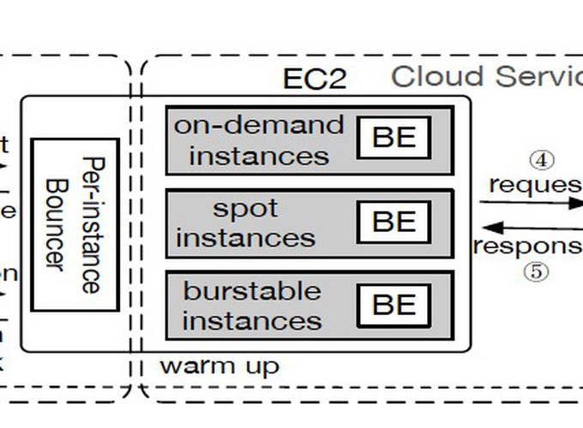
Architecture Diagram

Slide 10
Literature Survey
TITTLE | AUTHOR | CONCEPT
Enabling cost-aware and adaptive elasticity of multitier cloud applications. | HAN, R., GHANEM, M. M., GUO, L., GUO, Y.,ANDOSMOND,M. | Elasticity (on-demand scaling) of applications is one of the most important features of cloud computing.
Cutting the cost of hosting online services using cloud spot markets. | HE, X., SHENOY, P., SITARAMAN, R.,ANDIRWIN, D. | The use of cloud servers to host modern Internet-based services is becoming increasingly common. Today's cloud platforms offer a choice of server types, including non-revocable on-demand servers and cheaper but revocable spot servers.

Slide 11
TITTLE | AUTHOR | CONCEPT
Exploiting spot and burs table instances for improving the cost efficacy of in memory caches on the public cloud. | WANG, C., URGAONKAR, B., GUPTA, A., KESIDIS, G.,ANDLIANG, Q. | Public clouds offer numerous virtual machine (VM) types with complex trade-offs that tenants must navigate for cost-effective resource procurement.
Auto scaling web applications in clouds | QU, C., CALHEIROS, R. N.,ANDBUYYA, R. | Web application providers have been migrating their applications to cloud data centers, attracted by the emerging cloud computing paradigm. One of the appealing features of cloud is elasticity.

Slide 12
SOFTWARE REQUIREMENTS:
Operating System : Windows XP.
Platform : DOT NET TECHNOLOGY
Front End : ASP.Net 3.5
Back End : SQL SERVER 2005

Slide 13
HARDWARE REQUIREMENTS:
Keyboard
Mouse
Hard disk 500GB
Ram 4 Gb

Slide 14
REFERENCES
1. HAN, R., GHANEM, M. M., GUO, L., GUO, Y.,ANDOSMOND,M. Enabling cost-aware and adaptive elasticity of multitier cloud applications.Future Generation Computer Systems 32(2014), 82–98.
2.HE, X., SHENOY, P., SITARAMAN, R.,ANDIRWIN, D. Cutting the cost of hosting online services using cloud spot markets. In Proceedings of the 24th International Symposium on High-Performance Parallel and Distributed Computing (2015), ACM, pp. 207–218.
3. QU, C., CALHEIROS, R. N.,ANDBUYYA, R. A reliable and cost-efficient auto-scaling system for web applications using heterogeneous spot instances. Journal of Network and Computer Applications65(2016), 167–180.
4.WANG, C., URGAONKAR, B., GUPTA, A., KESIDIS, G.,ANDLIANG, Q. Exploiting spot and burs table instances for improving the cost efficacy of in memory caches on the public cloud. In Proceedings of ACM EuroSys(2017).

Slide 15
5.YI, J., ZHANG, C., WANG, W., LI, C.,ANDYAN, F.Not all explorations are equal: Harnessing heterogeneous profiling cost for efficient mlaas training. In the 34th IEEE IEEE International Parallel & Distributed Processing Symposium (IPDPS)(2020), IEEE.
6.ZHANG, C., YU, M., WANG, W.,ANDYAN, F. Mark: Exploitingcloud services for cost-effective, slo-aware machine learning inference serving. In USENIX ATC(2019).
7.QU, C., CALHEIROS, R. N.,ANDBUYYA, R. Autoscaling web applications in clouds: A taxonomy and survey.ACM Computing Surveys (CSUR) 51, 4 (2018), 73.
8.LEE, H., SATYAM, K.,ANDFOX, G.Evaluation of production server less computing environments. In Proceedings of IEEECLOUD (2018).
9.ALI-ELDIN, A., KIHL, M., TORDSSON, J.,ANDELMROTH, E. Ef-ficient provisioning of bursty scientific workloads on the cloudusing adaptive elasticity control. In Proceedings of the 3rd ACMWorkshop on Scientific Cloud Computing(2012).

