Slide 1
  Optimal Routing Analysis With RIP and OSPF
  Deployment in WAN

Slide 2
CONTENTS
Abstract
Existing Scheme
Introduction to IPv6
Proposed System With Block Diagram
Working Principle of Proposed System
Working Principle With Flow Chart
About the Software
Outcome and Results
Conclusion and Future Scope

Slide 3
ABSTRACT
An efficient dynamic routing protocol is necessary for the future broadband networks where a variety of Quality of Services are integrated.
This paper proposes an approach in which the outcome of deployment of RIPng and OSPFv3 on a network is explored on three aspects:
a) variation of packet loss in RIPng and OSPFv3 network .
b) Variation of convergence time of RIPng and OSPFv3.
c) Variation of latency in RIPng and OSPFv3.
d) Variation of throughput in RIPng and OSPFv3.
The various routing concepts are analyzed in IPv6 network in terms of packet loss and convergence time. Results manifest that the proposed approach yields better performance improvement over the existing strategies.

Slide 4
EXISTING SCHEME
  The internet protocol version 4, or IPv4, is the defined standard in the world today, but it is being replaced by the more advanced IPv6, to help solve the IP address exhaustion problem that is looming on the horizon.
  IPv4 Disadvantages:
  Limited address space.
  The most visible and urgent problem with using IPv4 on the
  modern internet is the rapid depletion of public addresses.

Slide 5
EXISTING SCHEME Cont..
Limitations of IPv4:
Shortage of IP address
IPv4, 32bits allows for 4,294,967,296 addresses
IP address exhaustion
Extended use of TCP/IP
TCP cannot conclude a transmission without all data in
motion being explicitly acknowledged.
TCP cannot be used for broadcast or multicast
transmission.

Slide 6
Introduction to IPv6
More efficient routing:
IPv6 reduces the size of routing tables and makes routing more efficient.
IPv6 allows ISPs to aggregate the prefixes of their customer’s network into a single prefix and announce this one prefix to the IPv6 internet.
Simplified network configuration
Address auto-configuration (address assignment) is built into IPv6

Slide 7
Introduction to IPv6 cont…
Support for new services:
By eliminating Network Address Translation (NAT), true end-to-end connectivity at the IP layer is restored, enabling new and valuable services.
Security:
IPSec, which provides confidentiality, authentication and data integrity, is baked into in IPv6.

Slide 8
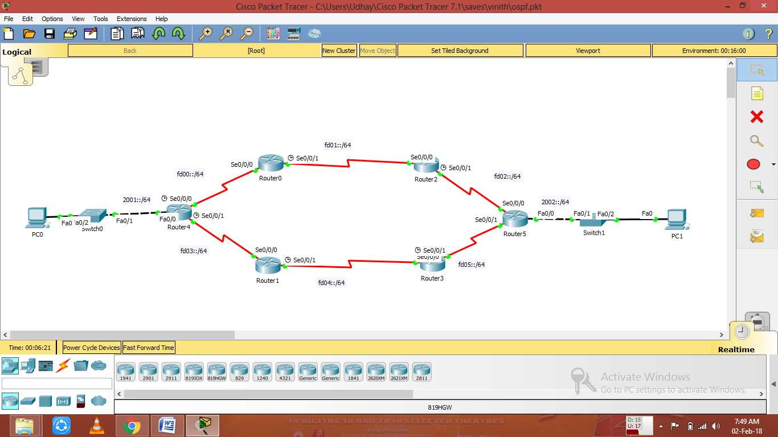
PROPOSED SYSTEM WITH BLOCK DIAGRAM

Slide 9
WORKING PRINCIPLE OF
PROPOSED SYSTEM
CISCO Packet Tracer V6 ( Software Simulation Tool)

Slide 10
WORKING PRINCIPLE WITH FLOW CHART
END
OPEN the CISCO packet tracer
Placing the routers in the tool and configure it
Enter the command of RIP and OSPF protocols

Slide 11
About the Software
We used Cisco packet tracer v6 for this project, and main thing about this software is essential for networking .
Its having lot of features like different availability of routers, switches, wires, IoT Elements and so on…
The software allows user to simulate the configuration of routers and switches using a command.

Slide 12
About the Software Cont
Packet tracer is a cross-platform visual simulation tool designed by Cisco systems that allows user to create network topologies and imitate modern computer networks.
Packet tracer supports an array of simulated applications layer protocols, as well as basic routing with RIP, OSPF, EIGRP.

Slide 13
Outcome and Results
The outcome for this project is analysis of RIP and OSPF protocols in the IPv6.
As we compare the three protocols report on various datagram size and we got the different results(Latency and Throughput).
All the protocols shows the different transmission speed of various datagram size.

Slide 14
Outcome and Results Cont…
In IPv6 there is no maximum losses of packets when compared to IPv4.
Since IPv6 is so reliable than IPv4 that’s why we got the definite outcome.
In IPv6 also causes some delays but its so minimum but in IPv4 delay will be maximum.

Slide 15
Outcome and Results Cont…
Almost we done everything in this project and we done the analysed value(Latency and Throughput).
These results were done and compared in the excel sheet.
Finally OSPF protocol only having the maximum throughput and less delay.

Slide 16
Conclusion and Future Scope
Since we using the IPv4 in the network because IPv6 installation process quite more cost of investments that’s why in most of the countries using IPv4 network.
But there is a another process for implementation of IPv6 is “CONVERGENCE”.
This process is combining the IPv4 and IPv6 this is known as convergence of network.

Slide 17
      Thank You

