Slide 1
MONITORING THE UNDERGROUND MINE ENVIRONMENT

Slide 2
CONTENTS
Abstract
Existing Scheme
Problems identified in existing scheme
Proposed scheme
Block diagram of proposed scheme
Working principle of proposed system
Applications

Slide 3
ABSTRACT
Underground mines are more hazardous in nature and contain unsafe zones for their workers.
There is the need to develop an effective, secure, reliable and low cost surveillance and safety system in underground mines.
This project presents a low cost, low power mobile wireless underground mine environment monitoring system, developed by using the RF Technology.

Slide 4
EXISTING SCHEME
"Application of gas monitoring sensors in underground coal mines and hazardous area," International Journal of Computer Technology and Electronics Engineering, Vol. 3 (3), pp. 9-23, June 2013.
"A study of the security monitoring system in coal mine underground based on WSN," IEEE 3rd International Conference on Communication Software and Networks (ICCSN), 2011, pp. 91-93.
“A Smart low power wireless sensor network for underground mine environment monitoring,” 3rd Int'l Conf. on Recent Advances in Information Technology, RAIT-2016.

Slide 5
PROBLEMS IDENTIFIED IN EXISTING SYSTEM
Short range communication 10 to 80 meter
More sensor used
More power required
No data was recorded

Slide 6
PROPOSED SCHEME
Communicating long range
Sensor reduced
Reliable
RF communication used
Data record in pc

Slide 7
BLOCK DIAGRAM OF PROPOSED SCHEME
TRANSMITTER
PIC
16F877A
MICRO
CONTROLLER
Air monitoring
SCU
RF
TRANSMITER
Helmet monitoring
SCU
buzzer
RF Tag
RF Reader

Slide 8
RECEIVER
16x2 LCD
PIC
16F877A
MICRO
CONTROLLER
RF
RECEIVER
PC

Slide 9
WORKING PRINCIPLE OF
PROPOSED SYSTEM
Hardware component:
Power supply
Microcontroller
Serial driver
RF Reader
RFID Tag
16x2LCD

Slide 10
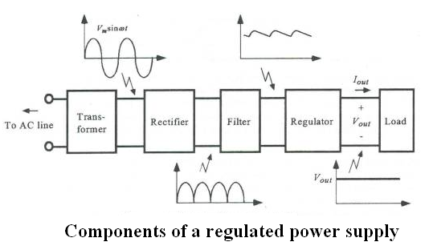
POWER SUPPLY

Slide 11
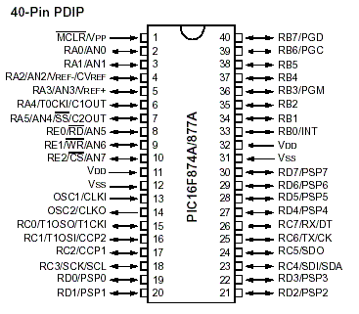
MICROCONTROLLER

Slide 12
RFID TAG
RFID is Radio Frequency Identification Device. It is a fast, affordable and automatic identification technology that uses radio frequency (RF) to transfer data between a RFID reader and a RFID tag.

Slide 13
RF READER
An RFID reader's function is to interrogate RFID tags.
These two devices exchange information by the use of short-range RF signals.
A reader contains an RF module, which acts as both a transmitter and receiver of radio frequency signals.

Slide 14
Software component:
Programming tool : MP_LAB-X
Language : EMBEDDED-C

Slide 15
MP_LAB-X
MPLAB X IDE is a software program that runs on a PC (Windows®, Mac OS®, Linux®) to develop applications for Microchip microcontrollers and digital signal controllers.
It is called an Integrated Development Environment (IDE), because it provides a single integrated "environment" to develop code for embedded microcontrollers.

Slide 16
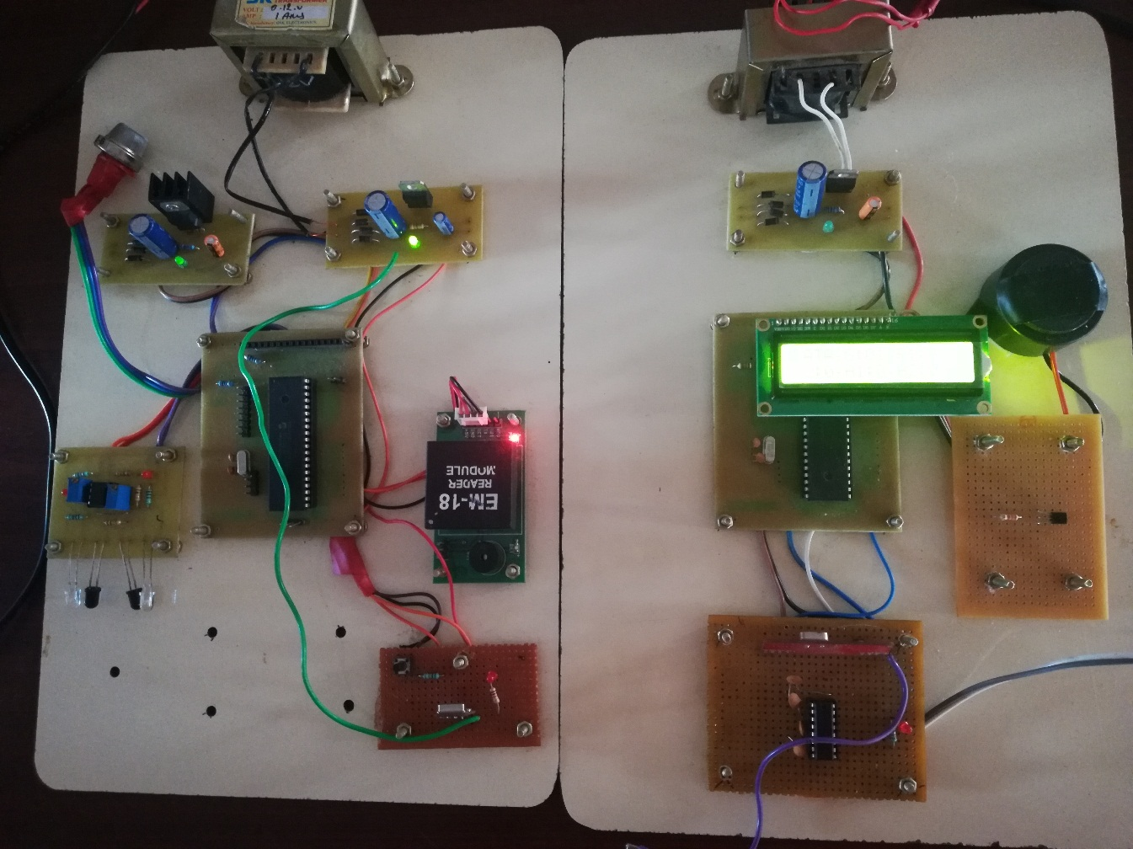
EXPERIMENTAL RESULT

Slide 17
APPLICATIONS
Underground monitoring
Workplace health and safety
Unwanted gas detection
Worker safety

Slide 18
FUTURE ENHANCEMENTS
The sensor nodes for their miniature size, low power and mobility, can be attached with the mine workers, resulting a flexible expandable mobile information network. So, there is tremendous scope of future research in this direction.

Slide 19

QUERIES

Slide 20
THANK YOU

